Slide 1
Tuesday January 20, 2015 Mr. Goblirsch – American Government
OBJECTIVE – Students Will Be Able To – SWBAT:
- Identify the weaknesses of the Articles of Confederation.
AGENDA:
WARM-UP: Government Powers Journal
CONCEPT: Articles of Confederation
2nd Congressional Vote: Taxes
COMMITTEE WORK: Declaration Newspaper
*****Declaration Newspaper Assignment DUE FRIDAY*****
***FAFSA Presentation w/ Ms. Srouji Thurs & Fri in Comp Lab 76***
*NEED BLUE FORM FOR FAFSA PRESENATION THURSDAY*
Government Powers Journal WARM-UP: (Follow the directions below)
***5 minutes***
Write a paragraph journal entry answering the question below.
We’ve talked about the purpose of government as outlined in the Preamble of the Constitution. What are some specific powers that you feel are absolutely necessary in order for a government to function well? (EX – raise/maintain a military)

Slide 2
The Articles of Confederation
The Articles of Confederation established “a firm league of friendship” among the States.
Powers
Congress was given the power to declare war, deal with national finance issues, and settle disputes among the States.
Obligations
The States promised to obey Congress, and to respect the laws of the other States. Most other powers were retained by each State.
1
2
4
5
Chapter 2, Section 3

Slide 3
Weaknesses of the Articles of Confederation
1
2
4
5
Chapter 2, Section 3

Slide 4
CONGRESSIONAL VOTE: Taxes
PROPOSED BILL:
Currently in Goblirsch’s class, there is a progressive tax system with 3 tax brackets (28% - 33% - 38%). Tax calculations would be easier with only 1 tax bracket, therefore this is a proposal for a proportional tax rate of 30%.
A “Yes” vote creates a proportional tax system
A “No” vote will keep the progressive tax system

Slide 5
BALLOT
Representative/Senator Name:
_________________________
_______________________
_____ YES
_____ NO

Slide 6
ASSIGNMENT: Declaration News Article
DIRECTIONS: Each committee will suppose they are news paper editors on the day of the signing of the Declaration of Independence. Your committee’s task is to complete the front page of the newspaper with 4 articles relating to the event.
***$50 Bonus to each group member for “Best Looking” newspaper (to be voted on by the class)
***$50 Bonus to each group member for “Best Overall Score” (as graded by Goblirsch)
*****NEWSPAPERS DUE FRIDAY******

Slide 7
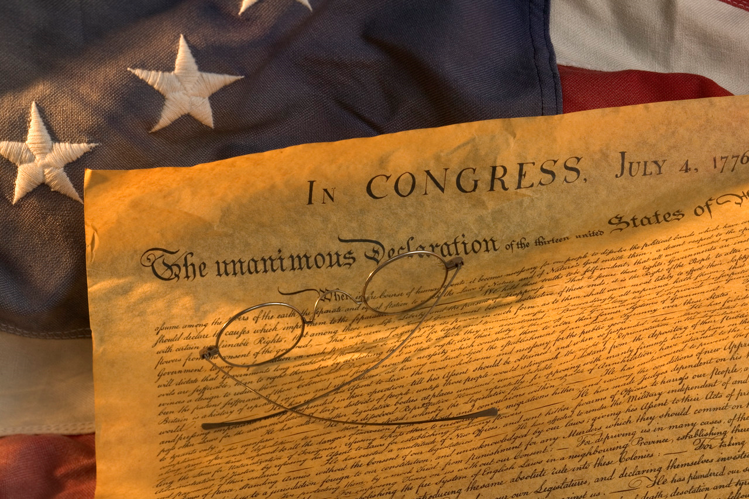
Newspaper Title HEADLINE!!!
Article Title
Summary of Rights
(Make sure to give credit to Thomas Jefferson and John Locke)
Article Title
Importance /
Significance
of Declaration
Article Title
Summary of Grievances
Article Title
2 Interviews:
1 with a patriot (supporter) and
1 with a loyalist (against/skepticlal)

Slide 8
Ch 2 Sec 3 TITLE: The Articles of Confederation
WEAKNESSES
No power to tax
Can’t regulate trade
Can’t force states to follow laws passed by the national gov’t
Need 9 of 13 states to pass a measure
need all 13 states to approve changes
No executive branch
No judicial branch
Accomplishments of the Confederation
Northwest Ordinance, 1787
Final peace treaty with Great Britain
Need for Stronger Government
States begin arguing, acting as independent nations (taxing goods from other states)
Debt. Gov’t owed $40 million
Shay’s Rebellion (armed farmers forced courts to close in order to prevent foreclosure on farms – Daniel Shays leads 1200 men toward federal arsenal, put down by Mass. State militia)
Founding Fathers Begin to Meet
1785, George Washington invites representatives from MD and VA to Mount Vernon
1786, Second meeting held in Annapolis, discuss commerce problems (5 present)
Call for another convention in Philadelphia in May 1787, Constitutional Convention

Slide 9
Government #1
DIRECTIONS: Analyze the structure and powers of the government below. Discuss with you partner what you feel might be missing, and what problems/weaknesses this government could have.
STRUCTURE:
Unicameral – 1 House – Confederation Congress
Committee of States w/ 1 delegate each
Each state has 1 vote in Congress
State Legislatures selected representative to Congress
POWERS:
Make war and peace
Send & receive ambassadors
Enter into treaties
Raise & equip a navy
Maintain an army by requesting troops from the states
Appoint senior military officers
Fix standard weights & measures
Regulate Indian affairs
Establish post offices
Decide certain disputes among the states
= ARTICLES OF CONFEDERATION

