Slide 1
Wednesday August 27, 2014 Mr. Goblirsch – Economics
OBJECTIVE – Students Will Be Able To – SWBAT:
- Describe the differences between a Free Market/Capitalism economy and a Centrally Planned/Command economy.
AGENDA:
WARM-UP: Centrally Planned Journal
REVIEW: Free Market Characteristics
INSTRUCTION: Free Market vs. Centrally Planned
INDEPENDENT PRACTICE: Ch 2 Sec 2&3 Workbook Pgs. 21 & 22
CLOSURE: Free Market vs. Centrally Planned
***Get your Stock Simulation Worksheets Stamped TODAY***
Centrally Planned Journal WARM-UP: (Follow the directions below)
***5 minutes***
Write a paragraph journal entry on the prompt below:
Imagine you are a worker with a guaranteed job. You are told what and how much to produce and when to produce it. How deeply committed would you be to efficiency, quality, and innovation?

Slide 2
PRIOR KNOWLEDGE: Free Market Review
Competition is important to a Capitalist/free market system because …
The “invisible hand” is …
The difference between
the Factor market and
the Product market is …

Slide 3
Market Economies (Capitalism)
Market: Any medium to get buyers and sellers together
Advantages:
Invisible hand = efficiency
Can adjust to change – innovation encourages growth
Individual freedom
Less government interference
Variety of goods available = consumer satisfaction
Disadvantages:
Does not provide for the basic needs of everyone
Gov’t must provide for justice, national defense, education, “comprehensive health care”
Uncertainty.
Market economies can fail if three conditions not met:
must have competition
resources must be able to move freely
consumers need information

Slide 4
STRUCTURED ACADEMIC DISCUSSION
An advantage of a Free Market economy is …
A disadvantage of a Free Market economy is …

Slide 5
Command Economies (Socialism)
Advantages:
Government can change economy quickly. Soviet Union & China industrialized quickly (cost of millions of lives… but hey, got the job done).
Health care and public services available to all at little or no cost. The quality sucks, but hey “access to some services is better than none.” (Really?)
Disadvantages:
Not designed for consumers.
No incentive to work hard.
Ex) Soviets measured production quotas of electric motors based on tonnage produced. Workers started producing the heaviest motors in the world.
HUGE government bureaucracy. SLOW decision making process. Inefficient. Can’t adapt
Doesn’t reward innovation

Slide 6
STRUCTURED ACADEMIC DISCUSSION
An advantage of a Centrally Planned economy is …
A disadvantage of a Centrally Planned economy is …

Slide 7
The Former Soviet Union
Soviet Agriculture
Use of collectives
Little incentives to work hard or create better product.
Soviet Industry
Inefficient & wasteful
Lack of a Profit motive
Soviet Consumers
Excessive shortages of everything

Slide 8
Problems with Centrally Planned Economies
Inferior Products
Shortages
Cannot meet the needs & wants of consumers
Workers lack incentives to work hard
Does not reward innovation
Expensive & inefficient bureaucracy

Slide 9
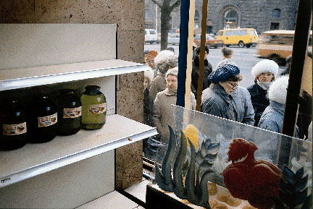
Problems of a Centrally Planned Economy
Centrally planned economies face problems of poor-quality goods, shortages, and diminishing production.

Slide 10
Section 1-29
Market Economies (cont.)

Slide 11
CLOSURE: Free Market vs. Centrally Planned
I, ___________, would want to live in a __________ economic system because …
AND
I, __________, would NOT want to live in a __________ economic system because …

Slide 12
THE DOW STOCK SIMULATION
DIRECTIONS:
You have $5,000 to invest in the stock market. ***You cannot spend over $5,000***
Select 5 stocks from The Dow Jones Industrial Average to invest your money in.
How many shares you buy of each stock is up to you.
Multiply the # of shares you want by the Last trade amount to calculate the Total Worth of that stock.
# shares X Last Trade $ = Total Worth

