Slide 1
Monday January 26, 2015 Mr. Goblirsch – American Government
OBJECTIVE – Students Will Be Able To – SWBAT:
- Analyze the arguments over ratifying the Constitution.
AGENDA:
WARM-UP: Ratification Vocab
CONCEPT: Ratification Debate
SKILL: Feds vs. Anti-Feds Worksheet
NEED TO KNOW: Foundations Quiz – Ch 1 & 2
*****Foundations Quiz TOMORROW – Ch 1 & 2
Ratification Vocab WARM-UP: (Follow the directions below)
***5 minutes***
Define the terms below using the glossary of your textbook.
Ratification
Federalist
Anti-Federalist

Slide 2
CONCEPTS TO KNOW: Foundations Quiz – Ch 1 & 2
Characteristics of Democracy (6)
Purpose of government from Preamble (6)
English influence – Limited & Representative government
John Locke’s influence
Declaration of Independence
Weaknesses of the Articles of Confederation
Compromises of the Constitutional Convention
Ratification Debate – Feds vs. Anti-Feds

Slide 3
DEBATE OVER RATIFICATION
Chapter 2 Section 5

Slide 4
PRIOR KNOWLEDGE: Review Constitutional Compromises
The Connecticut Compromise
Delegates agreed on a bicameral Congress, one segment with equal representation for States, and the other with representation proportionate to the States’ populations.
The Three-Fifths Compromise
The Framers decided to count a slave as three-fifths of a person when determining the population of a State.
The Commerce and Slave Trade Compromise
Congress was forbidden from taxing exported goods, and was not allowed to act on the slave trade for 20 years.
1
2
3
5
Chapter 2, Section 4

Slide 5
Ch 2 Sec 5 CONCEPT: Ratification Debate
Sides
Federalists – supported the Constitution
Supporters: property owners, merchants
Views
Elites feared the common people in a democracy
Favored strong central government; the balance of power
Protect from foreign enemies & internal threats
Famous Leader – Washington
Federalist advantages
More numerous
More vocal
More organized
The Federalist Papers
Over 80 Essays published to support the Constitution
Authors: Madison, Hamilton, and Jay
Objective: To analyze the arguments over the passing of the Constitution.

Slide 6
STRUCTURED ACADEMIC DISCUSSION
The Federalists believed …

Slide 7
Ch 2 Sec 5 CONCEPT: Ratification Debate
Sides cont’d
Anti-Federalists – opposed the Constitution, too strong
Supporters: small farmers, shopkeepers
Views –
Favored State Governments
Feared the Elites in the Federal Government
Extralegal – drafted in secrecy
NO BILL OF RIGHTS – Govt could take away rights without them in document
“The necessity of a Bill of Rights appears to me to be greater in this government than ever it was in any government before…All rights not expressly and unequivocally reserved to the people are impliedly and incidentally relinguished to rulers…If you intend to reserve your unalienable rights, you must have the most express stipluation; for…if the people do not think it necessary to reserve them, they will supposed to be given up.” Patrick Henry, 1788
Objective: To analyze the arguments over the passing of the Constitution.

Slide 8
STRUCTURED ACADEMIC DISCUSSION
The Anti-Federalists believed …

Slide 9
SKILL: Analyzing Fed vs. Anti-Fed Arguments
Read the passages on the handout.
Determine whether the speaker was a Federalist or Anti-Federalist.
Underline the statement or statements which led you to draw that conclusion.
Write Federalist or Anti-Federalist on the line provided next to the speaker’s name.
Be ready to support your choice with the evidence (statements) you underlined.

Slide 10
Ch 2 Sec 5 CONCEPT: Ratification Debate
Key dates
9 of 13 needed to ratify – Founding Fathers wanted all 13
June 21, 1788 – Constitution officially ratified (9/13)
March 4, 1789 – Congress first meets (Federal Hall in NYC)
April 30, 1789 – George Washington takes oath to become president
May 29, 1790 – All 13 ratified (Rhode Island)
1791 – 1st 10 Amendments ratified (Bill of Rights)

Slide 11
CONCEPT: Overview - Federalists vs. Anti-Federalists
The Constitution was very controversial at first, with some groups supporting it, and others attacking it.
Federalists thought that the Articles of Confederation were weak, and argued for the ratification of the Constitution.
Anti-Federalists objected to the Constitution for many reasons, including the strong central government and the lack of a bill of rights.
1
2
3
4
Chapter 2, Section 5

Slide 12
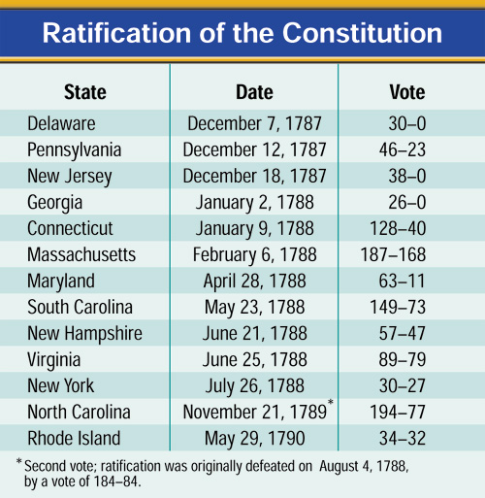
The Constitution is Ratified
Nine States ratified the Constitution by June 21, 1788, but the new government needed the ratification of the large States of New York and Virginia.
Great debates were held in both States, with Virginia ratifying the Constitution June 25, 1788.
New York’s ratification was hard fought. Supporters of the Constitution published a series of essays known as The Federalist.
1
2
3
4
Chapter 2, Section 5

Slide 13
Inaugurating the Government
The new Congress met for the first time on March 4, 1789.
Congress finally attained a quorum (majority) on April 6 and counted the electoral votes. Congress found that George Washington had been unanimously elected President. He was inaugurated on April 30.
1
2
3
4
Chapter 2, Section 5

