Slide 1
Thursday September 4, 2014 Mr. Goblirsch – Economics
OBJECTIVE – Students Will Be Able To – SWBAT:
- Explain the basic principles, the role of the consumer, and the role of the government in the American free enterprise system.
AGENDA:
WARM-UP: “Land of Opportunity” Journal
INSTRUCTION: American Free Enterprise System
Finish Designing An Economic System PRESENTATIONS
ACTIVITY: The DOW Stock Simulation Week 3
CLOSURE: Chapter 3-1 Vocab Boxes
***HW – Current Events Article #1 DUE THURSDAY 9/11***
“Land of Opportunity” Journal WARM-UP: (Follow the directions below)
***5 minutes***
Write a ½ page journal entry on the topic below:
For centuries, America has often been referred to as the “land of opportunity.” Explain in your own words 1) what you think this means, 2) why you think America is called that, and 3) an at least one example to demonstrate this.

Slide 2
Article #1 Homework
DIRECTIONS:
Bring in an article from a newspaper, magazine, internet, etc. that is related to Economics.
Stapled to the article you will need: 1) a written (or typed) summary of the economic concepts in the article and 2) an opinion about the article.
Your summary & opinion should be approximately 1 page in length.
DUE THURSDAY 9/11

Slide 3
Chapter 3: American Free Enterprise
◆ Benefits of Free Enterprise
❖ Promoting Growth & Stability
⬥ Providing Public Goods
 Providing a Safety Net

Slide 4
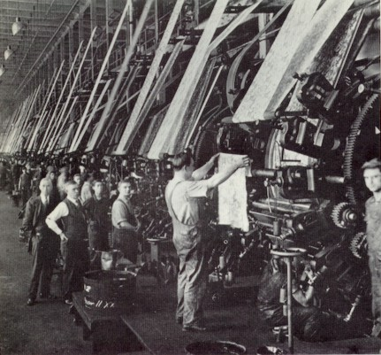
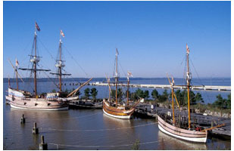
Section 1: Benefits of Free Enterprise
A tradition of Free Enterprise
The Land of Opportunity
Why do people immigrate to the US?

Slide 5
Constitutional Protections— Property Rights
5th Amendment
➢“No person shall be deprived of Life, liberty or property without due process of law”

Slide 6
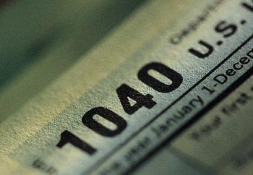
Constitutional Protections— Taxation
Everyone must pay the same
16th Amendment
Income tax
Binding Contracts

Slide 7
Basic Principles of Free Exercise Profit Motive
➢The Force that encourages people and organizations to improve their material well-being.

Slide 8
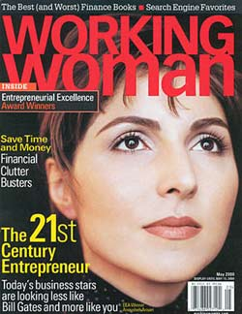
Basic Principles of Free Exercise Open Opportunity
➢ The concept that everyone can compete in the marketplace

Slide 9
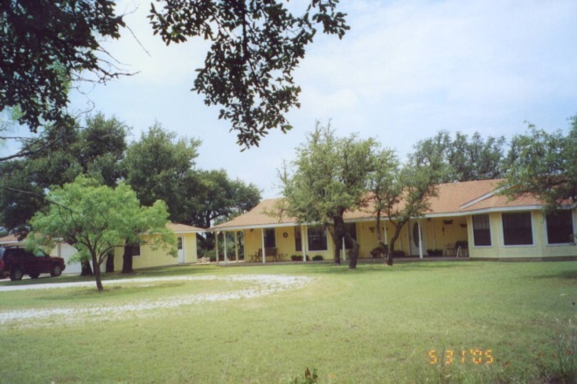
Basic Principles of Free Exercise Economic Rights
Legal Equality
Private Property
Free Contract
Voluntary Exchange
Competition

Slide 10
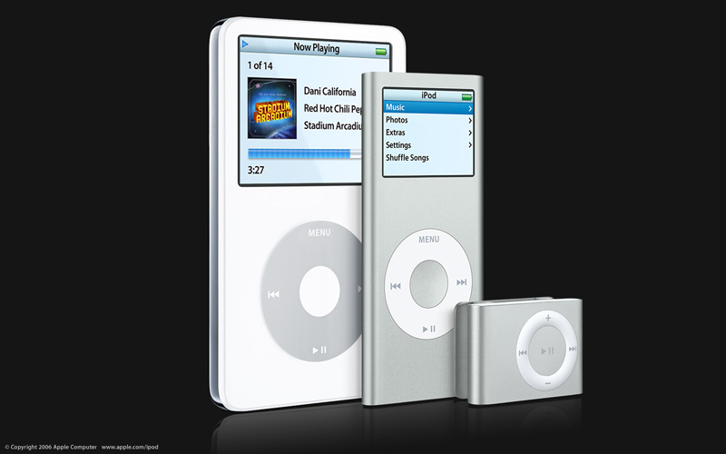
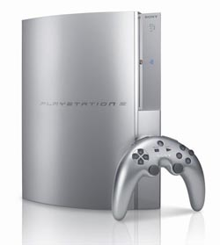
The Role of the Consumer
➢ Consumers make their desires known through purchases
➢ Tells Producers:
• What to produce
• How much to produce

Slide 11
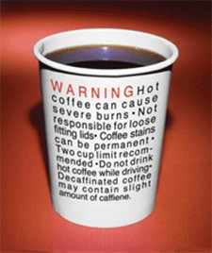
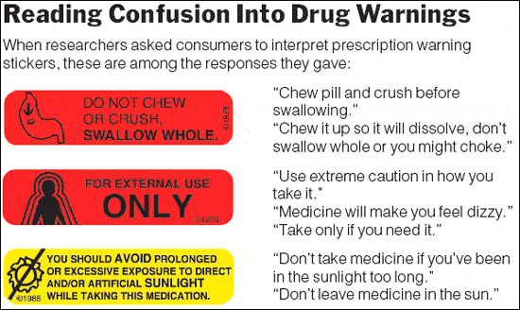
The Role of the Government
Educate Consumers
Public Disclosure laws
Protect the Health, Welfare & safety of Society

Slide 12
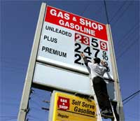
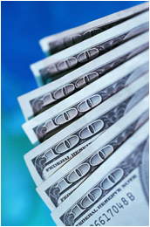
Negative Effects of Regulation
➢ Costs Businesses
➢ Costs Consumers
➢ Must establish a Cost Benefit Analysis

Slide 13
GUIDED ACTIVITY: Tracking The DOW
Locate your 5 stocks on The DOW handout.
Locate the “Last Trade” for your 5 stocks.
Multiply the “Last Trade” for your 1st stock by the number of shares of it you own
“Last Trade” X # of shares = Worth Week 2
Repeat for 2nd, 3rd, 4th, & 5th stocks
Add all 5 stocks together to = total worth
Calculate + / - change from last week’s worth

Slide 14
SIMULATION: Creating an Economic System
OBJECTIVE - Demonstrate knowledge of Free and Centrally Planned economies through a simulation of creating an economic system.
Get into groups of 6-8.
Select a slip with an economic system.
WITHIN YOUR GROUP:
Discuss each economic system with your
group. (You will be advocating for the economic system on your slip).
Delegates (representatives) of each system should present the benefits of their system.
Delegates should present drawbacks of the other system.
Negotiate to create a economic system.
Fill out the chart based on the economic system you agree on.
QUESTION TO BE ANSWERED | HOW DEFINED IN YOUR ECONOMY
1) Who decides how resources will be allocated?
2) Who owns the factors of production?
3) Who determines what goods & services will be produced?
4) Who determines prices?
5) How is income distributed?
6) Must all members contribute equally?
7) What social benefits does the system supply?
8) What is the role of government in the economy?

Slide 15
CLOSURE: Chapter 3-1 Vocab Boxes
For each of the terms below, complete a Vocab box like seen to the right:
Property Rights
Profit Motive
Open Opportunity
Voluntary Exchange
Competition
VOCAB TERM
Definition in your own words | Picture, Logo, Cartoon to demonstrate definition
***Complete the Vocab Boxes on a separate
piece of paper in order to turn it in
DUE TOMORROW - 9/5

