Slide 1
DOOR
CABINETS
Goblirsch’s Desk |  |  | Projector Screen |  |  | 7 | 1
 |  |  |  |  |  | 8 | 2
 |  |  | 18 | 13
27 | 23 |  | 19 | 14 |  | 9 | 3
28 | 24 |  | 20 | 15 |  | 10 | 4
 |  |  | 21 | 16
29 | 25 |  | 22 | 17 |  | 11 | 5
30 | 26 |  |  |  |  | 12 | 6
36 | 35 |  | 34 | 33 |  | 32 | 31

Slide 2
Tuesday January 6, 2015 Mr. Goblirsch – American Government
OBJECTIVE – Students Will Be Able To – SWBAT:
- Identify the political ideologies of Democrats & Republicans and evaluate your political beliefs.
AGENDA:
WARM-UP: Political Ideology Journal
SURVEY: Donkey or Elephant
CONCEPT: Political Parties
Section Leader Vote
Political Ideology Journal WARM-UP: (Follow the directions below)
***5 minutes***
Write a paragraph journal entry answering the questions below.
What do you feel a governments main job/responsibility should be? What political issue do you feel the most strongly about? If you don’t feel strongly about an issue then how come?

Slide 3
Are you a Donkey or an Elephant?
Intro to American Government
Mr. Goblirsch
Ceres High School
Room 410

Slide 4
Directions
Use a ½ sheet of paper
Print your full name on paper in right hand corner.
Put period and date below name.
Number paper from 1-10

Slide 5
Statement :
1 = Strongly Agree
2 = Agree
3 = Not an important issue to me
4 = Disagree
5 = Strongly Disagree
EXAMPLE:
I am proud to be a Bulldog.

Slide 6
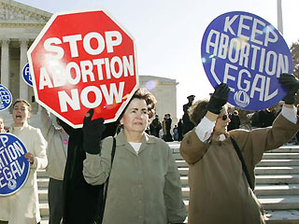
Statement 1:
Abortion should be a woman’s choice to make, no matter what the situation.
___________________________________________
1 2 3 4 5
Strongly Agree Neither Strongly Disagree
Agree Disagree

Slide 7
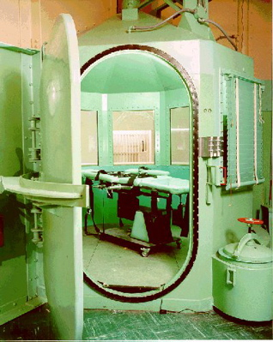
Statement 2:
The death penalty is a brutal and old fashioned form of punishment for criminals and crimes.
___________________________________________
1 2 3 4 5
Strongly Agree Neither Strongly Disagree
Agree Disagree

Slide 8
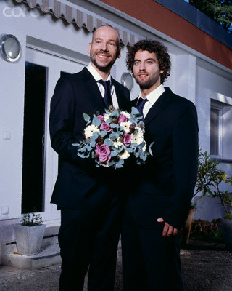
Statement 3:
Homosexuals should be afforded the same rights as heterosexuals, including marriage.
___________________________________________
1 2 3 4 5
Strongly Agree Neither Strongly Disagree
Agree Disagree

Slide 9
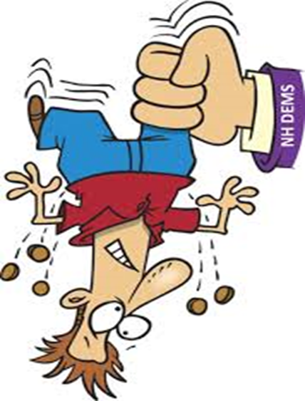
Statement 4:
The rich in this country should be responsible for paying a higher percentage of taxes.
___________________________________________
1 2 3 4 5
Strongly Agree Neither Strongly Disagree
Agree Disagree

Slide 10
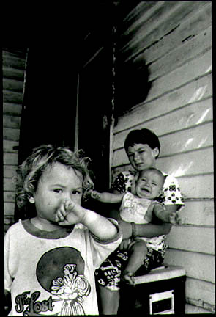
Statement 5:
Welfare programs like food stamps, checks and WIC are necessary to ensure the health and well being of women and children in a society.
___________________________________________
1 2 3 4 5
Strongly Agree Neither Strongly Disagree
Agree Disagree

Slide 11
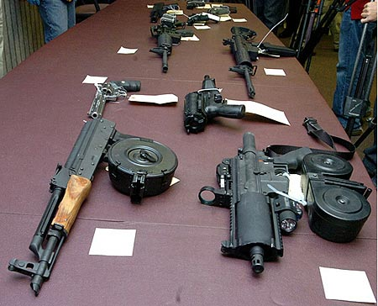
Statement 6:
The use of guns should be heavily supervised by the government if not outright banned in this country because of the high rates of gun violence.
___________________________________________
1 2 3 4 5
Strongly Agree Neither Strongly Disagree
Agree Disagree

Slide 12
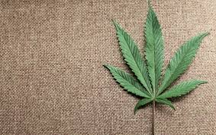
Statement 7:
Marijuana should not be an illegal drug, but rather a regulated recreation substance such as tobacco and alcohol.
___________________________________________
1 2 3 4 5
Strongly Agree Neither Strongly Disagree
Agree Disagree

Slide 13
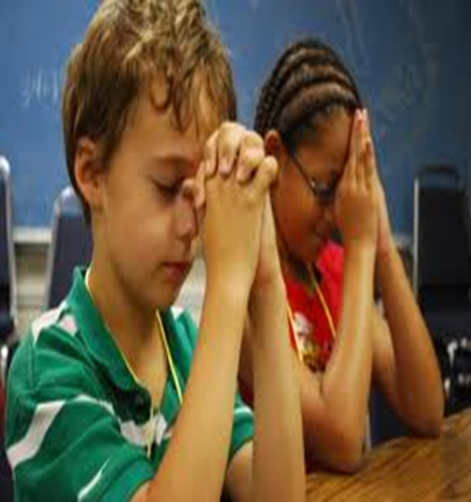
Statement 8:
A moment of prayer should never be conducted in a public atmosphere (ex. – school, football game, graduation, council meeting, etc.)
___________________________________________
1 2 3 4 5
Strongly Agree Neither Strongly Disagree
Agree Disagree

Slide 14
Statement 9:
The American Government should require universal healthcare for its citizens from the cradle to the grave.
___________________________________________
1 2 3 4 5
Strongly Agree Neither Strongly Disagree
Agree Disagree

Slide 15
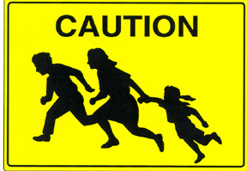
Statement 10:
The American government should grant amnesty/forgiveness to the 12 million illegal immigrants currently residing in the US, giving them an instant pathway to US Citizenship.
___________________________________________
1 2 3 4 5
Strongly Agree Neither Strongly Disagree
Agree Disagree

Slide 16
Totals
Total up your responses. Your score will be between 10 and 50.
So what does this all mean?

Slide 17
Political Parties
By no means are Republicans and Democrats the only two parties in the US, but they are by tradition and practice the two mainstream and powerful parties.

Slide 18
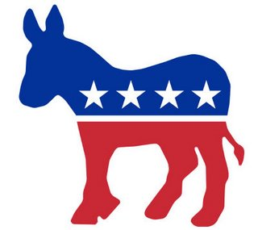
Score of <30, You’re a Donkey
A score of 30 or below indicates that you lean towards the Democratic political party. Democrats are liberal thinkers, dubbed as both “the left” and as “liberals.” They are represented by the color blue and the donkey.
Democrats seen as the liberal party. Defined, liberals believe the national government should be active in promoting health, education, justice, and equal opportunity

Slide 19
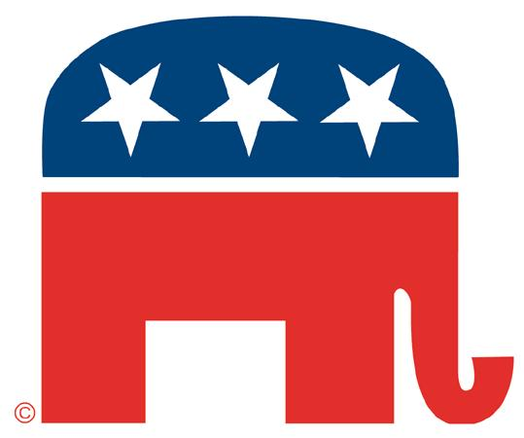
Score of >30, You’re an Elephant
A score higher than 30 indicates that you lean towards the Republican political party. Republicans are traditional thinkers, dubbed as “conservatives” or “the right.” They are represented by the color red and the elephant, and they even have a special name- The GOP, the Grand Ole Party.
Republicans are seen as the conservative party. Defined, conservatives believe government should be limited, except in supporting traditional values and promoting freedom of opportunity

Slide 20
POLITICAL PARTIES
Political Party: Group of people w. broad common interests organized to win elections, control gov’t & influence gov’t policies
Two-Party System
Growth of American Parties. Federalists v. Anti-federalists →Whigs v. Democrats →Republicans v. Democrats
Third Parties in USA. Exp: Green Party
Single-issue parties, Exp Right to Life Party. Focus on one economic, moral, or social issue
Ideological parties, Exp Communist Party USA. Socialist Party
Splinter parties. Break away from major party over disagreements. Exp the Progressive Party under T. Roosevelt (Bull Moose Party)
Influence = Can sway elections
Republican Democrat
Individuals responsible for place in society Gov’t to care for all individuals
Free Enterprise Gov’t to run/guide economy
Low taxes/less gov’t More taxes/more gov’t
Strong defense/military Cut military spending, negotiate
Stronger immigration laws, border protection Open borders, amnesty
Pro-life Pro-choice
Pro-death penalty Anti-death penalty
Pro Right to Bear Arms Strict regulation/ban gun ownership
Universal health care: bad Universal health care: good (Obamacare)

