Slide 1
Thursday September 11, 2014 Mr. Goblirsch – Economics
OBJECTIVE – Students Will Be Able To – SWBAT:
- Describe how the government promotes the economy and positive and negative effects of government provided public goods.
AGENDA:
WARM-UP: Ch 3 Vocab
QUICK WRITE: Competition
INSTRUCTION: Promoting Growth & Stability & Public Goods
INDEPENDENT PRACTICE: Externalities
*We will be discussing 1st News Article TOMORROW*
***CHANGE: Business Project Due Date - DUE TUESDAY SEPTEMBER 30th
*****Each Class will have 2 days in the Computer Lab Next Week*****
Ch 3 Vocab WARM-UP: (Follow the directions below)
***5 minutes***
Use the glossary of your textbook to define the terms below.
Public sector 3. Free rider
Private sector 4. Externality

Slide 2
COMPUTER LAB SCHEDULE
3rd Period
Monday Sept 15
Tuesday Sept 16
4th Period
Monday Sept 22
Tuesday Sept 23
5th Period
Monday Sept 15
Monday Sept 22
6th Period
Monday Sept 15
Monday Sept 22

Slide 3
Econ Quick Write #1
Competition is a vital element of the American free enterprise economic system and there are many different types of businesses that compete in the American economic system.
1) Describe why competition is so important to the free enterprise system.
2) Describe how competition impacts different types of businesses throughout the U.S.
3) Explain how competition benefits the economy and problems that can occur when competition is eliminated. (Use examples of businesses in today’s economy)
Refer back to your notes and the business types worksheet if needed.

Slide 4
Chapter 3: American Free Enterprise
◆ Benefits of Free Enterprise
❖ Promoting Growth & Stability
⬥ Providing Public Goods
 Providing a Safety Net

Slide 5
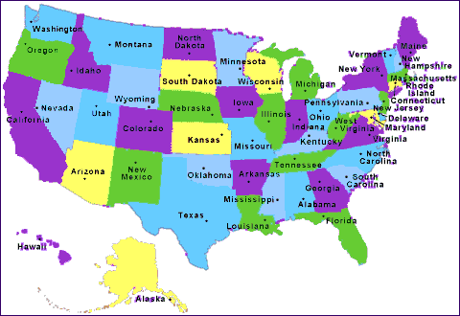
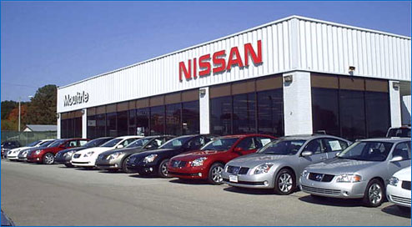
Section 2: Promoting Growth & Stability
Macroeconomics
➢ Deals with the entire economy.
Microeconomics
➢ Deals with specific markets

Slide 6
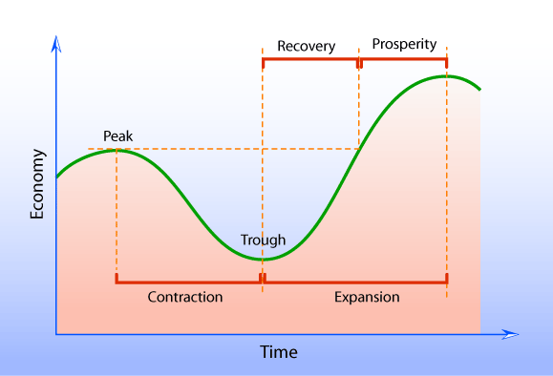
Tracking Business Cycles
Gross Domestic Product (GDP)
➢ Total of all G & S produced within a country’s border
Business Cycle
➢ Graph showing the ups and downs of GDP

Slide 7
STRUCTURED ACADEMIC DISCUSSION:
The difference between macroeconomics and microeconomics is …
GDP is …

Slide 8
Promoting Economic Strength
◆ Employment
❖ Growth
⬥ Stability
 Economic Citizenship
➢ Voting to change economic policy

Slide 9
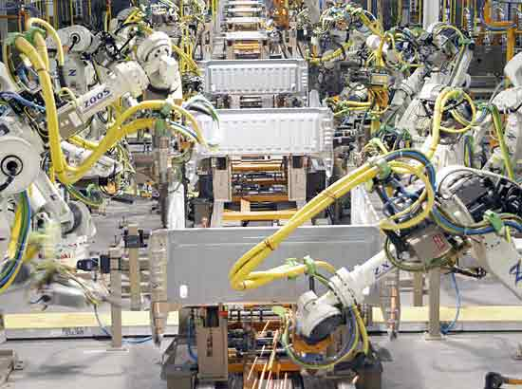
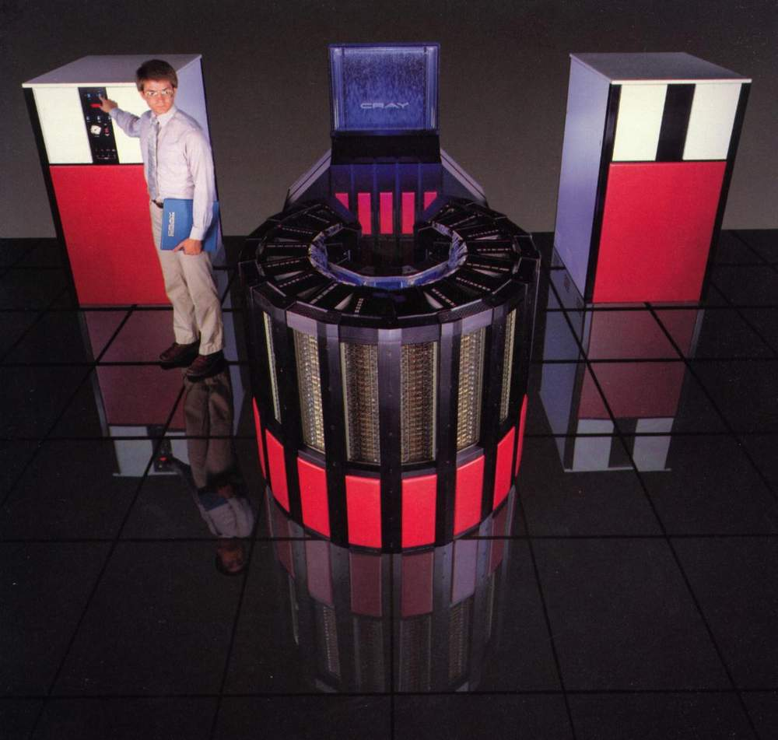
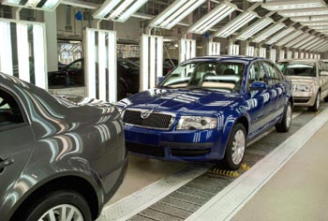
Technology & Productivity
Technology increases Productivity
· Innovation
Assembly lines
Computers
Robots

Slide 10
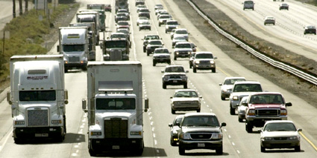
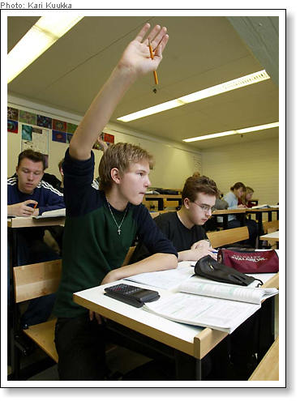
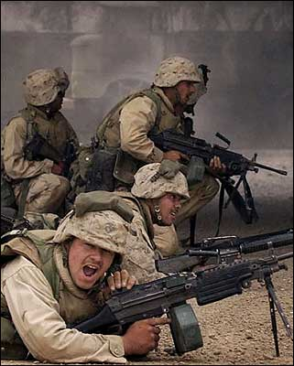
Section 3: Providing Public Goods
When Free Market doesn’t provide the government will
Market Failure when the market doesn’t provide.
Free Riders are a problem.

Slide 11
STRUCTURED ACADEMIC DISCUSSION:
The government promotes economic strength by …
The government provides public goods because …

Slide 12
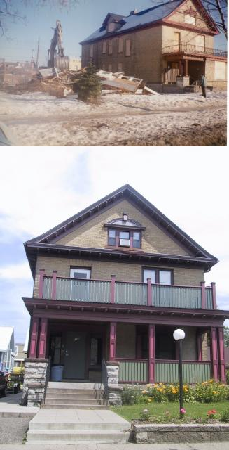
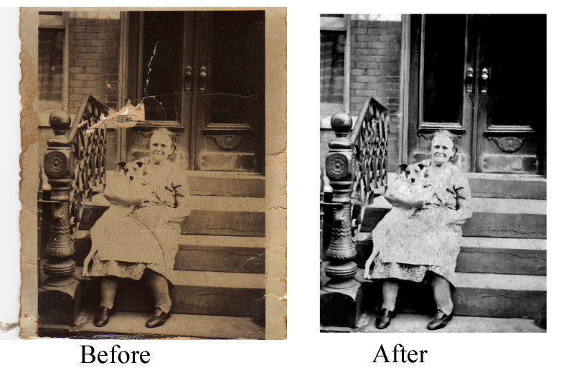
Positive Externalities a beneficial side effect of economic activity

Slide 13
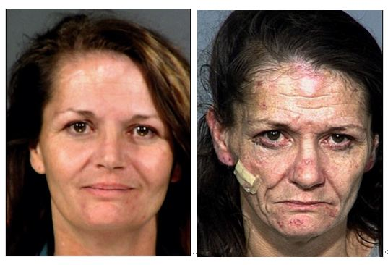
Negative Externality: _____________________________________________
Drug Use – Environmental Issues (Radiation)

Slide 14
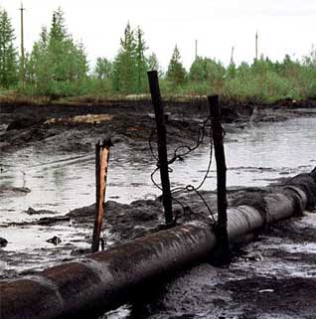
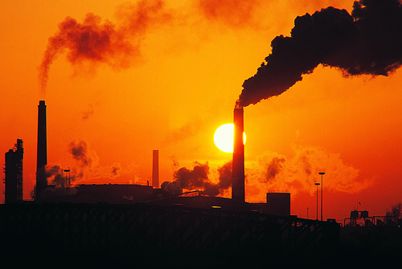
Negative Externality: a harmful side effect of economic activity
Pollution

Slide 15
EXTERNALITIES
DIRECTIONS: Create a list of the positive and negative externalities of the scenario below.
SCENARIO: The city of Ceres is deciding to purchase an abandoned building and the surrounding land. The city wants to destroy the structure and turn the land into a recreational park for city dwellers, complete with baseball fields, basketball courts, tennis courts, a swimming pool, and a bicycle path. Some of the city leaders support the plan and others condemn it. Work with your pod to speculate on both sides of why some feel it is a good idea, and others feel it is not a good idea.
POSITIVE
NEGATIVE

