Slide 1
Monday September 15, 2014 Mr. Goblirsch – Economics
OBJECTIVE – Students Will Be Able To – SWBAT:
- Simulate creating a business.
AGENDA: 3rd, 5th, & 6th Periods
WARM-UP: Log-In
Review Business Project Directions
Begin Working on Business Project
Raise your hand if you have a question or need help
***PERIOD 3, 5, &6: Unit 1 Test – Chapters 1-3 on Thursday***
Log-In WARM-UP: (Follow the directions below)
***2 minutes***
Log-In to a Computer

Slide 2
Monday September 15, 2014 Mr. Goblirsch – Economics
OBJECTIVE – Students Will Be Able To – SWBAT:
- Explain the government’s role in the economy of redistributing income.
AGENDA: 4th Period ONLY
WARM-UP: Poverty Journal
READING: Providing a Safety Net
INSTRUCTION: The Government’s Role – Redistributing Income
GUIDED PRACTICE: Poverty Statistics
***PERIOD 4: Unit 1 Test – Chapters 1-3 on Wednesday***
Poverty Journal WARM-UP: (Follow the directions below)
***5 minutes***
Write a ½ page journal entry on the topic below:
What does poverty mean? How much of a problem do you think poverty is in America? What do you feel is the best way to solve the poverty problem?

Slide 3
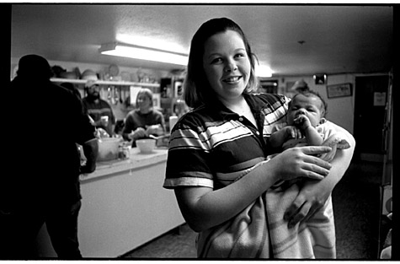
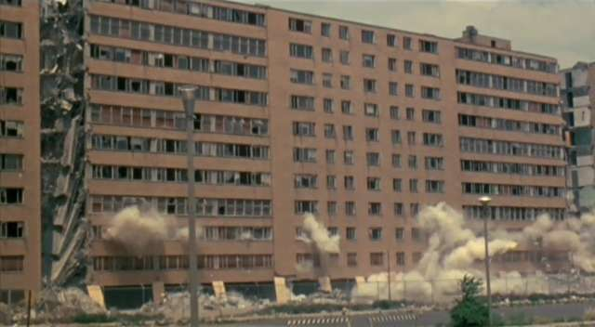
Section 4: Providing a Safety Net
The Poverty Problem
2012
➢ 46.5 Million people
15% of Population
Poverty Threshold
➢1 Parent—1 Child
 $14,000
➢ 2 parents—2 children
 $ 22,000

Slide 4
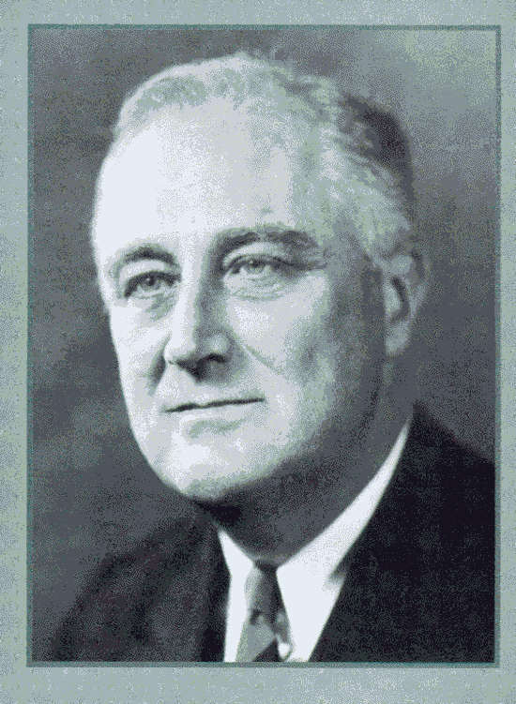
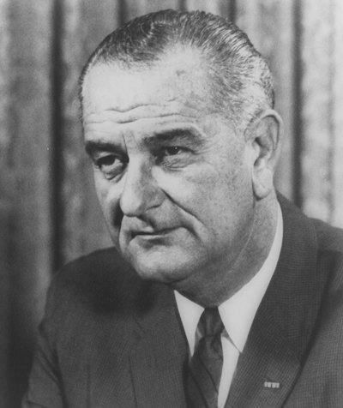
The Welfare System: Where it Started
The Great Depression
Johnson’s War on Poverty

Slide 5
Redistribution Programs
Cash transfers
Social Security Ins.
Temp. Ass. For Needy Families (TANF)
Unemployment Insurance
Workers’ Compensation

Slide 6
Redistribution Programs —Cont.
In-Kind Benefits
Food Giveaways
Food Stamps
Subsidized Housing
Legal Aid

Slide 7
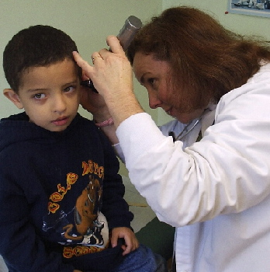
Redistribution Programs—Cont.
Medical Benefits
Medicare
Medicaid
Healthy Families
Etc.

Slide 8
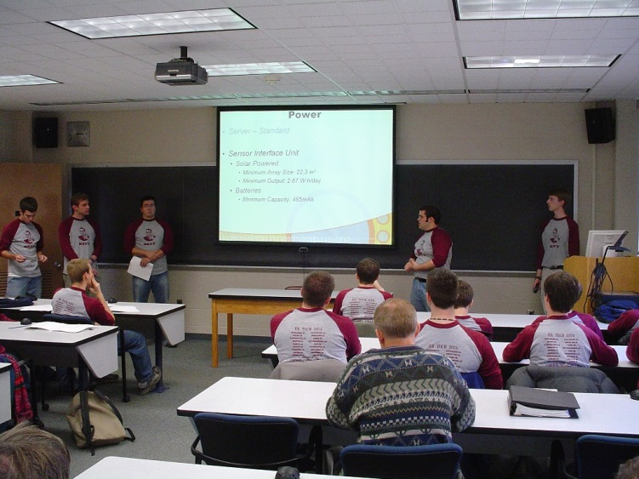
Redistribution Programs—Cont.
Education
➢Public Schools
Public Universities
Grants
Scholarships

Slide 9
GUIDED PRACTICE: Poverty Statistics
Create a bar graph of the Overall People poverty data:
2012 – Total Population & Number living below Poverty
Create a bar graph of the Age poverty data:
2012 – Total population of Under 18, 18 to 64, and 65 & older & Percent living Below Poverty
YOUR CHOICE: Choose one of the other Characteristics to create a bar graph of the data
2012 – Total & Percent below Poverty

