Slide 1
Thursday September 18, 2014 Mr. Goblirsch – Economics
OBJECTIVE – Students Will Be Able To – SWBAT:
- Identify key foundational economic concepts.
AGENDA: 3rd, 5th, & 6th
No WARM-UP
ASSESSMENT: Unit 1 Test
IF YOU FINISH EARLY: Work on DOW Stock Simulation for Week 4
***PERIOD 3, 5, & 6: Notebook Check TODAY***
No WARM-UP: (Follow the directions below)
***2 minutes***
Prepare to take Unit 1 Test
Pass your Economics Notebook forward
Take everything off of your desk except a pencil and a piece of binder paper

Slide 2
Thursday September 18, 2014 Mr. Goblirsch – Economics
OBJECTIVE – Students Will Be Able To – SWBAT:
- Explain the law of demand and interpret a demand graph using demand schedules.
AGENDA: 4th Period ONLY
WARM-UP: Demand Journal
CONCEPT: Demand
POLITICAL CARTOON: “I Demand!”
INDEPENDENT PRACTICE: Ch 4-1: Demand Vocab Boxes
***In the Computer Lab MONDAY & TUESDAY NEXT WEEK***
*Business Project DUE TUESDAY Sept 30*
– Make sure you complete Part 1 & Part 2 of the Business Project
Demand Journal WARM-UP: (Follow the directions below)
***5 minutes***
Write a paragraph journal entry on the topic below.
When you go shopping for new clothes, what is the most important thing when you consider buying something new? Is it price, or style, or brand, or something else? Explain your answer.

Slide 3
Chapter 4: Demand
Section 1: Understanding Demand
Section 2: Shifts of the Demand Curve
Section 3: Elasticity of Demand

Slide 4
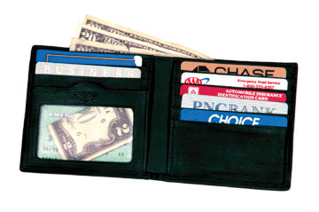
Section 1: Understanding Demand
Demand
Two Parts:
The desire to own something.
❖ The Ability to pay for it.

Slide 5
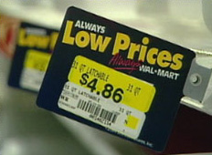
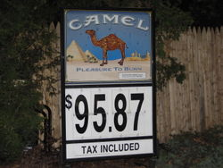
Section 1: Understanding Demand
The Law of Demand
When a good’s price is lower, consumers will buy more of it.
I like low prices!!
It costs too much! I’m going to quit!!!
When a good’s price is higher, consumers will buy less of it.
P$ = QD
P$ = QD

Slide 6
Demand Schedules & Graphs
Demand Schedule
Price of of a slice of pizza | Quantity Demanded
Demand Graph
Price
$3.00
$2.50
$2.00
$1.50
$1.00
$0.50
$0.50
5
$1.00
4
$1.50
3
$2.00
2
$2.50
1
D
$3.00
0
0 1 2 3 4 5 Q

Slide 7
INDEPENDENT PRACTICE: Chapter 4-1: DemandVocab Boxes
For each of the terms below, complete a Vocab box like seen to the right:
Demand
Law of Demand
Substitution effect
Income effect
VOCAB TERM
Definition in your own words | Picture, Logo, Cartoon to demonstrate definition
***Complete the Vocab Boxes on a separate
piece of paper in order to turn it in
DUE TOMORROW - 9/19

