Slide 1
Friday September 19, 2014 Mr. Goblirsch – Economics
OBJECTIVE – Students Will Be Able To – SWBAT:
- Describe the background and uses of money.
AGENDA:
WARM-UP: Tax Day
CONCEPT: $Money$
VIDEO: A World of Money
ACTIVITY: Dollar Assignment
***Computer Lab on Monday***
*****Business Projects DUE SEPTEMBER 30th*****
Tax Day WARM-UP: (Follow the directions below)
***5 minutes***
Take out your Weekly Time Sheet.
Complete the tax form for this week’s pay check. (Check with your partner to make sure it’s accurate)
Make your weekly deposit in your Account. (I will be coming around to stamp your account forms)

Slide 2
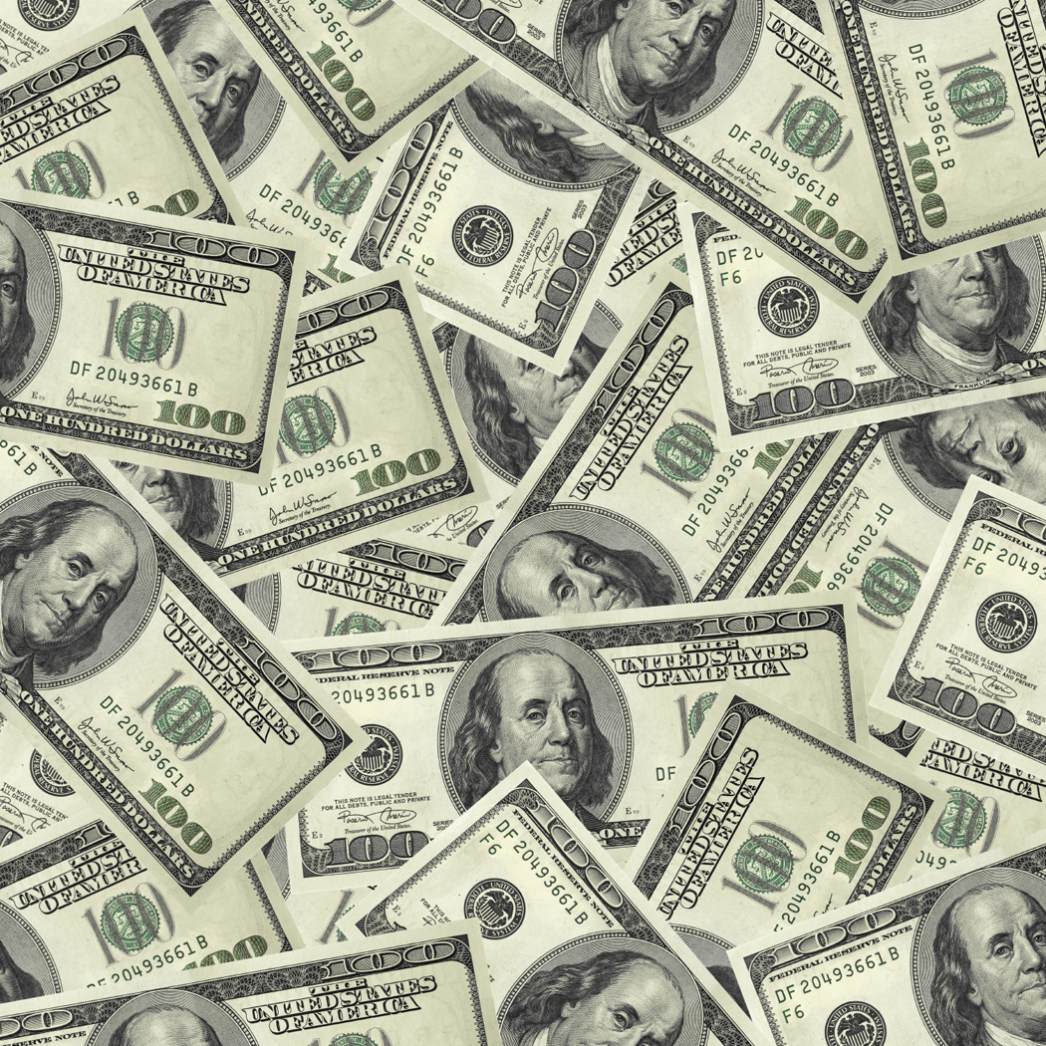
$$$
Money
$$$

Slide 3
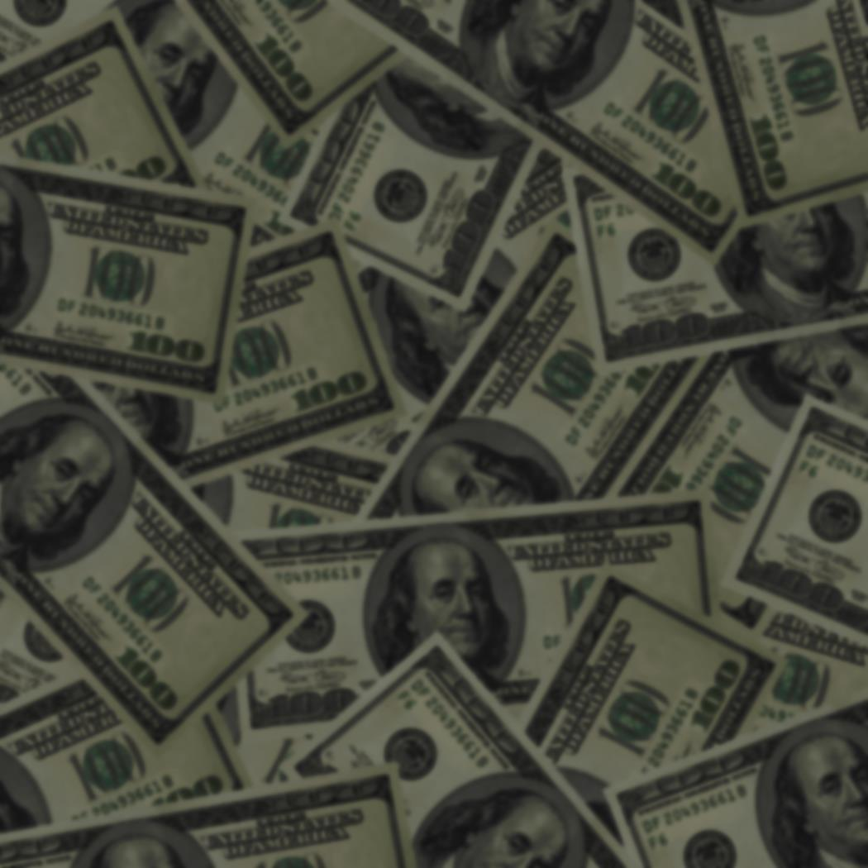
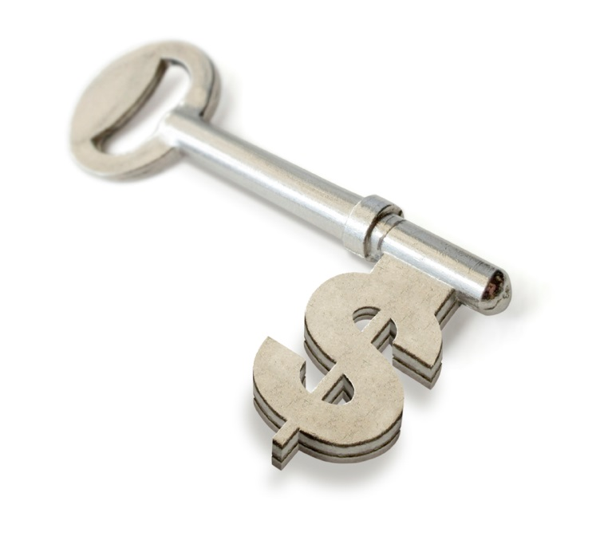
Three Uses of Money
Medium of Exchange
Replaces Barter System
Value determined by exchange of G & S
Unit of Account
Compares Value of goods
Store of Value
Savings & Wealth

Slide 4
A World of Money Questions
What were sheep, seashells, and salt all once used for?
What is the simplest form of trade?
What are some problems with using farm animals as medium of exchange?
Where, when, and how did gold & silver coins first come into use?
What was the role of money in ancient Greece?
How and why did Roman emperors inflate their currency?
How did the fall of the Rome affect trade?
Who invented paper money?
How are prices determined?
How do modern governments cause inflation?

Slide 5
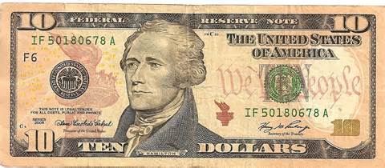
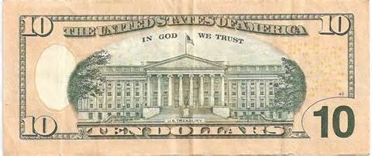
$ Dollar Assignment $
SUPPLIES NEEDED:
White Paper, Ruler, colored pencils
DIRECTIONS:
Give the $10 dollar bill a makeover. You must keep the denomination, serial number and Federal Reserve stamp in the same areas.
Size, Graphics and material are up to you.
Envision, Be Creative, Sketch
We will vote on a class winner
Winner will receive a $250 bonus
DUE FRIDAY SEPTEMBER 26

