Slide 1
Monday September 22, 2014 Mr. Goblirsch – U.S. History
OBJECTIVE – Students Will Be Able To – SWBAT:
Identify the division that developed over slavery and analyze the impact of the Dred Scott Supreme Court decision.
AGENDA:
WARM-UP: Road to Civil War Vocab
CONCEPT: The Divisive Politics of Slavery
GUIDED READING: Dred Scott Case
VIDEO: America the Story of Us: Division
Road to Civil War Vocab WARM-UP: (Follow the directions below)
***5 Minutes***
Define the terms below using the glossary of your textbook.
Secession 3. Underground Railroad
Popular sovereignty 4. Confederacy

Slide 2
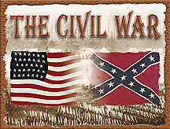
CHAPTER 4: THE UNION IN PERIL
BEFORE, DURING AND AFTER THE CIVIL WAR 1850-1877

Slide 3
THE DIVISIVE POLITICS OF SLAVERY
Over the centuries, the Northern and Southern sections of the United States had developed into two very different cultural and economic regions
There were also differences in geography and climate, as well as religious differences

Slide 4
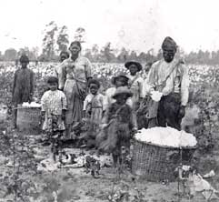
THE SOUTH BEFORE THE WAR
Rural plantation economy
Relied on slave labor
“Peculiar Institution” created tension
Southerners feared that the loss of slavery would mean lose of culture
Family working the cotton field on a Plantation

Slide 5
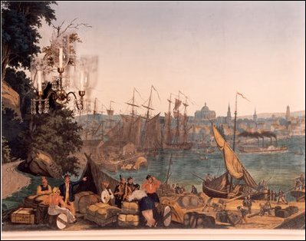
THE NORTH BEFORE THE WAR
The North had a more diverse economy
Industry flourished
Openly opposed slavery in the South and the new territories
More urbanized than South
BOSTON HARBOR

Slide 6
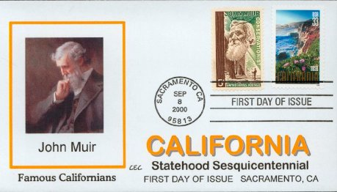
SLAVERY IN THE TERRITORIES
The issue of whether slavery in California and the West would be legal led to heated debates in Congress
Gold rush led to application for statehood for California

Slide 7
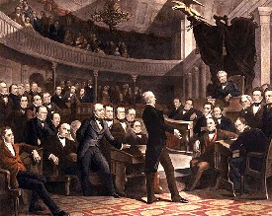
COMPROMISE OF 1850
Southerners threatened secession over issue (believed they had the right)
Henry Clay again worked a Compromise
For the North: California would be admitted as free state
For the South: A more effective fugitive slave law
Residents of New Mexico & Utah would vote themselves
CONGRESSIONAL DEBATE

Slide 8
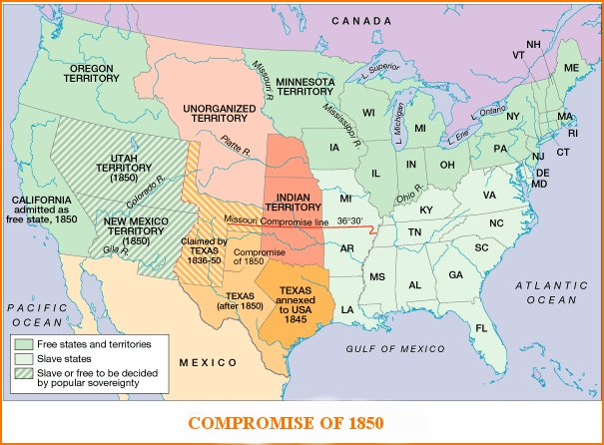

Slide 9
Structured Academic Discussion
In the North before the war…
In the South before the war…
The Compromise of 1850…

Slide 10
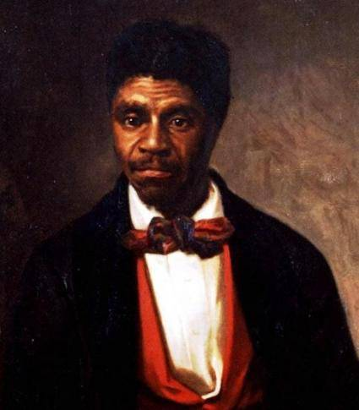
Dred Scott

Slide 11
Dred Scott Case Questions
What was the issue before the Supreme Court in this case?
What was the decision of the Court?
What was the effect of the decision?

Slide 12
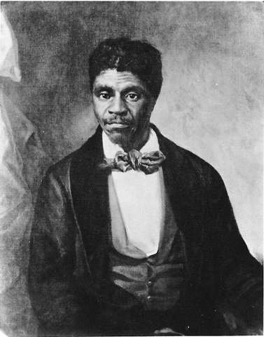
THE DRED SCOTT DECISION
A major Supreme Court decision occurred when slave Dred Scott was taken by his owner to free states Illinois & Wisconsin
Scott argued that made him a free man
Finally in 1857, the Court ruled against Dred Scott citing the Constitution’s protection of property
The decision increased tensions over slavery
Slavery would be able to spread to the western territories
DRED SCOTT LOST HIS CHANCE AT FREEDOM

Slide 13
Conflict = Secession
A. Dred Scott Decision
Scott taken from slave state (MO) to free state (IL & WI) and back to slave state by his owner
1. Argument: He had lived in a free state so he should be free
Sued for his freedom
Fed Court ruled against him
2. Decision:
a) Slaves were not & could never be citizens.
b) He had no right to sue. Remained a slave.
c) 5th Amend. Protected property
Territories could not deprive slaveholders of property

Slide 14
VIDEO QUESTIONS: America the Story of Us: Division
QUESTIONS:
What is the impact of the Erie Canal?
What is the impact of the power loom and factories?
Why was whaling appealing to African Americans?
Who was Harriet Tubman?
Who was John Brown?

