Slide 1
Wednesday September 24, 2014 Mr. Goblirsch – U.S. History
OBJECTIVE – Students Will Be Able To – SWBAT:
Identify the events that led directly to the beginning of the Civil War and which states seceded from the Union.
AGENDA:
WARM-UP: Secession Journal
CONCEPT: Southern Secession
GUIDED READING: Civil War Begins
INDEPENDENT PRACTICE: States Choose Sides Map
Secession Journal WARM-UP: (Follow the directions below)
***5 Minutes***
Write a paragraph journal entry on the topic below.
To secede means to formally withdraw from the nation. If a state wanted to leave the United States of America, do you think that state should be allowed to withdraw or not? Explain your reasoning.

Slide 2
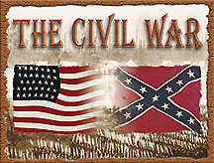
CHAPTER 4: THE UNION IN PERIL
BEFORE, DURING AND AFTER THE CIVIL WAR 1850-1877

Slide 3
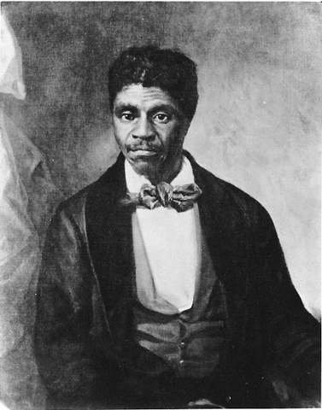
THE DRED SCOTT DECISION
A major Supreme Court decision occurred when slave Dred Scott was taken by his owner to free states Illinois & Wisconsin
Scott argued that made him a free man
Finally in 1857, the Court ruled against Dred Scott citing the Constitution’s protection of property
The decision increased tensions over slavery
Slavery would be able to spread to the western territories
DRED SCOTT LOST HIS CHANCE AT FREEDOM

Slide 4
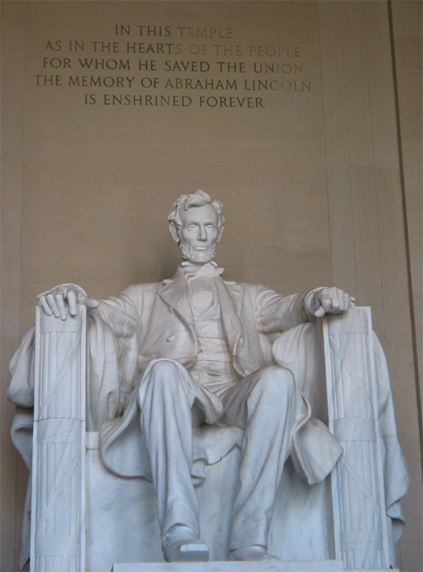
1860 PRESIDENTIAL ELECTION
Republicans nominated Abe Lincoln while the Democrats split
Lincoln won the 1860 election with less than half the popular vote and no Southern electoral votes
The Southern states were not happy
LINCOLN MEMORIAL

Slide 5
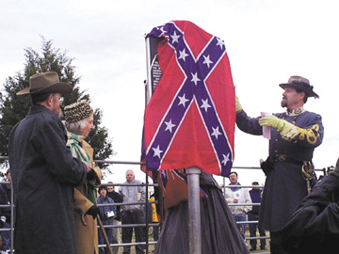
SOUTHERN SECESSION
Lincoln’s victory in 1860 election convinced Southerners that they had to act quickly
South Carolina was first, seceding from the union in December of 1860
Mississippi was next, then Florida, Alabama, Georgia, Louisiana, & Texas
Southern delegates met in February, 1861 and formed the Confederate States with Jefferson Davis as President
Believed federal government was acting beyond it’s authority

Slide 6
Structured Academic Discussion
The Dred Scott Supreme Court case allowed _____________________.
The southern states seceded from the union because _________________ and formed the Confederate States of America.

Slide 8
Who were the “sides”?
North
Union
United States of America
Yankees
Blue uniforms
President Abraham Lincoln
South
Confederacy
Confederate States of America (CSA)
Rebels
Gray uniforms
President Jefferson Davis

Slide 9
Question that Needs to be Answered
Would the North allow the South to Leave the Union without a Fight?

Slide 10
Civil War Begins Reading
Why did the Southern states secede?
ADVANTAGES
North
Why didn’t the North just allow the Southern states to leave?
South

Slide 11
States Choose Sides Map
DIRECTIONS: Use the map on P. A-31 to help you complete the map.
Write the name of each state (abbreviation is ok)
Color each of the following a different color:
Union States – Free States
Border States – Slave States that remained in the Union
Confederate States – Slave States that withdrew from the Union

Slide 12
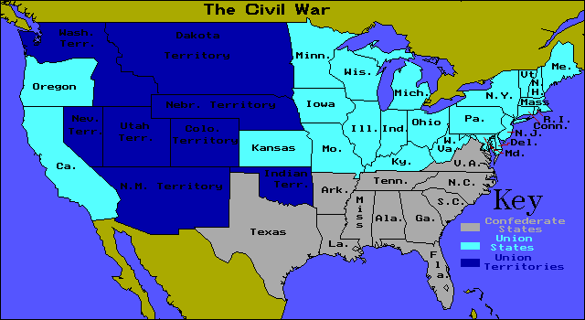

Slide 13
