Slide 1
Thursday September 25, 2014 Mr. Goblirsch – Economics
OBJECTIVE – Students Will Be Able To – SWBAT:
- Identify the factors of a change in demand, and the difference between a change in quantity demanded vs a change in demand.
AGENDA:
WARM-UP: Creating Demand Journal
PRIOR KNOWLEDGE: Change in Quantity Demanded
CONCEPT: Changes in Demand
GROUPS: “Blast from the Past” Activity
*Business Project DUE TUESDAY Sept 30*
– Make sure you complete Part 1 & Part 2 of the Business Project
***$10 Dollar Assignment – DUE TOMORROW – Winner gets $250 bonus
Creating Demand Journal WARM-UP: (Follow the directions below)
***5 minutes***
Write a paragraph journal entry answering the questions below.
How do companies try to create demand for their products?
How do sales/clearance at a store affect consumers? Do you tend to make more purchases during sales/clearance? How come or why not?

Slide 2
PRIOR KNOWLEDGE Change in the Quantity Demanded
Movement along the demand curve
Income changes and potential alternative goods and services can cause this
The Income/Substitution Effect
Income Effect
Change in price alters a persons real income
Substitution Effect
Quantity demanded changes as price of substitutes or trade-offs incr./decr.
EX) Rise in the ticket prices for an NFL team = change in quantity demanded (possibly because of the availability of NFL Sunday Ticket = Substitute)

Slide 3
Figure 4.3
Change in Quantity Demanded (cont.)

Slide 4
3rd Period – Market Demand Schedules & Graphs
Market Demand Schedule
Price of of a slice of pizza | Quantity Demanded
Market Demand Graph
Price
$3.00
$2.50
$2.00
$1.50
$1.00
$0.50
$0.50
184
$1.00
130
Decrease in QD
$1.50
100
Increase in QD
$2.00
72
$2.50
45
D
$3.00
26
0 40 80 120 160 200 Q

Slide 5
4th Period - Market Demand Schedules & Graphs
Market Demand Schedule
Price of of a slice of pizza | Quantity Demanded
Market Demand Graph
Price
$3.00
$2.50
$2.00
$1.50
$1.00
$0.50
$0.50
137
$1.00
105
Decrease in QD
$1.50
80.5
Increase in QD
$2.00
52
$2.50
35
D
$3.00
19
0 40 80 120 160 200 Q

Slide 6
5th Period - Market Demand Schedules & Graphs
Market Demand Schedule
Price of of a slice of pizza | Quantity Demanded
Market Demand Graph
Price
$3.00
$2.50
$2.00
$1.50
$1.00
$0.50
$0.50
194
$1.00
143
Decrease in QD
$1.50
102
Increase in QD
$2.00
66
$2.50
54
D
$3.00
35
0 40 80 120 160 200 Q

Slide 7
6th Period - Market Demand Schedules & Graphs
Market Demand Schedule
Price of of a slice of pizza | Quantity Demanded
Market Demand Graph
Price
$3.00
$2.50
$2.00
$1.50
$1.00
$0.50
$0.50
215
$1.00
148
Decrease in QD
$1.50
114
Increase in QD
$2.00
78
$2.50
66
D
$3.00
36
0 40 80 120 160 200 Q

Slide 8
Factors Affecting Demand
Chapter 4 Section 2

Slide 9
Factors Affecting Demand
Two factors that affect demand of a good or service
Change in the quantity demanded
Change in the demand
What is the difference between these?

Slide 10
Change in Demand
A change in demand is when people buy different amounts of the product at the same prices.
The willingness to buy a certain product changes even though there is no price change

Slide 11
STRUCTURED ACADEMIC DISCUSSION
A change in demand and change in quantity demanded are different because …

Slide 12
Section 2-10
Change in Demand (cont.)

Slide 13
Shift in Demand—Increase
$10
$9
$8
$7
$6
$5
$4
$3
$2
$1
$0
D₂
D₁
0 1 2 3 4 5 6 7 8 9 10

Slide 14
Shift in Demand—Decrease
$10
$9
$8
$7
$6
$5
$4
$3
$2
$1
$0
D₂
D₁
0 1 2 3 4 5 6 7 8 9 10

Slide 15
STRUCTURED ACADEMIC DISCUSSION
With an increase in demand, the demand curve will shift to the ________
With a decrease in demand, the demand curve will shift to the ________

Slide 16
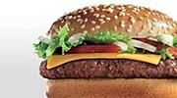
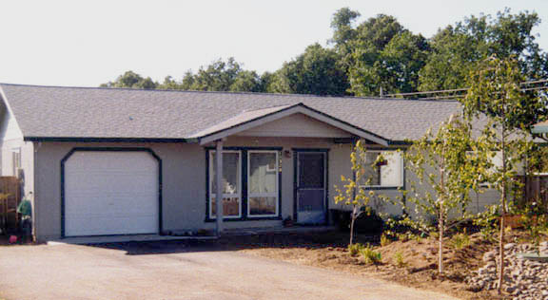
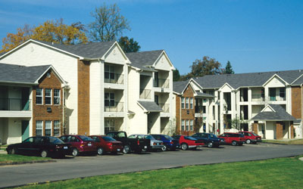
What Causes a Shift?  Income
or
or

Slide 17
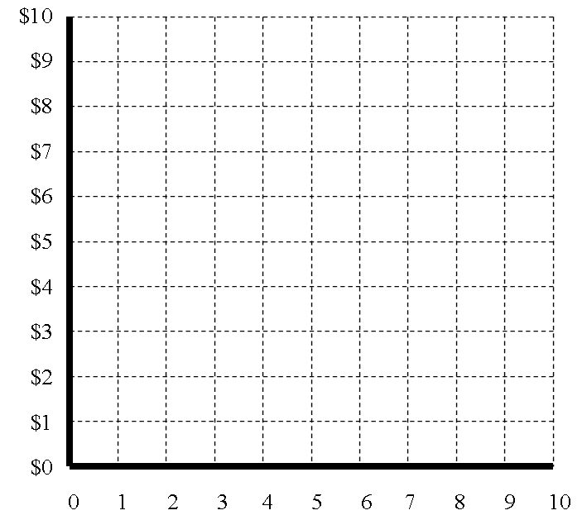
Demand for Homes
Income Increases
In $10,000 increments
D₂
D₁

Slide 18
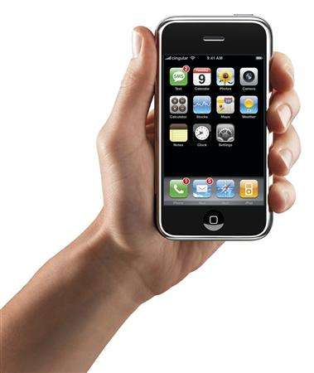
What Causes a Shift?  Consumer Expectations
Should I wait or should I buy now?

Slide 19
Demand for Cell Phones until September, because of the Expectations for the I-Phone 6
In $100 increments
D₁
D₂

Slide 20
STRUCTURED ACADEMIC DISCUSSION
Why might demand for the iPhone 4 & 5 have dropped over the past couple months?

Slide 21
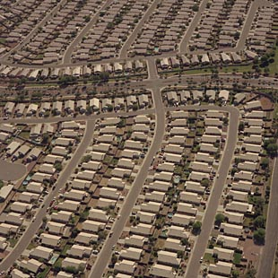
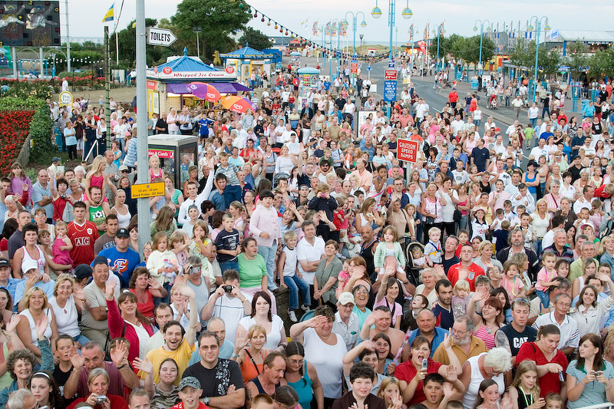
⬥ Population
1968—200 Million
2006—300 Million
2020-2030—400 Million
➢As Population grows so does demand.
➢more people to feed, clothe, and shelter

Slide 22
 Consumer Tastes & Advertising
What is cool?
What is the new thing?
It is always changing.

Slide 23
Demand for “Red Bull”
Consumer Taste & Advertising
Which way will Red Bull fly?
In $10 increments
D₂
D₁

Slide 24
STRUCTURED ACADEMIC DISCUSSION
Companies will spend millions of dollars on advertising because …

Slide 25
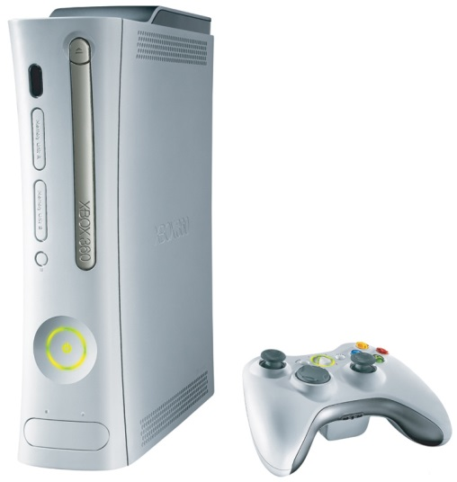
Price of Related Goods
◆ Complements—Two goods that are bought & sold together.
❖ Substitutes—Goods that are used in place of one another.
&

Slide 26
STRUCTURED ACADEMIC DISCUSSION
A complement good is …

Slide 27
“Blast From The Past” Assignment
Create a list of 10 items from the past decade or two that were once the most popular product in its genre that are no longer at the top…
Product choices can be anything from clothing to food to cars…anything goes
Once list is created give examples of why the product is no longer number one in its particular market…
Was it a marketing flaw?
Is there a better alternative choice?
Did peoples income changes cause it?
Maybe it’s a combination of several factors…be specific and detailed
SUMMARY OF DIRECTIONS: 2 Parts
Part 1 – List Product
Part 2 – Description of why product is no longer in demand

