Slide 1
Friday September 26, 2014 Mr. Goblirsch – Economics
OBJECTIVE – Students Will Be Able To – SWBAT:
- Calculate taxes, vote in a democratic election, monitor progress of stocks, and understand the concept of demand.
AGENDA:
WARM-UP: Tax Day
ELECTION: 1st Round: Vote on $10 Bills
ACTIVITY: Monitor DOW Stock progress for Week 5
ELECTION: Final Round: Vote on $10 Bills – Top 5
INDEPENDENT ASSIGNMENT: Workbook Pgs. 28 & 29
*Business Project DUE TUESDAY Sept 30*
– Make sure you complete Part 1 & Part 2 of the Business Project
Tax Day WARM-UP: (Follow the directions below)
***5 minutes***
Take out your Weekly Time Sheet.
Complete the tax form for this week’s pay check. (Check with your partner to make sure it’s accurate)
Make your weekly deposit in your Account. (I will be coming around to stamp your account forms)

Slide 2
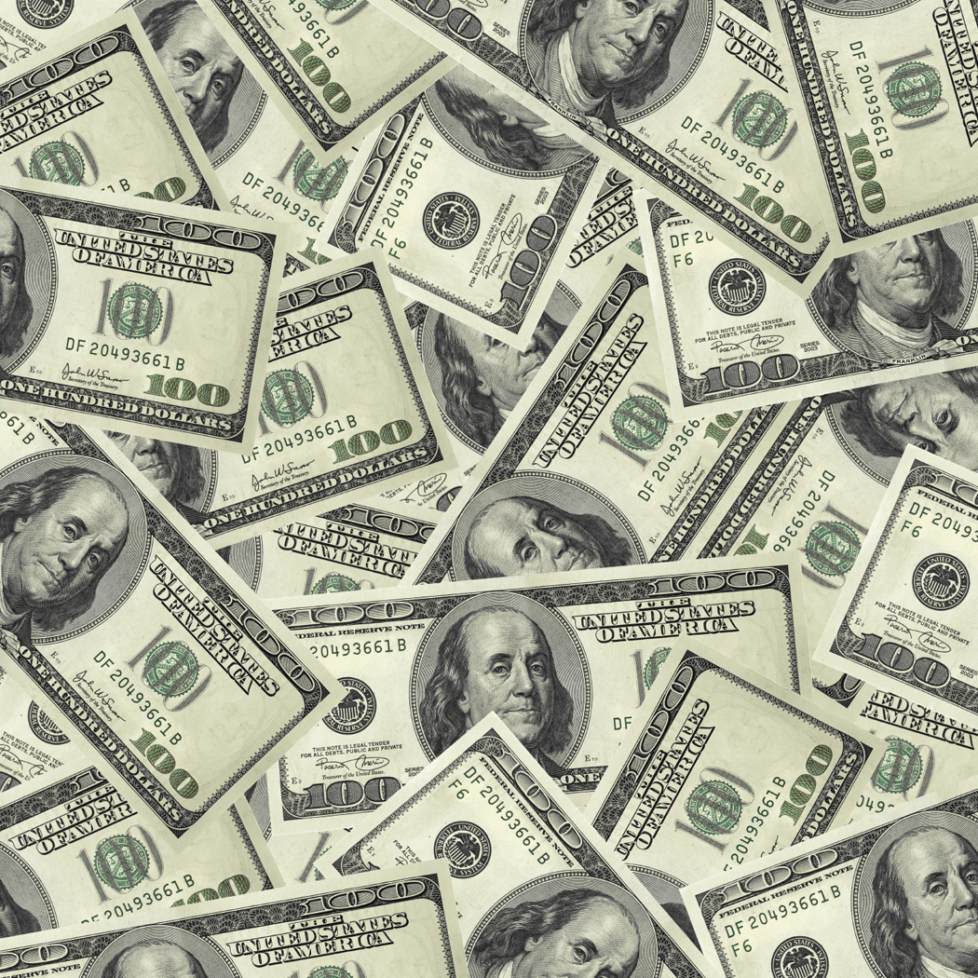
$$$
Money
$$$

Slide 3
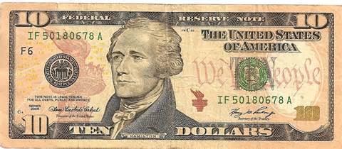
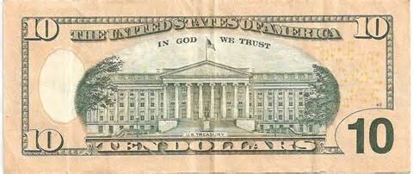
$ Dollar Assignment $
SUPPLIES NEEDED:
White Paper, Ruler, colored pencils
DIRECTIONS:
Give the $10 dollar bill a makeover. You must keep the denomination, serial number and Federal Reserve stamp in the same areas.
Size, Graphics and material are up to you.
Envision, Be Creative, Sketch
We will vote on a class winner
Winner will receive a $250 bonus
DUE FRIDAY SEPTEMBER 26

