Slide 1
Monday September 29, 2014 Mr. Goblirsch – Economics
OBJECTIVE – Students Will Be Able To – SWBAT:
- Analyze demand curves and identify changes in demand and changes in quantity demanded.
AGENDA:
WARM-UP: Identifying Changes in Demand
WHITEBOARD REVIEW: Demand Changes
GUIDED PRACTICE: Demand Worksheet
INDEPENDENT PRACTICE: Workbook Pgs. 28-29
***Business Project DUE TOMORROW Sept 30*
– Make sure you complete Part 1 & Part 2 of the Business Project
*****NO INTERNET TOMORROW – Make sure you email me your project TODAY, or bring it in on a Flash Drive*****
Identifying Changes in Demand WARM-UP: (Follow the directions below)
***5 minutes***
Decide whether each of these events would cause an increase/decrease in demand or an increase/decrease in the quantity demanded of the good in parentheses, and explain why.
The computer manufacturer lowers its prices. (computers)
A baseball maker convinces high schools to increase funding for varsity baseball teams. (baseballs)
A freeze ruins the orange crop, and orange juice prices rise. (apple juice)

Slide 2
Comparing Demand & Quantity Demanded
Causes a Change in Quantity Demanded
Causes a Change in Demand
Price change of good/service
P$ up = QD down
P$ down = QD up
Income change
Consumer expectations
Population
Consumer tastes
Advertising
Price/Availability of Substitute & Complement goods

Slide 3
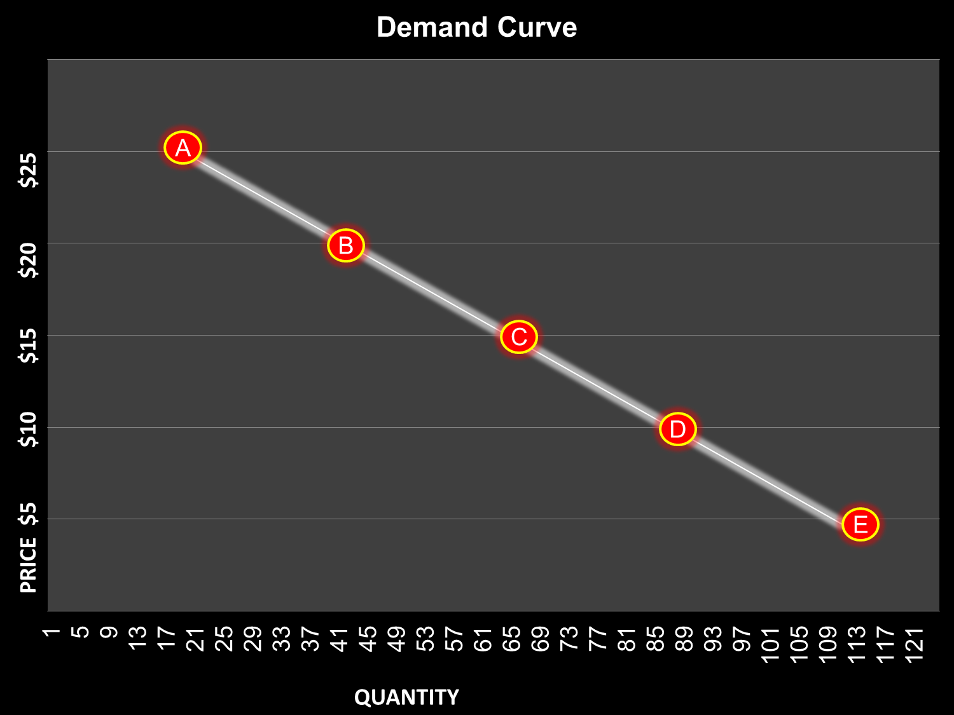
Demand Curve Review
Draw the Demand Curve to the right on your whiteboard. Don’t worry about the numbers, just draw the curve and the points A - E

Slide 4
Increase in Quantity Demanded
Using the demand curve to the right, on your whiteboard, show me what an increase in quantity demanded would look like

Slide 5
Increase in Demand
Using the demand curve to the right, on your whiteboard, show me what an increase in demand would look like

Slide 6
Decrease in Quantity Demanded
Using the demand curve to the right, on your whiteboard, show me what an decrease in quantity demanded would look like

Slide 7
Decrease in Demand
Using the demand curve to the right, on your whiteboard, show me what an decrease in demand would look like

Slide 8
Business Project Grading
PART 1
Structure - _______ 30 Points (5 points each)
___ Title/Cover Page ___ Mission Statement
___ Type: Sell/Produce ___ Location
___ Employees ___ Summary
Creativeness - _______ 20 Points
Presentation - _______ 20 Points
PART 1 TOTAL = _______ 70 Points
PART 2
PART 2 TOTAL - _______30 Points
PROJECT TOTAL = __________ 100 Points

