Slide 1
Tuesday September 30, 2014 Mr. Goblirsch – Economics
OBJECTIVE – Students Will Be Able To – SWBAT:
- Present and sell their business to the class in an effort to create demand for their good/service.
AGENDA:
WARM-UP: Demand Situations
Introduce Business Project Grading
Business Project Presentations
Demand Situations WARM-UP: (Follow the directions below)
***5 minutes***
Describe what you think will happen to the demand of each of these products. Explain your reasoning.
Flip-flops in November
Sweatshirts in November
Kids’ toys during November/December
Tank tops on sale during the winter
Vegetables since the drought has created a shortage and higher prices

Slide 2
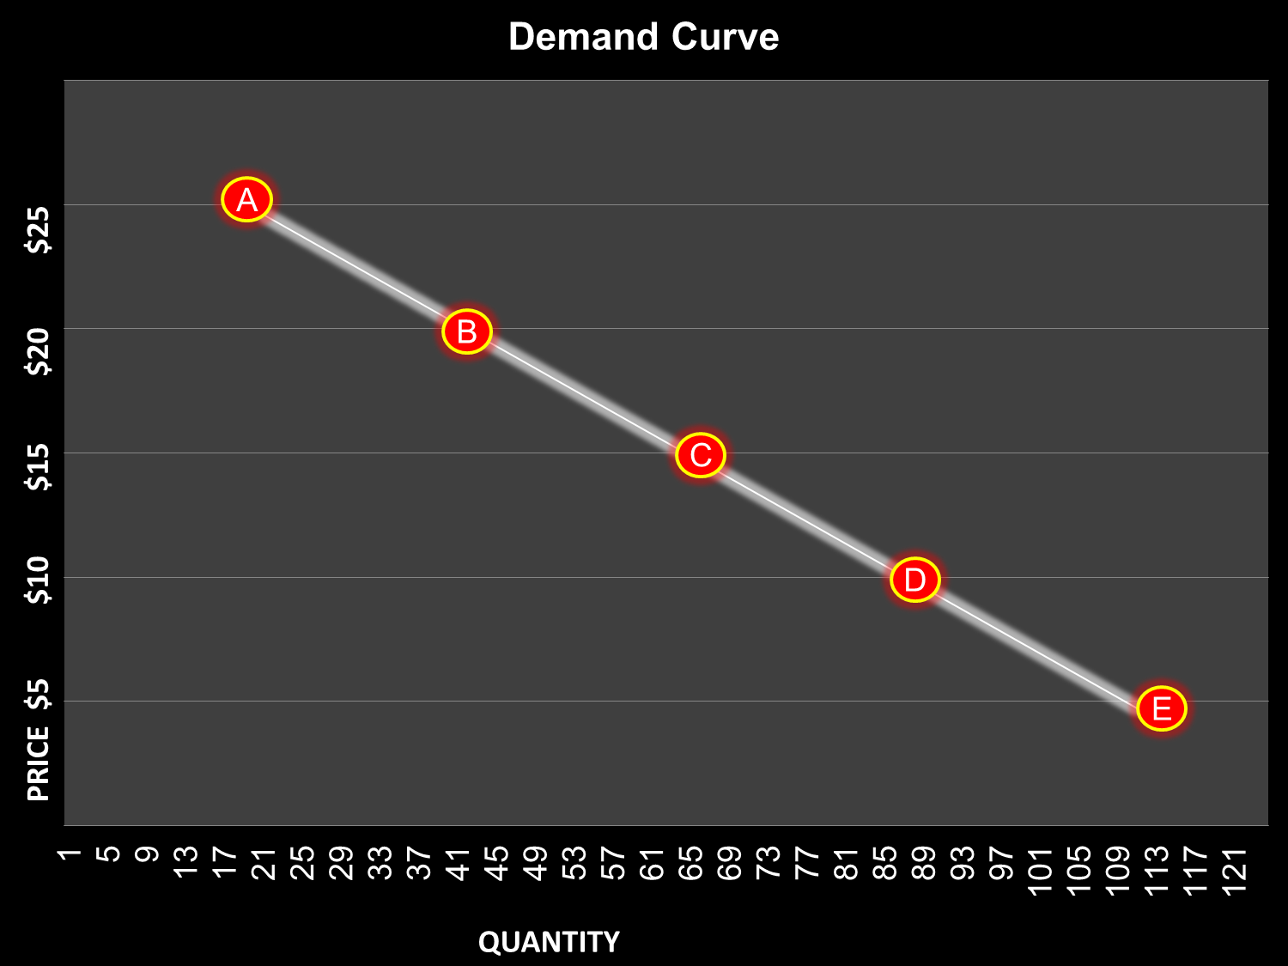
Increase in Quantity Demanded

Slide 3
Increase in Demand

Slide 4
Decrease in Quantity Demanded

Slide 5
Decrease in Demand

Slide 6
Business Project Grading
PART 1
Structure - _______ 30 Points (5 points each)
___ Title/Cover Page ___ Mission Statement
___ Type: Sell/Produce ___ Location
___ Employees ___ Summary
Creativeness - _______ 20 Points
Presentation - _______ 20 Points
PART 1 TOTAL = _______ 70 Points
PART 2
PART 2 TOTAL - _______30 Points
PROJECT TOTAL = __________ 100 Points

