Slide 1
Friday October 3, 2014 Mr. Goblirsch – Economics
OBJECTIVE – Students Will Be Able To – SWBAT:
- Describe the concept of demand elasticity and determine if a good is elastic, inelastic, or unitary elastic.
AGENDA:
WARM-UP: Taxes
VIDEO CLIP: Episode 16: Elasticity of Demand (9 min)
CONCEPT: Elasticity of Demand
VIDEO CLIP: Demand: The Economic Lowdown (6 min)
INDEPENDENT PRACTICE: Workbook Pg. 30
**Chapter 4 – Demand Quiz TUESDAY**
Tax Day WARM-UP: (Follow the directions below)
***5 minutes***
Take out your Weekly Time Sheet.
Calculate your tax deduction.
Make your weekly deposit in your Account.
STEP 1: Gross Pay (Total of Weekly Pay) X 0.27 (27% tax rate) = Amount of Taxes
STEP 2: Gross Pay (Total of Weekly Pay) – Amount of Taxes = Net Pay (Weekly Deposit)

Slide 2
Chapter 4: Demand
Section 1: Understanding Demand
Section 2: Shifts of the Demand Curve
Section 3: Elasticity of Demand

Slide 3
Section 3: Elasticity of Demand
How consumers respond to a change in Price.
Elastic
Demand is very responsive to change in price.
Inelastic
Demand is not very responsive to a change in price.
Unitary Elastic
A change in price is equal to the change in quantity demanded

Slide 4
Focus Activity 3.1
Elasticity = % change QD
% change P$
>1 = Elastic Demand
<1 = Inelastic Demand
=1 = Unit Elastic Demand

Slide 5
II. Total Expenditures Test
P$ X QD = total expenditures.
if the price changes and expenditures move in opposite directions on the demand curve, demand is elastic
same direction, demand is inelastic
no change, demand is unit elastic

Slide 6
Section 3-9
The Total Expenditures Test (cont.)

Slide 7
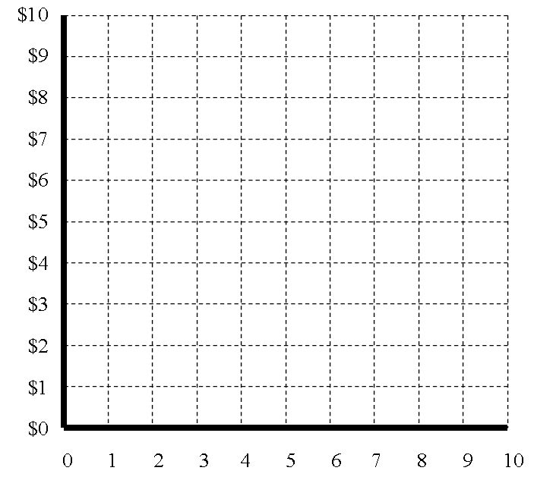
Elastic
Inelastic
$6 X 5= $30
$5 X 8.5= $42.50
$6 X 3.5= $21
$4 X 4= $16

Slide 8
III. Determinants of Elasticity
Three Questions that can help determine if a product is Elastic or Inelastic
Can the purchase be delayed?
Are adequate substitutes available?
Does the purchase use a large portion of the income?

Slide 9
Factors Affecting Elasticity
Needs (Inelastic) vs. Wants (Elastic)
Necessity Versus Luxuries
➢Necessities are always bought
➢ Luxuries can be cut back on/delayed
VS.

Slide 10
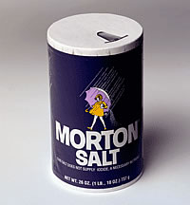
Factors Affecting Elasticity
Availability of Substitutes
➢ Few choices
 Gasoline
 Medical care
 Salt

Slide 11
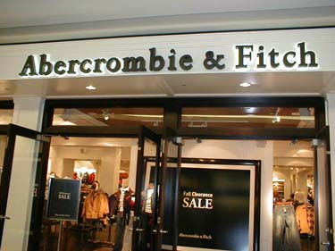
Factors Affecting Elasticity
Relative Importance
➢ Thinking at the margin
➢ Will a price increase change how much you buy?

Slide 12
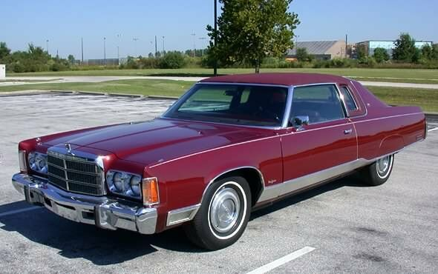
Factors Affecting Elasticity
Change Over Time
➢ High Prices will cause people to look for alternatives or efficiency.
8-12 MPG

