Slide 1
Monday October 6, 2014 Mr. Goblirsch – Economics
OBJECTIVE – Students Will Be Able To – SWBAT:
- Determine if a good is elastic, inelastic, or unit elastic and explain the factors effecting elasticity.
AGENDA:
WARM-UP: Elasticity Math Practice
READING: Demand Elasticity Summary
REVIEW: Determining Demand Elasticity
CONCEPT: Factors of Elasticity of Demand
VIDEO CLIP: Demand: The Economic Lowdown (6 min)
CLOSURE: Need to Know for Tomorrow’s Quiz
***Chapter 4 – Demand Quiz TOMORROW***
*Workbook Pgs. 28, 29, & 30 DUE TOMORROW*
Elasticity Math Practice WARM-UP: (Follow the directions below)
***5 minutes***
Answer the questions below.
Use the formula on P. 92 to calculate the exact elasticity of demand in the following examples. Then tell in each case, if demand is elastic, inelastic, or unit elastic.
When the price of a deluxe car wash rises from $10 to $11, the number of daily customers falls from 60 to 48.
A dentist with 80 patients cuts his fee for a cleaning from $60 to $54 and attracts two new patients

Slide 2
Chapter 4: Demand
Section 1: Understanding Demand
Section 2: Shifts of the Demand Curve
Section 3: Elasticity of Demand

Slide 3
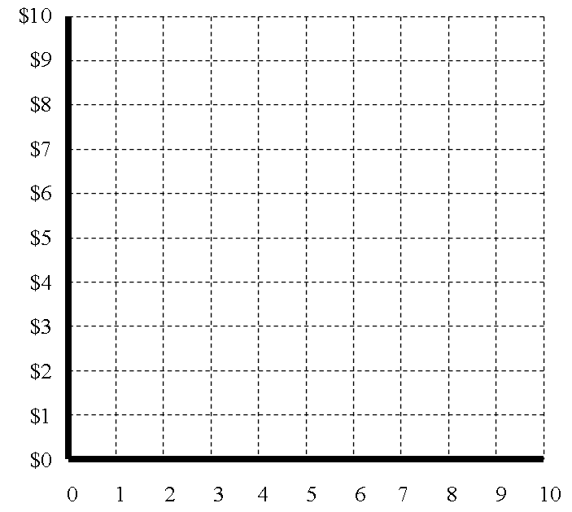
__________
___________
$__ X __ = $__
$__ X __ = $__
$__ X __ = $__
$__ X __ = $__

Slide 4
Determinants of Elasticity
Three Questions that can help determine if a product is Elastic or Inelastic
Can the purchase be delayed?
Are adequate substitutes available?
Does the purchase use a large portion of the income?

Slide 5
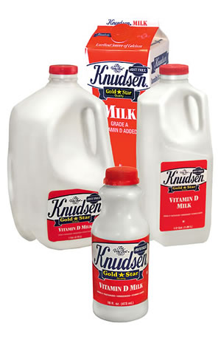
Factors Affecting Elasticity
Needs (Inelastic) vs. Wants (Elastic)
Necessity Versus Luxuries
➢Necessities are always bought
➢ Luxuries can be cut back on/delayed
VS.

Slide 6
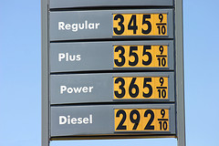
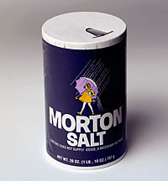
Factors Affecting Elasticity
Availability of Substitutes
➢ Few choices
 Gasoline
 Medical care
 Salt

Slide 7
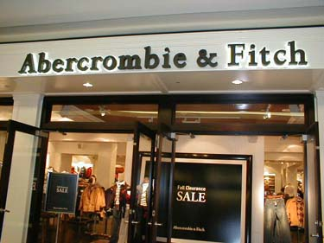
Factors Affecting Elasticity
Relative Importance
➢ Thinking at the margin
➢ Will a price increase change how much you buy?

Slide 8
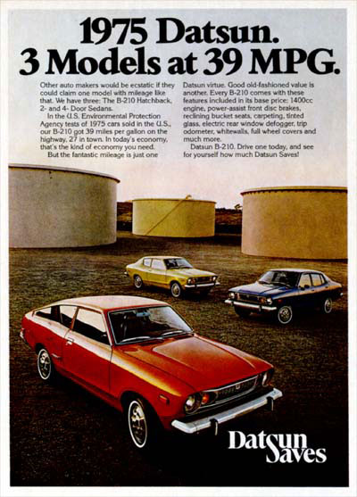
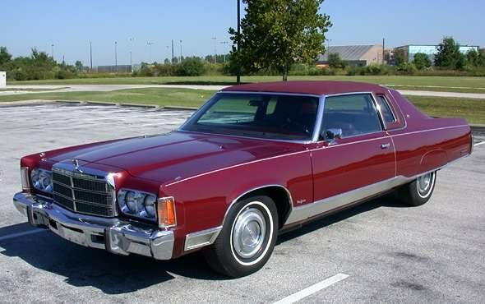
Factors Affecting Elasticity
Change Over Time
➢ High Prices will cause people to look for alternatives or efficiency.
8-12 MPG

Slide 9
NEED TO KNOW FOR TOMORROW’S QUIZ
Substitution & Income effect
Individual vs. market demand schedule
Complementary & substitute goods
Elasticity
Elastic vs. Inelastic
Definition of demand
Law of Demand
Factors that influence demand
Changes in quantity demanded
Changes in demand

