Slide 1
Tuesday October 7, 2014 Mr. Goblirsch – Economics
OBJECTIVE – Students Will Be Able To – SWBAT:
- Explain the concept of demand, law of demand, changes in demand, and elasticity of demand.
AGENDA:
WARM-UP: Business Owner Problem Solving
ASSESSMENT: Chapter 4 Quiz - Demand
CLOSE READING: Fine Dining vs. Fast Food Article
***Chapter 4 – Demand Quiz TODAY***
*Workbook Pgs. 28, 29, & 30 DUE TODAY*
Business Owner Problem Solving WARM-UP: (Follow the directions below)
***5 minutes***
Answer the question below.
As a business owner, you are always concerned about demand for your goods or services and about profit ($$$). If there is an increase in your production costs (the cost of producing/providing your good/service), what options do you have to keep selling your good/service?

Slide 2
CURRENT EVENTS: Income Gap: Fine Dining Up; Fast Food Down
DIRECTIONS:
Read the article with your partner.
Closely Read and Annotate the text.
AS YOU READ, LOOK FOR:
Economic concepts
Authors claims and evidence
DISCUSSION QUESTIONS:
What are some reasons that have nothing to do with income that might be causing a decline in fast-food dining?
In 2008, there was a financial crisis and recession, and McDonald's did well during that recession. Many concluded that this was because McDonald's is inexpensive, so people who could no longer afford to go to fancy restaurants went there instead. Can the explanation for McDonald's success during the recession and this article's explanation for the fast food industry's current struggles both be true? What do you think is the best explanation for both these things?

Slide 3
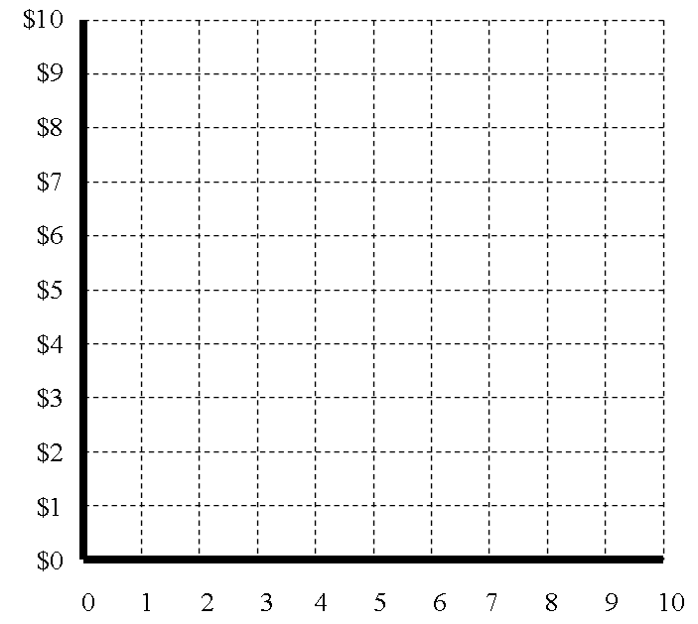
__________
___________
$__ X __ = $__
$__ X __ = $__
$__ X __ = $__
$__ X __ = $__

