Slide 1
Thursday January 8, 2015 Mr. Goblirsch – American Government
OBJECTIVE – Students Will Be Able To – SWBAT:
- Identify the characteristics & purpose of American Democracy.
AGENDA:
WARM-UP: Government Journal
CONCEPT: Foundations of Government
CLOSE READING: 2nd Treatise of Government
CLOSURE: Focus Question
***Bring a Wallet-Size picture of yourself TOMORROW for your Congressional Name Tag***
Government Journal WARM-UP: (Follow the directions below)
***5 minutes***
Write a paragraph journal answering the questions below.
Is a government really necessary? What does government have to do with my life? How does government impact me?

Slide 2
American Government
C H A P T E R 1 Foundations of Government
© 2001 by Prentice Hall, Inc.

Slide 3
PRIOR KNOWLEDGE: What Is Government?
Government is the institution through which a society makes and enforces its public policies.

Slide 4
Ch 1 Sec 2 & 3 CONCEPT: Foundations of Government
I. Foundations of American Government
Democracy – rule by the people, many (People have sovereign power)
Direct Democracy – people vote individually as citizens
Representative Democracy – people elect officials to make laws & conduct government
Republic – voters are the source of government’s authority
Federalism – Power is divided between national, state, & local levels

Slide 5
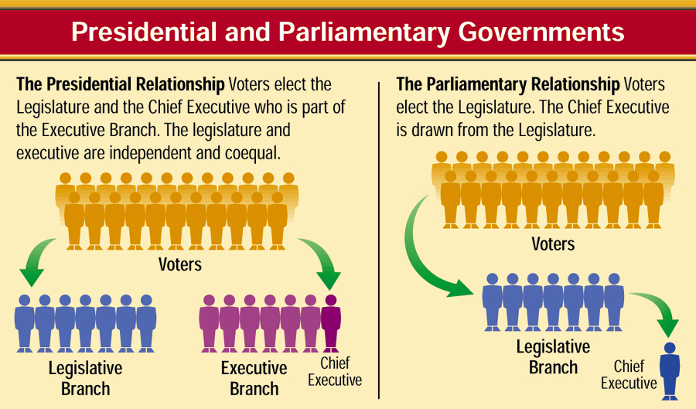
Classification by the Relationship Between Legislative and Executive Branches
1
3
Chapter 1, Section 2

Slide 6
Structured Academic Discussion
The United States is a (direct or representative) democracy because …
The United States is a (Presidential or Parliamentary) system because …

Slide 7
Ch 1 Sec 2 & 3 CONCEPT: Foundations of Government
II. Democracy
Characteristics
Individual liberty – certain rights, not absolute freedom
Majority rule w/ Minority rights – people accept decisions even when they lose
Free elections – Choose leaders, voice opinions, “one person, one vote,” citizens can help candidate/issues, secret ballot, minimum legal requirements
Competing Political Parties – choices, hold officials accountable “loyal opposition”
STRUCTURED ACADEMIC DISCUSSION:
I think the most important characteristic of Democracy is …

Slide 8
Ch 1 Sec 2 & 3 CONCEPT: Foundations of Government
II. Democracy cont’d
Keys to success
Active citizen participation
Favorable economy – free enterprise; capitalism
Educated public – free education;
“If an elective republic is to endure for any great length of time, every elector must have sufficient information…to direct wisely the legislature, the ambassadors, and the executive of the nation…It is the duty of government to see that the means of information be diffused to every citizen.” - Thaddeus Stevens, 1835, speaking in favor of education funding
Strong Civil Society – Groups exist outside governments control – religious, political, volunteer, etc.
Social Consensus – people accept democratic values

Slide 9
Structured Academic Discussion & Write
With your partner, discuss why free enterprise (capitalism) is conducive to the growth and preservation of democracy?
After your discussion, write a brief answer to the question in your notebook.

Slide 10
CLOSE READING: PRIMARY SOURCE Second Treatise of Government
DIRECTIONS: Read through the document with your partner. Make annotations based on the chart below.
POLITICAL – relating to politics/government (ex - voting, political issues, branches, etc.)
ECONOMIC – relating to the economy (ex - business, regulation, money, etc.)
SOCIAL – relating to society, the people (ex - rights/liberties, interactions between people, etc.)
***It is possible (and quite often) that a statement could fall into more than one area. Use your annotation to make you case for the one you labeled it as.
Symbol | What this symbol represents | What to write in your annotation
P | This is a POLITICAL statement/argument | Explain why you feel this is a political statement/argument.
E | This is an ECONOMICAL statement/argument | Explain why you feel this is an economical statement/argument.
S | This is a SOCIAL argument/statement | Explain why you feel this is a social statement/argument.
B | Potential BIAS within statement/argument | Reflect/Explain (on) which information may contain a bias viewpoint.
? | Information you are confused about or doesn’t make sense | Compose a question to express what confuses you.
* | IMPORTANT information, key idea/concept | Summarize or paraphrase the important information, key ideas/concept.
 | Put a circle around words you with which you are unfamiliar. | Look up the word and write a (brief) definition in the margin.
FOCUS QUESTION: What is the purpose of government?

Slide 11
Ch 1 Sec 2 & 3 CONCEPT: Principles of Government
Enlightenment Legacy
John Locke: people have NATURAL RIGHTS: Life, liberty, and property (Jefferson changed to “pursuit of happiness”)
- Government’s job is to protect people’s natural rights, people willingly “contract” with the government = less freedom for protection
If government “breaks” the contract, people have the right to form a new government

Slide 12
The Purpose of Government
The main purposes of government are described in the Preamble of the Constitution of the United States:
“We the People of the United States, in Order to form a more perfect Union, establish Justice, insure domestic Tranquility, provide for the common defence, promote the general Welfare, and secure the Blessings of Liberty to ourselves and our Posterity, do ordain and establish this Constitution for the United States of America.”
2
3
Chapter 1, Section 1

