Slide 1
Wednesday October 8, 2014 Mr. Goblirsch – Economics
OBJECTIVE – Students Will Be Able To – SWBAT:
- Identify the law of supply and explain the difference between it and the law of demand.
AGENDA:
WARM-UP: Supply Quick Think
REVIEW: Go over Ch 4 Demand Quiz
VIDEO CLIP: Supply: The Economic Lowdown (4 min)
CONCEPT: Law of Supply
CLOSURE: Exit Ticket - Law of Supply vs. Law of Demand
Supply Quick Think WARM-UP: (Follow the directions below)
***5 minutes***
Write a paragraph journal entry answering the question below.
Studying = doing any school activity related to a class including: homework and assignments, research, preparations for a test/project
How many hours per night do you spend studying? Per week?
How many hours would you study if someone paid you $1 per hour of studying? What about if someone paid you $20 per hour?
Explain your reasoning.

Slide 2
Supply
Chapter 5 Section 1

Slide 3
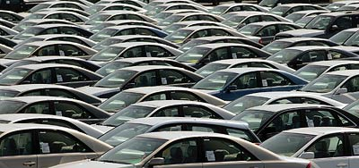
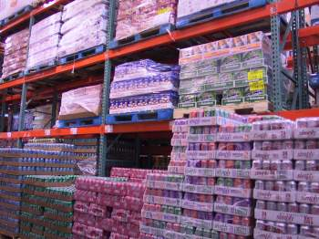
Section 1: Understanding Supply
Supply
➢ The amount of Goods and services made available by producers at each price.

Slide 4
The Law of Supply: The higher the price, the larger the quantity produced.
Firms will produce more at high prices— want more profits.
New firms will enter the market to earn profits, because they now can.
$P = QS
$P = QS

Slide 5
Supply Decisions: Price is a signal to producers to produce more or less
High Prices
➢ Firms produce more
➢ New Firms enter the market to profit
Low Prices
➢ Firms cut production
➢Firms leave the market

Slide 6
Chapter 5 FA1
Continued on next slide.

Slide 7
EXIT TICKET
DIRECTIONS: Write a paragraph explaining the difference between the law of supply and the law of demand.
1st Sentence) The Law of Demand is …
2nd Sentence) The Law of Supply is …
3rd Sentence) The difference between the two is …
Rest of Paragraph) Explain the difference and provide a specific example of each

Slide 8
Looking at Supply
Supply Curve = a graph showing the various quantities supplied at each and every price
Market Supply Curve = a graph showing the quantities offered at various prices by all firms selling said product

Slide 9
Pizza Supply Schedule
Price per Slice
Slices Supplied
$3.00
$2.50
$2.00
$1.50
$1.00
$0.50
$0.50
100
$1.00
150
$1.50
200
$2.00
250
S₁
$2.50
300
$3.00
350
50 100 150 200 250 300 350

Slide 10
Section 1-11
The Market Supply Curve

