Slide 1
Monday October 13, 2014 Mr. Goblirsch – Economics
OBJECTIVE – Students Will Be Able To – SWBAT:
- Describe the factors that impact supply.
AGENDA:
WARM-UP: Price Increase
REVIEW: Supply
CONCEPT: Changes in Supply
INDEPENDENT PRACTICE: Supply Worksheet
***Workbook P. 31 DUE TOMORROW***
Price Increase WARM-UP: (Follow the directions below)
***5 minutes***
Write a paragraph journal entry answering the following question.
The law of supply says that when prices go up, suppliers will increase their quantity supplied. However, some businesses may choose actually choose to decrease, or keep the same, level of production. Would you choose to increase, decrease, or keep the same level of production? Why?

Slide 2
SUPPLY CHANGES REVIEW
The Law of Supply says that when prices ________, the quantity supplied will _________
A change in quantity supplied occurs when …
A change in supply occurs when …
An _______ in supply occurs when the curve shifts to the ______

Slide 3
Section 3: Changes in Supply
$10
$9
$8
$7
$6
$5
$4
$3
$2
$1
$0
Decrease in Supply
S₂
Increase in Supply
S₁
S₂
0 1 2 3 4 5 6 7 8 9 10

Slide 4
Change in Supply
Change in Supply = situation where suppliers offer different amount of products for sale
Causes
Cost of Inputs
Productivity
Technology
Taxes and Subsidies
Subsidy = government payment to an individual or business to encourage economic activity

Slide 5
STRUCTURED ACADEMIC DISCUSSION
A change in supply is …
A cause of a change in supply is …

Slide 6
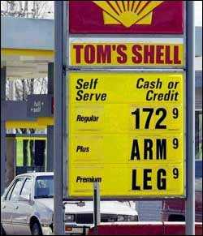
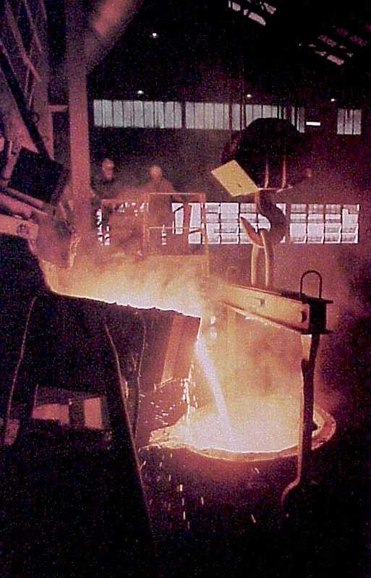
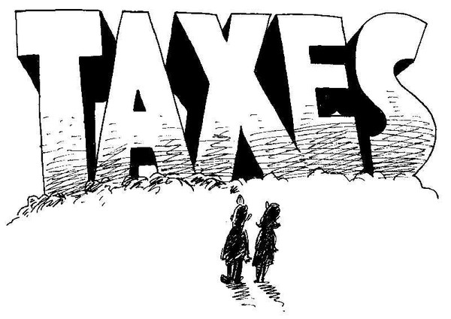
Input Costs
Effects of Rising Costs
➢ If costs go up, then it costs more to produce G & S
CA minimum wage increase and price increase.

Slide 7
Effects of Rising Costs
$10
$9
$8
$7
$6
$5
$4
$3
$2
$1
$0
S₂
S₁
D₁
0 1 2 3 4 5 6 7 8 9 10

Slide 8
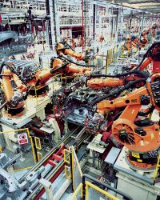
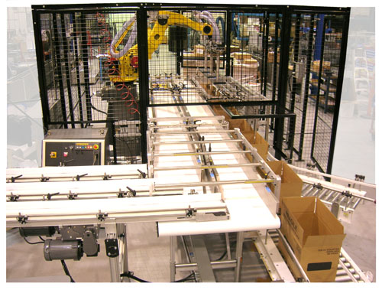
Input Costs
Technology
Lowers costs
Increases Supply

Slide 9
Technology How does an increase in technology effect supply?
$10
$9
$8
$7
$6
$5
$4
$3
$2
$1
$0
S₁
D₁
S₂
0 1 2 3 4 5 6 7 8 9 10

Slide 10
STRUCTURED ACADEMIC DISCUSSION
An example of an input cost that might cause a decrease in supply is …
An example of an input cost that might cause an increase in supply is …

Slide 11
Government’s Influence on Supply
Subsidies: Gov. payment to support a business
➢ Farms
➢ Infant industries
Taxes: Gov.uses to discourage some industries
➢ Tobacco
➢ Gasoline
Regulation: Gov intervention in the market that affects the price, quantity, or quality of a good.
➢ Fight Pollution
➢ Benefit Health

Slide 12
STRUCTURED ACADEMIC DISCUSSION
The government can influence supply by …

Slide 13
Other Influences on Supply
Future Expectations of Price
 Price to rise in the future—hold product & sell later.
 Price to fall in the future—sell now
Number of Suppliers
☞ If the number of suppliers increases so does supply
☞ If the number of suppliers decreases so does supply.

Slide 14
Econ Class Jobs
Students who have an assigned job will be responsible for carrying out their duty, and in return will be receive a $2 a day raise. The jobs are as follows:
Light person – turning on and off the lights as needed during the class period
Distributor/Collector – passing out/collecting papers as needed during the class period
Book Person – there will be one book person per pod. Their job will be to get out and return each pod members book as needed.

