Slide 1
Monday August 18, 2014 Mr. Goblirsch – Economics
OBJECTIVE – Students Will Be Able To – SWBAT:
- Explain the relationship between the fundamental economic problem of scarcity and making choices.
AGENDA:
WARM-UP: Choices Journal
INSTRUCTION: Scarcity & Choices
ACTIVITY: Needs vs. Wants & Goods vs. Services
CLOSURE: Scarcity Exit Ticket
***HW: Class Syllabus Signature DUE WEDNESDAY 8/20
Choices Journal WARM-UP: (Follow the directions below)
***5 minutes***
We all make choices on a daily basis. Write a ½ page journal entry about a choice you have made recently (within the last month). Expand on the other possible options and why you made the choice you made.

Slide 2
Daily Objective
Students will be able to (SWBAT):
Explain the relationship between the fundamental economic problem of scarcity and making choices.

Slide 3
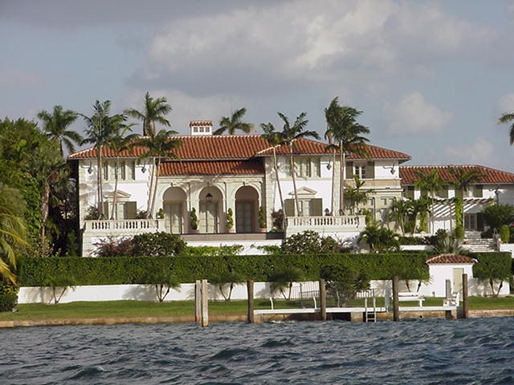
CHAPTER 1 Section 1: Scarcity
Economics: The study of how people make choices

Slide 4
Needs
A basic requirement
for survival
Wants
➢ A way of expressing a need.
➢ Something we desire.
Structured Academic Discussion:
The difference between a need and want is _______________.

Slide 5
Examples
NEED
WANT
Water
Food
Clothing
Shelter
Car (depending on where you live)
________________
________________
________________
Xbox, PlayStation
Cell phone (could be a need depending on situation)
Movie
Computer (could be a need depending on job/profession)
__________________
__________________
__________________
Structured Academic Discussion:
________ is an example of a need because ________________.
________ is an example of a want because ________________.

Slide 6
Goods
Physical/Tangible objects that are bought & sold (shirt/car/machine/road)
Services
Intangible Actions that a person performs someone
(medical care /movie experience, legal advice)
Structured Academic Discussion:
The difference between a good and a service is _______________.

Slide 7
Examples
GOOD
SERVICE
Food
Shirt/Jeans
House
Car
Computer
__________________
__________________
__________________
Waiter/Waitress
Dry cleaning
Plumber
Oil Change from shop
Geek squad at Best Buy
___________________
___________________
___________________
Structured Academic Discussion:
________ is an example of a good because ________________.
________ is an example of a service because ________________.

Slide 8
HOW THIS APPLIES TO ME?
Good that is a need
Service that is a need
Good that is a want
Service that is a want

Slide 9
Scarcity
The fundamental economic problem
Scarcity
Limited Resources to fulfill Unlimited wants and needs
Scarcity:
When there are not enough G & S to meet peoples W & N.
It may be temporary or it may be long term.
Limited resources = we can’t have everything
Goods & Services; Needs vs. Wants
= CHOICES to make
Structured Academic Discussion:
The fundamental economic problem is _____ because ______.

Slide 10
Full Definition of Economics
Economics: The study of how people make choices to try to satisfy what appears to be seemingly unlimited & competing wants and needs through the careful use of relatively scarce resources

Slide 11
CHOICES:
Trade-Offs: making alternative choices
A or B
Left or right
➢ Go to college or go into the workforce
➢ Do your homework or take a zero
➢ Mexican Food or Chinese
Hershey’s with almonds or plain chocolate
Structured Academic Discussion:
Today I made (or will make) a trade-off of ______ for _____.

Slide 12
CLOSURE: Exit Ticket
Describe the fundamental economic problem and it’s relationship to choices.
What is the difference between a good and a service?
Provide an example from your life of a good that is a need, good that is a want, service that is a need, and a service that is a want.
Define the terms: need, want, and trade-off in your own words AND draw a picture to represent each term.

