Slide 1
Friday January 9, 2015 Mr. Goblirsch – American Government
OBJECTIVE – Students Will Be Able To – SWBAT:
- Participate in a mock election and determine their role as a member of our mock Congress.
- Identify the purpose of government according to Enlightenment thinker John Locke.
AGENDA:
WARM-UP: Tax Day
Section Leader Vote
Selecting States
Congressional Name Tags
DISCUSSION: Analyzing Primary Document
2nd Treatise of Government
Tax Day WARM-UP: (Follow the directions below)
***5 minutes***
Calculate weekly taxes
We will be walking through the steps of calculating your weekly taxes

Slide 2
TAX DAY 1/9
$7.25 House Member
$10.25 Senate Member
Gross Income =
$7.25 x 4 = $29.00
Weekly Taxes =
$29.00 x 0.28 (28% tax rate) = $8.12
Net Income =
$29.00 - $8.12 = $20.88
Weekly Deposit = $20.88
Gross Income =
$10.25 x 4 = $41.00
Weekly Taxes =
$41.00 x 0.33 (33% tax rate) = $13.53
Net Income =
$41.00 - $13.53 = $27.47
Weekly Deposit = $27.47

Slide 3
DOOR
CABINETS
Goblirsch’s Desk |  |  | Projector Screen |  |  | 7 | 1
 |  |  |  |  |  | 8 | 2
 |  |  | 18 | 13
27 | 23 |  | 19 | 14 |  | 9 | 3
28 | 24 |  | 20 | 15 |  | 10 | 4
 |  |  | 21 | 16
29 | 25 |  | 22 | 17 |  | 11 | 5
30 | 26 |  |  |  |  | 12 | 6
36 | 35 |  | 34 | 33 |  | 32 | 31

Slide 4
Section Leader Responsibilities
Take daily attendance
Call on members for participation
Keeping track of restroom visits
Assign section jobs (Books, Clean-Up, Collection, Voting Monitor)
Conducting all votes needed
Monitoring behavior of your section
Rearranging seating assignment
Distribute bonus pay for section ($5 a day)

Slide 5
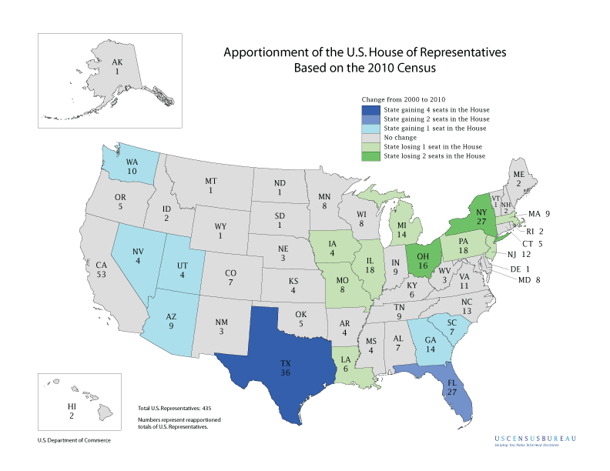

Slide 6
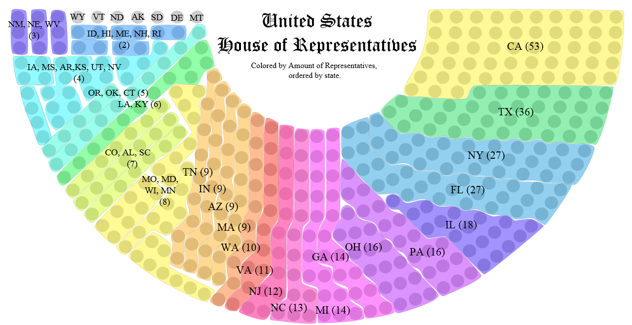
STATE SELECTION OPTIONS:
Big State = 15 – 53 Medium State = 5 – 14 Small State = 1 – 4

Slide 7
Congressional Name Tag
DIRECTIONS: Create your identification tag for our class Congress. It must include your House (ex. – Rep or Sen), First & Last Name, your Political Party, and your state.
EXAMPLES:
Rep. Mr. Goblirsch (R – CA)
Sen. Mr. Goblirsch (D – TX)
SYMBOLS:
House of Reps Member = Rep. ***Use the Map
Senate Member = Sen. to find State
Democrat = D abbreviation
Republican = R
Independent = I

Slide 8
Voter Turnout
National – Presidential Elections 50-60%
2000 – 54%
2004 – 60%
2008 – 62%
2012 – 57%
Congressional Elections 25-30%
Local Elections 10-15%
Greek for a person who doesn’t vote
… “idiot”

Slide 9
Party Affiliation
According to a Gallup poll (March 2014)
“In politics, as of today, do you consider yourself a Democrat, Republican, or Independent?”
“If independent, which party do you lean towards?”
Republicans: 25%
Democrats: 30%
Independents: 42%
Republicans w/ “leaners” – 42%
Democrats w/ “leaners” – 47%

Slide 10
Rm 410 Political Ideology Spectrum BY THE NUMBERS:
LIBERAL
Score 10 – 26
Survey Score | 17 | 19 | 20 | 21 | 22 | 23 | 24 | 25 | 26 | 27 | 28 | 29 | 30
# of Students | 1 | 1 | 2 | 3 | 1 | 5 | 7 | 6 | 7 | 12 | 7 | 11 | 13
Blue = Liberal Red = Conservative Purple = Moderate | 33 LIBERALS 27 % |  |  |  |  |  |  |  |  | 30 MODERATE LIBERALS 25% |  |  | 13 10%
MODERATE
LIBERAL
Score 27 – 29
MODERATE
Score = 30
Survey Score | 31 | 32 | 33 | 34 | 35 | 36 | 37 | 38 | 39 | 40 | 44
# of Students | 12 | 7 | 8 | 1 | 5 | 4 | 2 | 3 | 2 | 1 | 1
Blue = Liberal Red = Conservative Purple = Moderate | 27 MODERATE CONSER- VATIVES 22 % |  |  | 19 CONSERVATIVES 16%
MODERATE CONSERVATIVE
Score = 31 - 33
CONSERVATIVE
Score = 34 – 50
Total Liberals / Democratic Leaners
63 = 52%
Total Conservatives / Republican Leaners
46 = 38%

Slide 11
CLOSE READING: PRIMARY SOURCE Second Treatise of Government
DIRECTIONS: Read through the document with your partner. Make annotations based on the chart below.
POLITICAL – relating to politics/government (ex - voting, political issues, branches, etc.)
ECONOMIC – relating to the economy (ex - business, regulation, money, etc.)
SOCIAL – relating to society, the people (ex - rights/liberties, interactions between people, etc.)
***It is possible (and quite often) that a statement could fall into more than one area. Use your annotation to make you case for the one you labeled it as.
Symbol | What this symbol represents | What to write in your annotation
P | This is a POLITICAL statement/argument | Explain why you feel this is a political statement/argument.
E | This is an ECONOMICAL statement/argument | Explain why you feel this is an economical statement/argument.
S | This is a SOCIAL argument/statement | Explain why you feel this is a social statement/argument.
B | Potential BIAS within statement/argument | Reflect/Explain (on) which information may contain a bias viewpoint.
? | Information you are confused about or doesn’t make sense | Compose a question to express what confuses you.
* | IMPORTANT information, key idea/concept | Summarize or paraphrase the important information, key ideas/concept.
 | Put a circle around words you with which you are unfamiliar. | Look up the word and write a (brief) definition in the margin.
FOCUS QUESTION: What is the purpose of government?

Slide 12
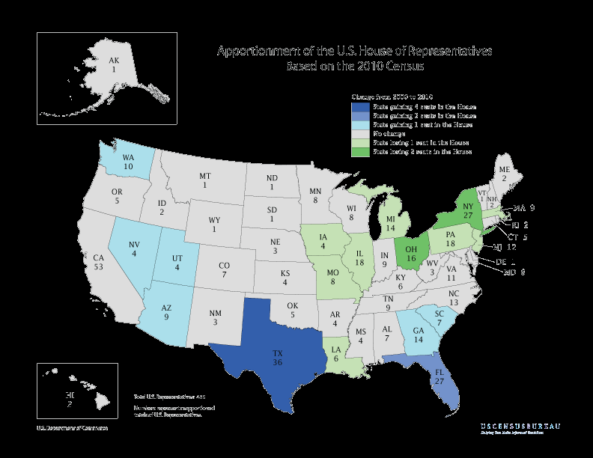

Slide 13
Rm 410 Political Ideology Spectrum
LIBERAL
CONSERVATIVE
ISSUE 122 Surveys | 1 – Strong Agree | 2 - Agree | 3 – On the Fence | 4 - Disagree | 5 – Strongly Disagree
Abortion | 14 – 11.5% | 33 – 27% | 16 – 13.1% | 35 – 28.7% | 24 – 19.7%
Death Penalty | 11 – 9% | 14 – 11.5% | 23 -18.9% | 50 – 41% | 24 – 19.7%
Homosexual Rights | 35 – 28.7% | 34 – 27.9% | 38 – 31.1% | 6 – 4.9% | 9 – 7.4%
Taxing | 18 – 14.8% | 35 – 28.7% | 31 - 25.4% | 29 – 23.8% | 9 – 7.4%
Welfare Programs | 28 – 23% | 49 – 40.1% | 25 – 20.5% | 14 – 11.5% | 6 – 4.9%
Gun Rights | 14– 11.5% | 22 – 18% | 27 – 22.1% | 26 – 21.3% | 33 – 27%
Marijuana Legalization | 23 -18.9% | 21 – 17.2% | 38– 31.1% | 18 – 14.8% | 22 – 18%
Public Prayer | 16 – 13.1% | 12 | 29 | 33 – 27% | 32
Healthcare | 16 – 13.1% | 35 – 28.7% | 35 – 28.7% | 27 | 9 – 7.4%
Immigration | 23 -18.9% | 34 – 27.9% | 42 | 12 | 11 – 9%

