Slide 1
Monday October 27, 2014
Mr. Goblirsch – Economics
OBJECTIVE – Students Will Be Able To – SWBAT:
- Describe how changes in Supply & Demand impact the equilibrium price, and identify 2 market structures: perfect competition & monopoly.
AGENDA:
WARM-UP: Monopoly Journal
WHITEBOARDS: Price Adjustments
VIDEO CLIP: EconMovies: Indiana Jones – Supply & Demand (7 min)
CONCEPT: Market Structures
INDEPENDENT PRACTICE: Types of Monopolies Chart
*****Unit 2 (Chapters 4 – 7) Test THURSDAY*****
Monopoly Journal WARM-UP: (Follow the directions below)
***5 minutes***
Write a paragraph journal entry answering the questions below.
  REVIEW: What role does competition play in the economy?
  What is the object of the board game Monopoly?
  Why do you think they named it Monopoly?

Slide 2
MARKET
1) What is the Equilibrium Price?
2) What is the Equilibrium Quantity?
$3.00
$2.50
$2.00
$1.50
$1.00
$0.50
100
200
300
400
500
600
700

Slide 3
MARKET
1) Draw the Supply & Demand curves on your whiteboard.
2) On your whiteboard, draw an INCREASE in SUPPLY.
PARTNER DISCUSSION: What happens to the Equilibrium Price & Quantity?
$3.00
$2.50
$2.00
$1.50
$1.00
$0.50
100
200
300
400
500
600
700

Slide 4
MARKET
PARTNER DISCUSSION: What happens to the Equilibrium Price & Quantity when there is a DECREASE in SUPPLY?
$3.00
$2.50
$2.00
$1.50
$1.00
$0.50
100
200
300
400
500
600
700

Slide 5
MARKET
1) Draw the Supply & Demand curves on your whiteboard.
2) On your whiteboard, draw an INCREASE in DEMAND.
PARTNER DISCUSSION: What happens to the Equilibrium Price & Quantity?
$3.00
$2.50
$2.00
$1.50
$1.00
$0.50
100
200
300
400
500
600
700

Slide 6
MARKET
PARTNER DISCUSSION: What happens to the Equilibrium Price & Quantity when there is a DECREASE in DEMAND?
$3.00
$2.50
$2.00
$1.50
$1.00
$0.50
100
200
300
400
500
600
700

Slide 7
MARKET
1) Draw the Supply & Demand curves on your whiteboard.
2) Draw an INCREASE in SUPPLY along with a DECREASE in DEMAND.
PARTNER DISCUSSION: What happens to the Equilibrium Price?
$3.00
$2.50
$2.00
$1.50
$1.00
$0.50
100
200
300
400
500
600
700

Slide 8
MARKET
PARTNER DISCUSSION: What happened to the Equilibrium Price?
$3.00
$2.50
$2.00
$1.50
$1.00
$0.50
100
200
300
400
500
600
700

Slide 9
CH. 7 Market Structures

Slide 10

Market Structures
Perfect Competition
Monopolistic Competition
Oligopoly
Monopoly

Slide 11

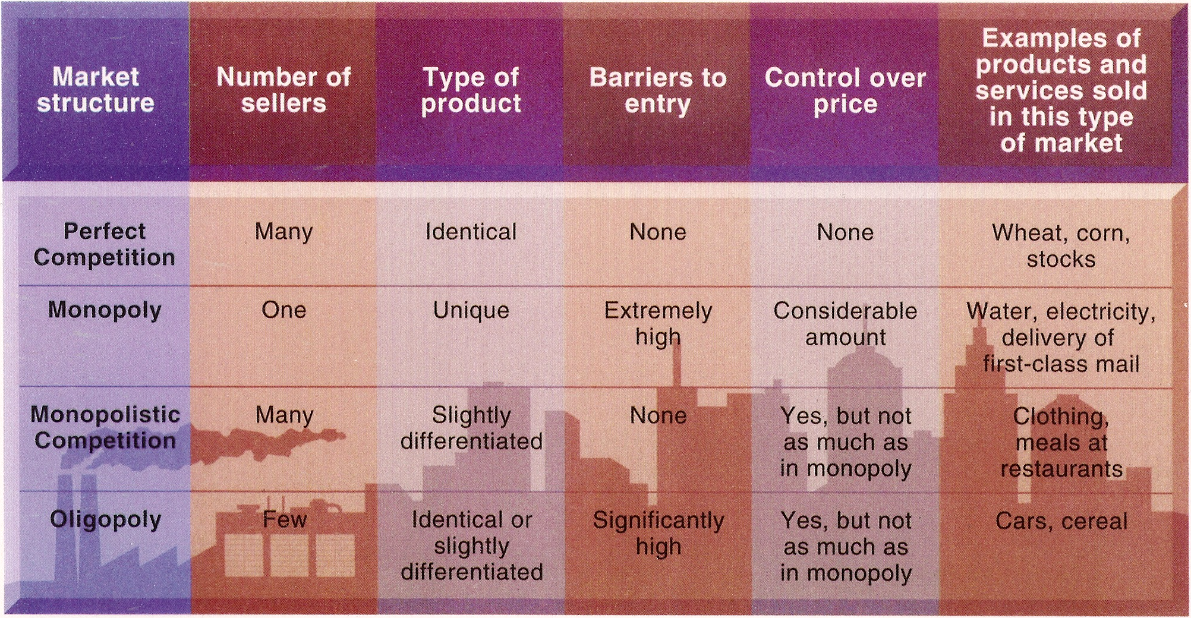
Market Structures

Slide 12
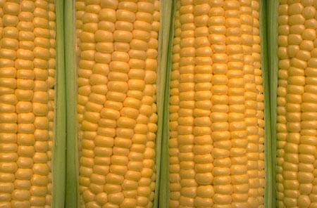
Five Conditions for Perfect Competition
1) Large number buyers and sellers
2) Identical products
3) Informed buyers and sellers
4) Free market entry and exit
        No Barriers
5) Buyers & Sellers act independently

Slide 13
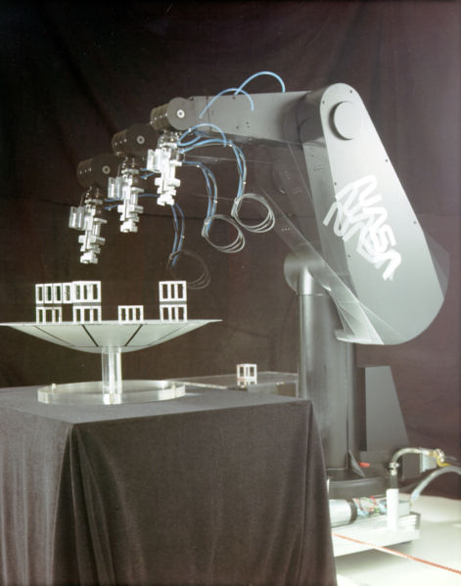

Barriers to Entry in the Market
Technology
Startup Costs
  Money/Capital
Legislation

Slide 14

1) A monopoly forms when barriers prevent firms from entering a market with a single supplier
a) this leads to inadequate competition and unfair pricing as they are a price maker.

Slide 15
Market Structures

Slide 16

Types of Monopolies
DIRECTIONS: Read P. 158-160. Complete the Chart below.
TYPE | DESCRIPTION
Natural Monopoly
Government Monopoly
Technological Monopoly
Franchises & Licenses
Industrial Organizations
Geographical Monopoly

Slide 17
Types of Monopolies
Natural Monopolies
Governmental Monopolies
Geographical Monopolies
Technological Monopolies

Slide 18
Natural Monopolies
high fixed costs
permits to operate are granted
price is regulated
example—utilities MID, P G & E

Slide 19
Governmental Monopolies
a monopoly the government owns and operates
examples—state run liquor stores and lotteries

Slide 20

Technological monopolies
  patents, copyrights, franchises, and licenses
  gives an advantage to those who posses them

Slide 21
Geographical Monopoly
No other sellers in the area

