Slide 1
SUB PLANS
Pass out handout for Warm-up
Take Attendance on Roll Sheet
After 5 mins, discuss Warm-up questions. Use the popsicle sticks to call on students randomly to answer the questions
Collect the handouts, then Watch YouTube video clip (9 min)
Next, Read Oligopoly slide (& Monopolistic Competition slide to 4th period ONLY)
Pass out Market Structures Chart worksheet to students who need it (some have it from yesterday)
Have the students fill-in the chart worksheet based off the Market Structures slide
Have students complete Workbook P. 39 & turn into the basket before they leave.
As they are working on Workbook P. 39, please display the Unit II Study Guide for those students who want to write it down
***I do allow them to use their phones to take a picture of the Study Guide instead of writing it down***

Slide 2
Wednesday October 29, 2014 Mr. Goblirsch – Economics
OBJECTIVE – Students Will Be Able To – SWBAT:
- Identify the 4 different market structures; including monopolistic competition and oligopoly.
AGENDA:
WARM-UP: Ch 7 Sec 3 Summary
VIDEO CLIP: Khan Academy: Monopolistic & Oligopoly (9 min)
CONCEPT: Market Structures
INDEPENDENT PRACTICE: Workbook P. 39 – DUE TODAY
REVIEW: Unit II Study Guide
*****Unit 2 (Chapters 4 – 7) Test TOMORROW*****
Ch 7 Sec 3 Summary WARM-UP: (Follow the directions below)
***5 minutes***
Read the handout. Answer the questions below.
In a monopolistic competition marketplace, how do firms compete against one another?
In an oligopoly marketplace, what is price fixing?
What is the difference between monopolistic competition and oligopoly?

Slide 3
CH. 7 Market Structures

Slide 4
Market Structures

Slide 5
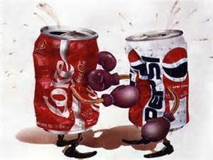
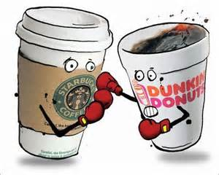
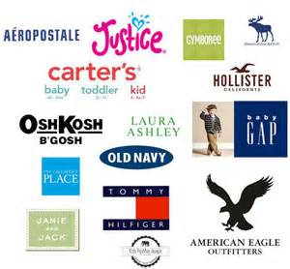
Monopolistic Competition
Many companies compete in an open market to sell similar products

Slide 6
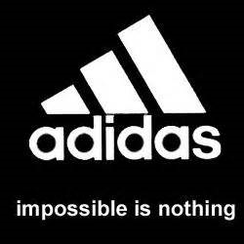
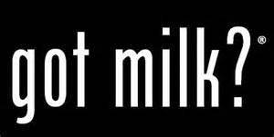
Non-Price Competition
Physical characteristics
Location
Service level
Advertising, image, or status

Slide 7
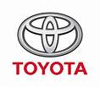
Oligopoly
A few large firms dominate the market
High barriers to entry
Cooperation and collusion
avoid price competition—if one firm lowers prices, others tend to follow
price fixing
Cartels
a formal organization that agrees to coordinate prices and production
example—OPEC

Slide 8
Market Structures

Slide 9
UNIT II STUDY GUIDE
MULTIPLE CHOICE
3 stages of production
Demand & Supply
Law of Demand & Supply
Market Structures:
Perfect competition
Monopolistic competition
Oligopoly
Monopoly
ANALYZING GRAPHS
Demand & Supply
Changes in Demand & Supply
ANALYZING EQUILIBRIUM
Price & Quantity
Result of a price ceiling
Changes in Eq. price & Eq. quantity when supply & demand shift

