Slide 1
Tuesday November 4, 2014 Mr. Goblirsch – Economics
OBJECTIVE – Students Will Be Able To – SWBAT:
- Describe the difference between current and real GDP measures.
AGENDA:
WARM-UP: GDP Vocab
CONCEPT: Real GDP
VIDEO CLIP: Real GDP (2 min)
GUIDED PRACTICE: Nominal vs. Real GDP
GRAPHING: Real GDP Figures
GDP Vocab WARM-UP: (Follow the directions below)
Define the terms below.
Nominal GDP 3) Aggregate supply
Real GDP 4) Aggregate demand
*****ELECTION DAY TODAY*****
18 & REGISTERED TO VOTE: $50 Bonus for Voting
IF NOT, you can still earn $50 Bonus by getting your parents, grandparents, relatives, etc. to vote
PROOF NEEDED: “I Voted” sticker” & Ballot Receipt
GO TO CAChoices.org to get information on voting Choices

Slide 2
GDP
Chapter 12 Section 1

Slide 3
Section 1-30
12
PRIOR KNOWLEDGE
GDP Equation –
The Output-Expenditure Model
GDP = C + I + G + (X-M)
C = consumer sector includes individuals/households
I = investment sector includes businesses
G = government sector includes local, state, and federal levels of government
(X-M) = foreign sector (Exports – Imports)
includes all consumers and producers outside the United States.

Slide 4
Section 1-Assessment 1
Discussion Question
What does an increase in GDP indicate?
That the country experienced economic growth.
Click the mouse button or press the Space Bar to display the answer.

Slide 5
Section 2-13
Real vs. Nominal (Current) GDP
Nominal GDP = current year $dollars$
Real GDP = GDP expressed in constant unchanging prices (adjusted for inflation & population – more accurate)
Choose a base year and use the prices from that year
Measuring Growth
Real GDP per capita = “better measure” of growth & quality of life
Real GDP divided by Population = per capita

Slide 6
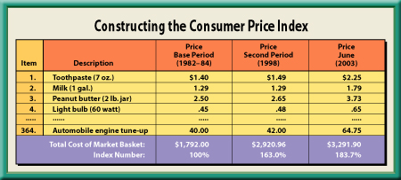
Section 2-7b
Constructing a Price Index

Slide 7
STRUCTURED ACADEMIC DISCUSSION
Suppose that a very small economy produces only TVs and Computers. Determine the current GDP and real GDP in year 4, using the following information:
In Year 1, the base year, 10 computers sold at $2,000 each & 15 TVs sold at $500 each
In Year 4, 17 computers sold at $2,200 each & 20 TVs sold at $550 each

Slide 8
Analyzing Real GDP
Look at the GDP data, analyze what happened from 1929 – 1934. What was going on in the U.S. to make this happen?
Look at the GDP data, analyze what happened from 1941 – 1944. What was going on in the U.S. to make this happen?
Look at the GDP data, analyze what happened in 2008 & 2009. What was going on in the U.S. to make this happen?
Create a bar graph using the “GDP in billions of chained 2009 dollars” on your graph for:
1930 – 1940 – 1950 – 1960 – 1970 – 1980 – 1990 – 2000 - 2010

