Slide 1
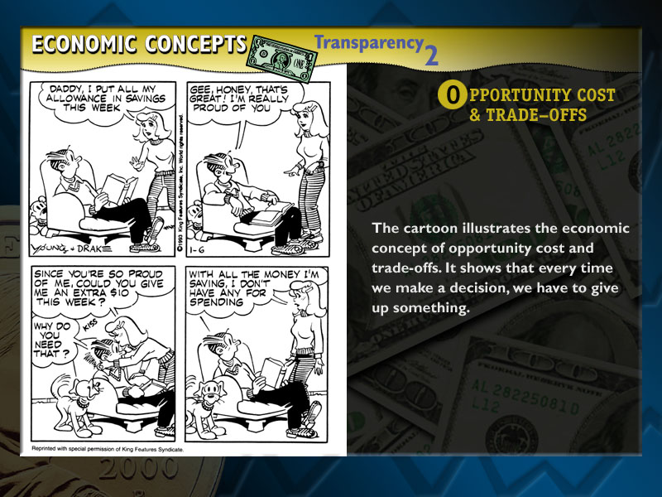






Unit 1 EC2

Slide 2

Tuesday August 19, 2014
Mr. Goblirsch – Economics
OBJECTIVE – Students Will Be Able To – SWBAT:
- Describe why every decision involves trade-offs and explain the concept of opportunity cost.
AGENDA:
WARM-UP: Opportunity Cost Cartoon
INSTRUCTION: Opportunity Cost
ACTIVITY: Going Out to Dinner
INDEPENDENT PRACTICE: Ch 1-2 Workbook P. 18
***HW: Class Syllabus Signature DUE TOMORROW 8/20
Opportunity Cost Cartoon WARM-UP: (Follow the directions below)
***5 minutes***
Yesterday we talked about scarcity and
having to make economic choices.
What choice did this girl make?
What did she give up by making that
choice?

Slide 3
Section 3-4
Introduction
Economics is about choices. 
Because resources are scarce, consumers need to make wise choices. 
To become a good decision maker, you need to know how to identify the problem and then analyze your alternatives. 
Finally, you have to make your choice in a way that carefully considers the costs and benefits of each possibility.

Slide 4
TINSTAAFL
“There is no such thing as a free lunch”
TINSTAAFL
Means everything has a cost somewhere along the line to somebody
Structured Academic Discussion:
TINSTAAFL stands for ____________ and it means __________.

Slide 5
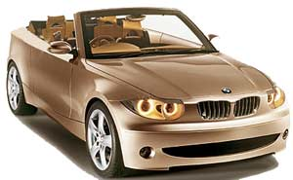

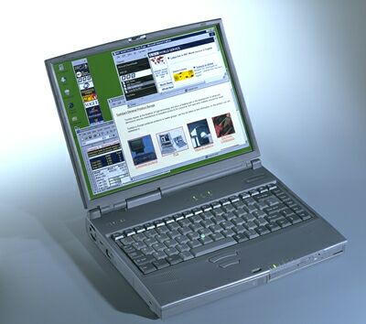
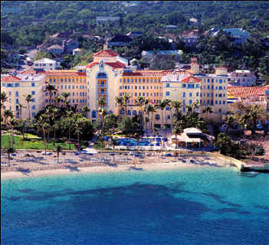
Opportunity Costs: The next best alternative use of time, money, or resources
When you make a trade-off (Choice) you must give some-thing up. In economics we call that an opportunity cost.
OR
OR

Slide 6



The Decision-Making Grid
Economists encourage us to consider the benefits and costs of our decisions.
Karen’s Decision-making Grid
Alternatives
Sleep late
Wake up early to study
Benefits
Enjoy more sleep
Have more energy during the day
Better grade on test
Teacher and parental approval
Personal satisfaction
Decision
Sleep late
Wake up early to study for test
Opportunity cost
Extra study time
Extra sleep time
Benefits forgone
Better grade on test
Teacher and parental approval
Personal satisfaction
Enjoy more sleep
Have more energy during the day

Slide 7
Opportunity Cost Activity
DIRECTIONS: In your notebook, create a chart like the one below. In each box, write down what you would order from each restaurant.
Togo’s | Outback
Chili’s | Red Robin

Slide 8
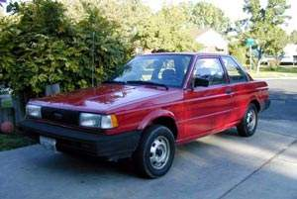
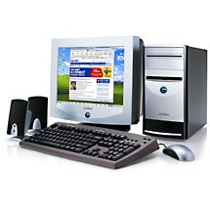
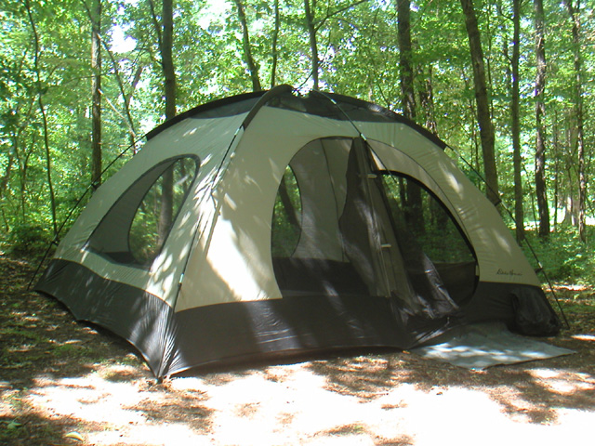
Thinking at the Margin
Choices don’t have to be black and white. When we talk about the margin or how much of our time, money, or resources we use.
&
&

Slide 9
Thinking at the Margin/Marginal Cost
Deciding how much more or less to do
Cost/Benefit Analysis
Law of Diminishing Returns

Slide 10

Thinking at the Margin
When you decide how much more or less to do, you are thinking at the margin.
Options
1st hour of extra study time
2nd hour of extra study time
3rd hour of extra study time
Benefit
Grade of C on
test
Grade of B on
test
Grade of B+ on test
Opportunity Cost
1 hour of
sleep
2 hours of
sleep
3 hours of
sleep

