Slide 1
Monday January 12, 2015 Mr. Goblirsch – American Government
OBJECTIVE – Students Will Be Able To – SWBAT:
- Identify the purpose of government according to Enlightenment thinker John Locke and the Preamble to the Constitution.
AGENDA:
WARM-UP: Foundations Vocab
DISCUSSION: Analyzing Primary Document
2nd Treatise of Government
GUIDED PRACTICE: Preamble
ASSIGNMENT: Workbook Pgs. 17 & 19
***HW: 2 Political Surveys – DUE FRIDAY***
Foundations Vocab WARM-UP: (Follow the directions below)
***5 minutes***
Define the terms below using the glossary of your textbook.
Legislative power 4. Constitution
Executive power 5. Sovereign
Judicial power

Slide 2
Political Survey HW
You are to ask at least 2 people outside of school to take the Political Survey we took on the 1st day of school. You will be responsible for conducting the survey and inputting the results into the Google Form linked below. You can interview up to a total of 5 people for extra credit.
http://goo.gl/forms/Mn4PE5W7af

Slide 3
CLOSE READING: PRIMARY SOURCE Second Treatise of Government
DIRECTIONS: Read through the document with your partner. Make annotations based on the chart below.
POLITICAL – relating to politics/government (ex - voting, political issues, branches, etc.)
ECONOMIC – relating to the economy (ex - business, regulation, money, etc.)
SOCIAL – relating to society, the people (ex - rights/liberties, interactions between people, etc.)
***It is possible (and quite often) that a statement could fall into more than one area. Use your annotation to make you case for the one you labeled it as.
Symbol | What this symbol represents | What to write in your annotation
P | This is a POLITICAL statement/argument | Explain why you feel this is a political statement/argument.
E | This is an ECONOMICAL statement/argument | Explain why you feel this is an economical statement/argument.
S | This is a SOCIAL argument/statement | Explain why you feel this is a social statement/argument.
B | Potential BIAS within statement/argument | Reflect/Explain (on) which information may contain a bias viewpoint.
? | Information you are confused about or doesn’t make sense | Compose a question to express what confuses you.
* | IMPORTANT information, key idea/concept | Summarize or paraphrase the important information, key ideas/concept.
 | Put a circle around words you with which you are unfamiliar. | Look up the word and write a (brief) definition in the margin.
FOCUS QUESTION: What is the purpose of government?

Slide 4
Preamble
Blue Print
Purpose of the Constitution
The legitimacy of the Constitution comes from the American People NOT the States
“We the People of the United States in order to form a more perfect Union, establish justice, insure domestic tranquility, provide for the common defense, promote general welfare, and secure the blessings of liberty to ourselves and our posterity, do ordain and establish this Constitution for the United States of America.”

Slide 5
Preamble
“We the People of the United States
(1) in order to form a more perfect Union,
(2) establish justice,
(3) insure domestic tranquility,
(4) provide for the common defense,
(5) promote general welfare, and
(6) secure the blessings of liberty to ourselves and our posterity,
do ordain and establish this Constitution for the United States of America.”
STURCTURED ACADEMIC DISCUSSION:
I believe the loftiest (most expensive) goal of the preamble is ______________ because …

Slide 7
Here’s 2013 Federal spending all in one beautiful pie chart. If you master this, you’ll understand way more than most. The “fiscal year” actually begins October 1st of the year preceding, so we are already halfway through Fiscal Year (FY) 2014.
When Congress and the President cannot agree on a full-year budget, we often keep the government open using a series of Continuing Resolutions (CRs), which are temporary agreements to continue spending at pretty much existing levels. Last fall, the Republicans refused to agree on an FY 2014 budget or temporary CR that did not repeal the Affordable Care Act — hostage-taking the Democrats and President Obama would not allow — so the government shut down on Oct 1st 2013 for sixteen days until public pressure caused Republicans to cave.
Back to the chart... Everything shown in red is Mandatory spending, meaning it is dictated by existing law and very difficult to change without a battle royale. This makes up about 2/3 of the entire budget and includes benefit programs like Social Security (23%), Medicare (14%), Medicaid (8%), and other Income Security safety net programs (10%). Interest on the long-term debt (6%) is dictated by prevailing interest rates.
Everything shown in yellow is Discretionary spending, which is hammered out each year between Congress and the President. What I found most surprising is that almost all Military spending ($625 Billion), including war activities, is negotiated each year. And it makes up more than half of our Discretionary spending.
That leaves only about 16% of the entire budget — the little bitty 1% and 2% slivers in the lower right — that comprise the “non-defense discretionary” spending. It includes important investments like Education, Environment, Science and Transportation. And that’s where Republicans love to hack away. A $100 billion cut is less than 3% of the entire budget, but it’s a gigantic chunk out of just these little slivers.
Note that Social Security and Medicare each have a dedicated revenue stream through the payroll tax. Social Security’s 12.4% dedicated payroll tax currently covers its entire costs, so it is a 100% “earned benefit.” Medicare’s 2.9% dedicated payroll tax, however, was only designed to cover the Part A hospital portion. Because Medicare draws over $200 Billion per year from general tax revenues — for Part B (doctor/outpatient) and Part D (prescription drugs) — it can only be considered about 50% an earned benefit.
Also note that Foreign Aid is only about 1% of the budget (part of the Int’l Affairs sliver). In a recent poll, most people mistakenly believe it is a whopping 27% and that just eliminating foreign aid will solve our budget woes.

Slide 8
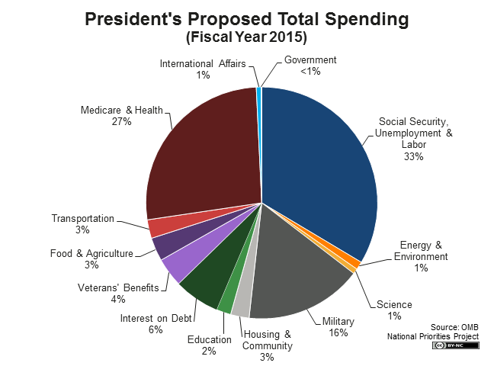

Slide 9
WORKBOOK ASSIGNMENT:
Complete Workbook Pg. 17 Part A only
Complete Workbook Pg. 19 Part A only
DUE WEDNESDAY

Slide 10
Voter Turnout
National – Presidential Elections 50-60%
2000 – 54%
2004 – 60%
2008 – 62%
2012 – 57%
Congressional Elections 25-30%
Local Elections 10-15%
Greek for a person who doesn’t vote
… “idiot”

Slide 11
Party Affiliation
According to a Gallup poll (March 2014)
“In politics, as of today, do you consider yourself a Democrat, Republican, or Independent?”
“If independent, which party do you lean towards?”
Republicans: 25%
Democrats: 30%
Independents: 42%
Republicans w/ “leaners” – 42%
Democrats w/ “leaners” – 47%

Slide 12
Rm 410 Political Ideology Spectrum BY THE NUMBERS:
LIBERAL
Score 10 – 26
Survey Score | 17 | 19 | 20 | 21 | 22 | 23 | 24 | 25 | 26 | 27 | 28 | 29 | 30
# of Students | 1 | 1 | 2 | 3 | 1 | 5 | 7 | 6 | 7 | 12 | 7 | 11 | 13
Blue = Liberal Red = Conservative Purple = Moderate | 33 LIBERALS 27 % |  |  |  |  |  |  |  |  | 30 MODERATE LIBERALS 25% |  |  | 13 10%
MODERATE
LIBERAL
Score 27 – 29
MODERATE
Score = 30
Survey Score | 31 | 32 | 33 | 34 | 35 | 36 | 37 | 38 | 39 | 40 | 44
# of Students | 12 | 7 | 8 | 1 | 5 | 4 | 2 | 3 | 2 | 1 | 1
Blue = Liberal Red = Conservative Purple = Moderate | 27 MODERATE CONSER- VATIVES 22 % |  |  | 19 CONSERVATIVES 16%
MODERATE CONSERVATIVE
Score = 31 - 33
CONSERVATIVE
Score = 34 – 50
Total Liberals / Democratic Leaners
63 = 52%
Total Conservatives / Republican Leaners
46 = 38%

Slide 13
Rm 410 Political Ideology Spectrum
LIBERAL
CONSERVATIVE
ISSUE 122 Surveys | 1 – Strong Agree | 2 - Agree | 3 – On the Fence | 4 - Disagree | 5 – Strongly Disagree
Abortion | 14 – 11.5% | 33 – 27% | 16 – 13.1% | 35 – 28.7% | 24 – 19.7%
Death Penalty | 11 – 9% | 14 – 11.5% | 23 -18.9% | 50 – 41% | 24 – 19.7%
Homosexual Rights | 35 – 28.7% | 34 – 27.9% | 38 – 31.1% | 6 – 4.9% | 9 – 7.4%
Taxing | 18 – 14.8% | 35 – 28.7% | 31 - 25.4% | 29 – 23.8% | 9 – 7.4%
Welfare Programs | 28 – 23% | 49 – 40.1% | 25 – 20.5% | 14 – 11.5% | 6 – 4.9%
Gun Rights | 14– 11.5% | 22 – 18% | 27 – 22.1% | 26 – 21.3% | 33 – 27%
Marijuana Legalization | 23 -18.9% | 21 – 17.2% | 38– 31.1% | 18 – 14.8% | 22 – 18%
Public Prayer | 16 – 13.1% | 12 | 29 | 33 – 27% | 32
Healthcare | 16 – 13.1% | 35 – 28.7% | 35 – 28.7% | 27 | 9 – 7.4%
Immigration | 23 -18.9% | 34 – 27.9% | 42 | 12 | 11 – 9%

Slide 14
Congressional Name Tag
DIRECTIONS: Create your identification tag for our class Congress. It must include your House (ex. – Rep or Sen), First & Last Name, your Political Party, and your state.
EXAMPLES:
Rep. Mr. Goblirsch (R – CA)
Sen. Mr. Goblirsch (D – TX)
SYMBOLS:
House of Reps Member = Rep. ***Use the Map
Senate Member = Sen. to find State
Democrat = D abbreviation
Republican = R
Independent = I

Slide 15
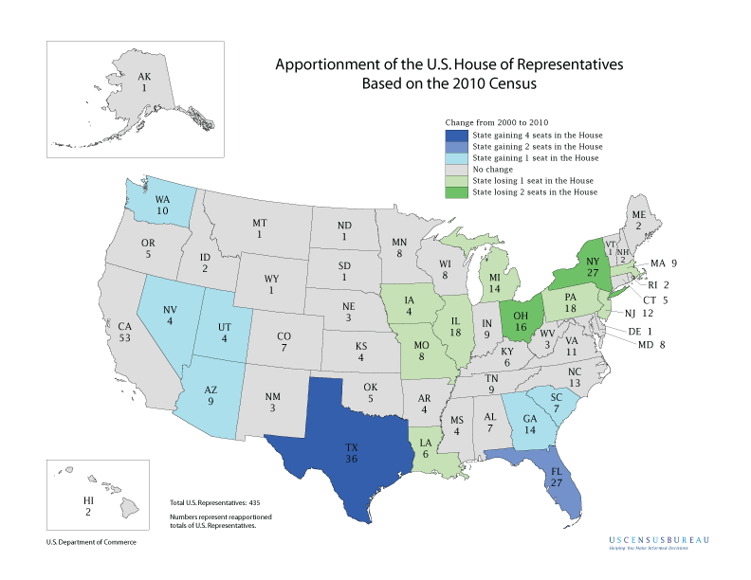

Slide 16
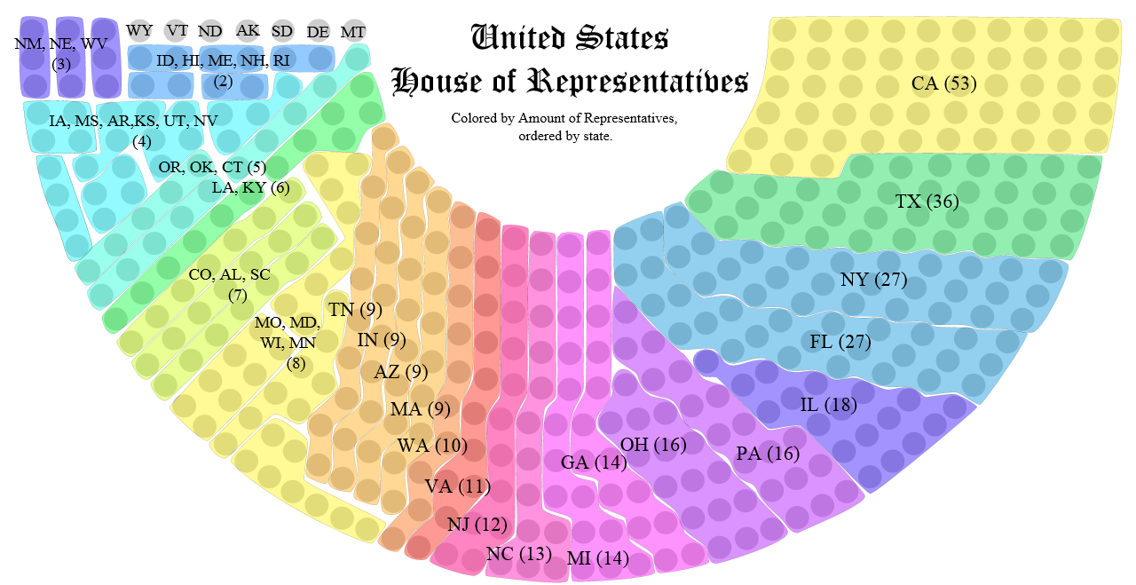
STATE SELECTION OPTIONS:
Big State = 15 – 53 Medium State = 5 – 14 Small State = 1 – 4

Slide 17
DOOR
CABINETS
Goblirsch’s Desk |  |  | Projector Screen |  |  | 7 | 1
 |  |  |  |  |  | 8 | 2
 |  |  | 18 | 13
27 | 23 |  | 19 | 14 |  | 9 | 3
28 | 24 |  | 20 | 15 |  | 10 | 4
 |  |  | 21 | 16
29 | 25 |  | 22 | 17 |  | 11 | 5
30 | 26 |  |  |  |  | 12 | 6
36 | 35 |  | 34 | 33 |  | 32 | 31

Slide 18
Section Leader Responsibilities
Take daily attendance
Call on members for participation
Keeping track of restroom visits
Assign section jobs (Books, Clean-Up, Collection, Voting Monitor)
Conducting all votes needed
Monitoring behavior of your section
Rearranging seating assignment
Distribute bonus pay for section ($5 a day)

