Slide 1
Wednesday November 12, 2014 Mr. Goblirsch – Economics
OBJECTIVE – Students Will Be Able To – SWBAT:
- Describe the different types of unemployment.
AGENDA:
WARM-UP: Unemployment Journal
CONCEPT: Unemployment
READING: Unemployment in Stanislaus County
CHART: Types of Unemployment
Unemployment Journal WARM-UP: (Follow the directions below)
***5 minutes***
Create a list of 5 terms that come to mind when you hear “unemployment”
Write a paragraph explaining why people lose their jobs.

Slide 2
UNEMPLOYMENT
Chapter 13 Section 1

Slide 3
Section 2-6
13
Did You Know?
At the peak of the Great Depression, one out of every four people was unemployed. Between 1929 and 1933, real net national product, wholesale prices, and the money supply all declined by more than one-third.
Every spring, the unemployment rate slightly rises as college graduates enter the labor force.
High unemployment rates in the mid-1980s were caused in part by the baby boomers who had graduated from college and were entering the work force

Slide 4
Section 2-5
13
Measuring Unemployment
The unemployment rate shows the percentage of unemployed people divided by the total number of people in the civilian labor force.
Unemployed population = Unemployment
Total Labor Force Rate
Understating unemployment
does not include “discouraged” workers
people who are working part-time because they cannot find full-time work.
Hard to track the homeless

Slide 5
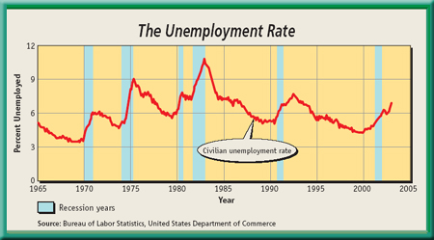
Section 2-8
13
Measuring Unemployment
- Increases rapidly during a Recession
- Comes down slowly after
Figure 14.3

Slide 6
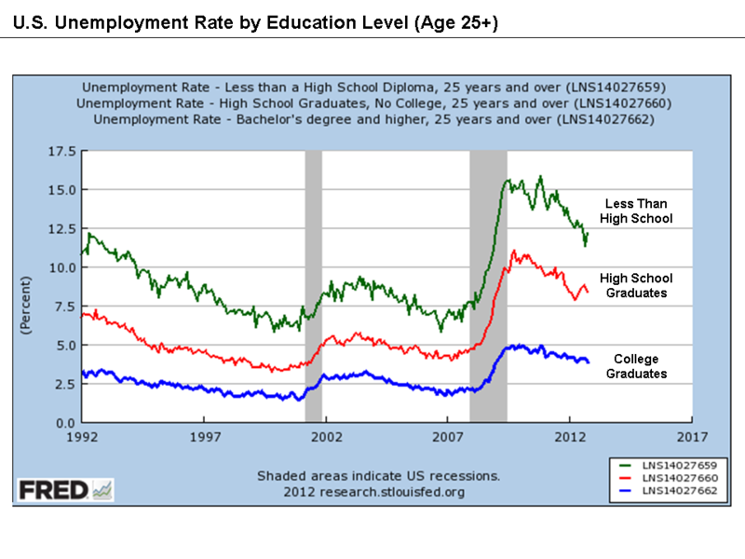

Slide 7
Section 2-4
13
Unemployment
Population of the United States = Approximately 318,000,000
Total population over age 16 = 245,679,000 (2013)
Civilian labor force = 155,389,000 (2013) – approximately ½ of total population (63.2% of pop over 16)
At any given time millions of these people are without jobs.
2013 Employed Number = 143,929,000 (58.6% of Total Population)
2013 Unemployment Number = 11,460,000 (Unemployment Rate = 7.4 % of Labor Force)
California’s current Unemployment rate = 7.3% 45th highest out of 50 states
(North Dakota lowest 2.8% - Georgia highest 7.9%)

Slide 8
Kinds of Unemployment Chart
Frictional | Seasonal | Structural | Tech nological | Cyclical | Full Employ ment
DESCRIPTION OF CAUSES - EXAMPLE - | DESCRIPTION OF CAUSES - EXAMPLE - | DESCRIPTION OF CAUSES - EXAMPLE - | DESCRIPTION OF CAUSES - EXAMPLE - | DESCRIPTION OF CAUSES - EXAMPLE - | What does this mean? Underemploy ment – Discouraged Workers –

Slide 9
Types of Unemployment
Frictional
Between jobs – Short Term
Seasonal
– Based on Season/Weather
Structural
Hardest to overcome
Abilities are no longer demanded
Retraining or Re-education are often needed
Cyclical
Related to swings in the business cycle
Technological
Technology replaces workers

Slide 10
Section 2-Assessment 1
13
Unemployment Questions
What does it mean to be unemployed?
How is the unemployment rate actually underestimated?
Use the chart to answer the following. (The numbers are in thousands)
What is the difference in the labor force from 1942 – 2013 (3rd column “Total”)
What percentage of the American population was employed in 2012?
What percentage of the labor force was unemployed in 2012? How many Americans?
Since 1942, what year had the highest unemployment rate? 2nd & 3rd highest?
How many years have there been over 10 million American unemployed?
In what years was the U.S. longest stretch of unemployment over 7%? Longest stretch over 8%?
Use the back to answer the following. (Numbers are in thousands)
What percentage of women in the workforce are unemployed? Men? How many of each?
What percentage of whites in the workforce are unemployed? African Americans? Asians? Hispanics/Latinos? How many of each?

