Slide 1
Friday November 14, 2014 Mr. Goblirsch – Economics
OBJECTIVE – Students Will Be Able To – SWBAT:
- Identify the pros and cons of a minimum wage increase, including the impact it could have on unemployment.
AGENDA:
WARM-UP: Tax Day & DOW Stock Simulation
GUIDED PRACTICE: Minimum Wage Article
Finish SMALL GROUPS: Unemployment Skits
ANALYZING DATA: U.S. Unemployment Stats
Tax Day & Stocks WARM-UP: (Follow the directions below)
***5 minutes***
1) Take out your Weekly Time Sheet.
Calculate your tax deduction.
STEP 1: Gross Pay (Total of Weekly Pay) X Tax % = Amount of Taxes
STEP 2: Gross Pay (Total of Weekly Pay) – Amount of Taxes = Net Pay (Weekly Deposit)
Make your weekly deposit in your Account. (Have it stamped)
2) Then, Calculate you stocks for week 5

Slide 2
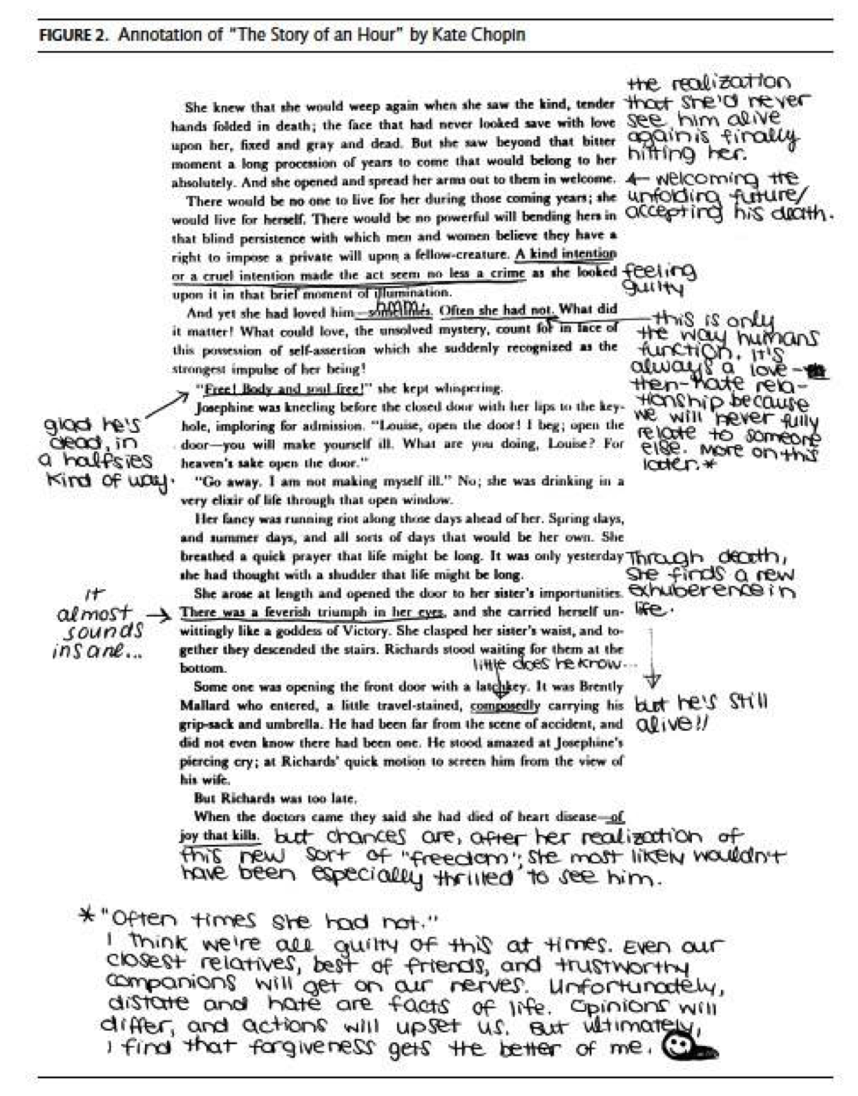
Annotating Articles

Slide 3
What is Annotation?
Making notes, comments or writing questions on a reading.
Way to make the most out of reading-- makes it easy to find important information quickly when you review/discuss.

Slide 4
What to do?
Every annotation has THREE elements:
Highlight or underline a section
Place a symbol
Write a sentence

Slide 5
The Symbols
Symbol | What this symbol represents | What to write in your annotation
+ | I agree with what the text/author says here! | Explain why you agree with the text/author.
- | I disagree with what the text/author says here! | Explain why you disagree with the text/author.
* | Important information, key ideas/concepts | Summarize or paraphrase the important information/ideas.
! | Information you find interesting, hard to believe, or surprising | Reflect/Explain what about the information was surprising/ interesting, etc.
? | Information you are confused about or doesn’t make sense | Compose a question to express what confuses you.
= | Information that reminds you of something you’ve read/ heard/ seen before. | Discuss the connection you are making between this information and previously read/heard/ seen information.
 | Put a circle around words you with which you are unfamiliar. | Look up the word and write a (brief) definition in the margin.

Slide 6
Instructions
Follow along as teacher reads story
Copy annotations shown

Slide 8
What next?
Finish the rest of the story with your own annotations.
Complete a minimum of 5 more annotations.

Slide 9
Think Pair Share
At the bottom of your paper answer the following.
What are the pros and cons of raising minimum wage?

Slide 10
Pros | Cons

Slide 11
Section 2-Assessment 1
13
Unemployment Skits
DIRECTIONS:
You will be working in groups of 4
Your group will draw a slip that has an unemployment type on it
Your group will create a skit that demonstrates the causes and effects of the type of unemployment you drew
Everyone in the group must participate in the creating of the skit, and the performance of the skit
After each skit, the rest of the class will discuss which form of unemployment the group just demonstrated

Slide 12
Section 2-Assessment 1
13
Unemployment Data Questions
What does it mean to be unemployed?
How is the unemployment rate actually underestimated?
Use the chart to answer the following. (The numbers are in thousands)
What is the difference in the labor force from 1942 – 2013 (3rd column “Total”)
What percentage of the labor force was unemployed in 2012? How many Americans?
Since 1942, what year had the highest unemployment rate? 2nd & 3rd highest?
How many years have there been over 10 million American unemployed?
In what years was the U.S. longest stretch of unemployment over 7%? Longest stretch over 8%?

