Slide 1
Friday November 21, 2014
Mr. Goblirsch – Economics
OBJECTIVE – Students Will Be Able To – SWBAT:
- Explain the functions of financial institutions and analyze the availability of easy credit.
AGENDA:
WARM-UP: Tax Day
CONCEPT: Banking Today
READING: Easy Credit
CLOSURE: Take a Side: Yes or No?
Tax Day WARM-UP: (Follow the directions below)
***5 minutes***
1) Take out your Weekly Time Sheet.
Calculate your tax deduction.
  STEP 1: Gross Pay (Total of Weekly Pay) X Tax % = Amount of Taxes
  STEP 2: Gross Pay (Total of Weekly Pay) – Amount of Taxes = Net Pay (Weekly Deposit)
Make your weekly deposit in your Account. (Have it stamped)

Slide 2

Banking
Today

Slide 3


Functions of Financial Systems
1) Storing money
2) Saving money
3) Loans
4) Mortgages
5) Credit cards

Slide 4
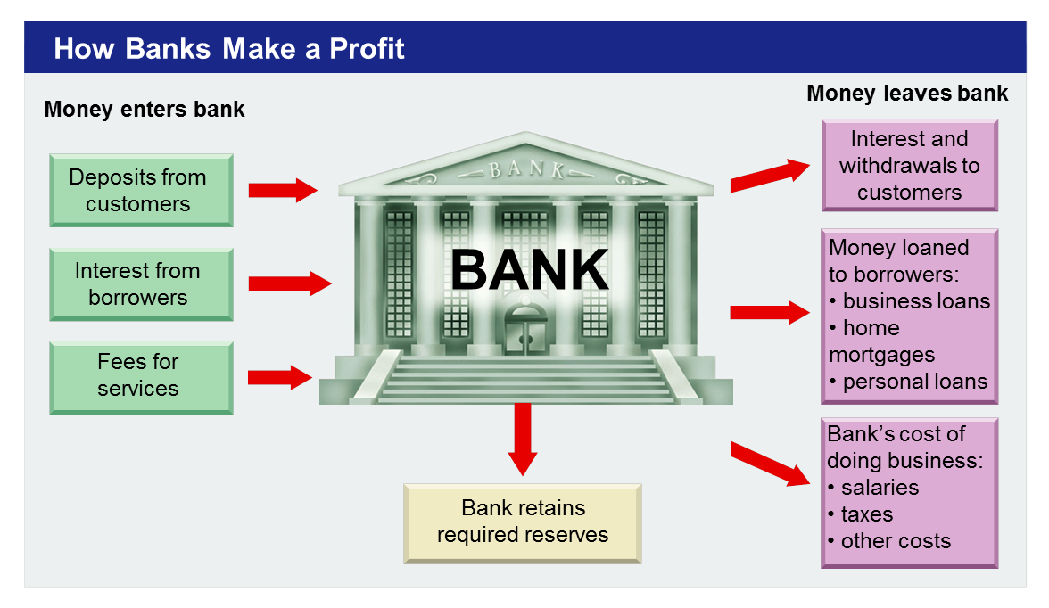

How Banks Make Money
Largest source of income = interest from loans
Interest - is the price paid for the use of borrowed money
  simple
    interest paid only on the principal (amount borrowed)
  compound
    interest paid on the principal and accumulated interest

Slide 5


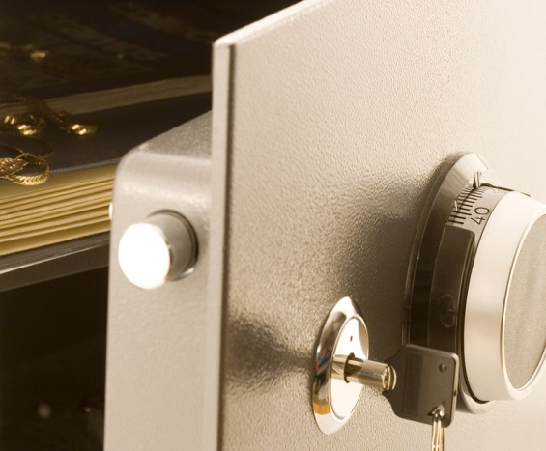
Types of Financial Institutions
Commercial Banks
Savings and Loan Associations
Savings Banks
Credit Unions
Finance Companies

Slide 6
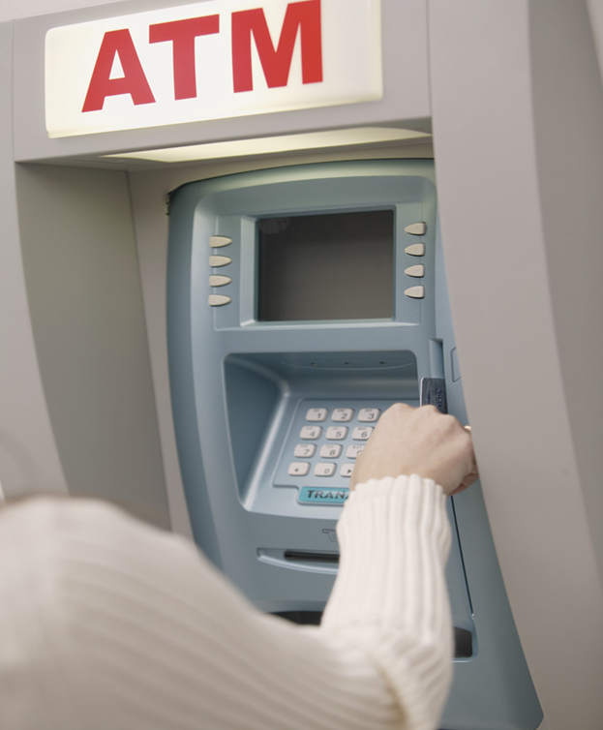
Electronic Banking
Automated Teller Machines (ATMs)
Debit Cards
Automatic Clearing Houses (ACH)
Home Banking

Slide 7
U.S. household consumer debt profile:
  Average credit card debt: $15,593
  Average mortgage debt: $153,184
  Average student loan debt: $32,511
In total, American consumers owe:
  $11.62 trillion in debt
    An increase of 3.4% from last year
  $880.3 billion in credit card debt
  $8.05 trillion in mortgages
  $1,122.7 billion in student loans
    An increase of 10.5% from last year

Slide 8

YES | NO
KEY POINTS / ARGUMENTS: 1. 2. 3. | KEY POINTS / ARGUMENTS: 1. 2. 3.
CLOSURE: These two arguments disagree on whether consumers can accurately judge the risks of borrowing money for online purchases or home improvements. Which argument do you agree with? Why?

Slide 9
Banking
Today

Slide 10


Money Supply
  1) M1 money—“liquid money”
    Easily converted to cash
    Cash, travelers checks, and checking (demand deposit) accounts
  2) M2 money
    everything in M1
    savings accounts
    money market mutual funds

Slide 11




Measuring the Money Supply
M1
M1 consists of assets that have liquidity, or the ability to be used as, or easily converted into, cash.
Components of M1 include all currency, traveler’s checks, and demand deposits.
Demand deposits are the money in checking accounts.
M2
M2 consists of all of the assets in M1, plus deposits in savings accounts and money market mutual funds.
A money market mutual fund is a fund that pools money from small investors to purchase government or corporate bonds.
The money supply is all the money available in the United States economy.

Slide 12
Functions of Financial Systems
1) Storing money
2) Saving money
  savings accounts
  checking accounts
  money market accounts
  certificates of deposit
3) Loans
  money for homes, businesses, cars, etc.
  banks earn interest
  risk of default
4) Mortgages ---
  loans used to buy real estate
5) Credit cards
  buying goods or services on the promise to pay the bank back
  these also give the bank interest

Slide 13
Banking Services
Banks perform many functions and offer a wide range of services to consumers.
Storing Money
Banks provide a safe, convenient place for people to store their money.
Credit Cards
Banks issue credit cards — cards entitling their holder to buy goods and services based on each holder's promise to pay.
Saving Money
Four of the most common options banks offer for saving money are:
1. Savings Accounts 2. Checking Accounts
3. Money Market Accounts 4. Certificates of Deposit (CDs)
Loans
By making loans, banks help new businesses get started, and they help established businesses grow.
Mortgages
A mortgage is a specific type of loan that is used to purchase real estate.

Slide 14
How Banks Make Money
The largest source of income for banks is the interest they receive from customers who have taken loans.
Interest is the price paid for the use of borrowed money.
Simple and compound interest
  simple
    interest paid only on the principal (amount borrowed)
  compound
    interest paid on the principal and accumulated interest

Slide 15
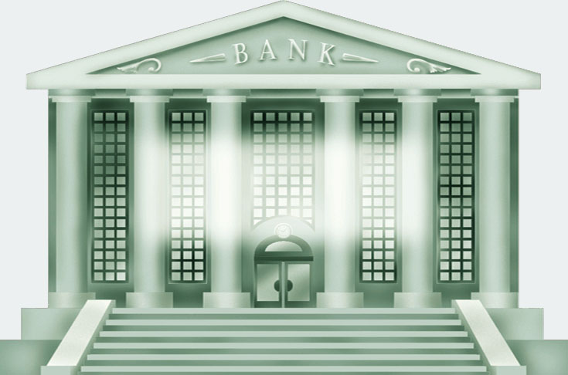
How Banks Make a Profit
The largest source of income for banks is the interest they receive from customers who have taken loans.
Interest is the price paid for the use of borrowed money.
How Banks Make a Profit
Money enters bank
Money leaves bank
Interest and withdrawals to customers
Deposits from customers
BANK
Money loaned to borrowers:
• business loans
• home mortgages
• personal loans
Interest from borrowers
Fees for services
Bank’s cost of doing business:
• salaries
• taxes
• other costs
Bank retains required reserves

Slide 16
Types of Financial Institutions
Commercial Banks
  Commercial banks offer checking services, accept deposits, and make loans. Bank of America, Wells Fargo
Savings and Loan Associations
  Savings and Loan Associations were originally chartered to lend money for home-building in the mid-1800s.
Savings Banks
  Savings banks traditionally served people who made smaller deposits and transactions than commercial banks wished to handle.
Credit Unions
  Credit unions are non profit cooperative lending associations for particular groups, usually employees of a specific firm or government agency. Mocse & Golden One
Finance Companies
  Finance companies make installment loans to consumers.

Slide 17
Types of Financial Institutions
Commercial Banks
  Commercial banks offer checking services, accept deposits, and make loans.
Savings and Loan Associations
  Savings and Loan Associations were originally chartered to lend money for home-building in the mid-1800s.
Savings Banks
  Savings banks traditionally served people who made smaller deposits and transactions than commercial banks wished to handle.
Credit Unions
  Credit unions are cooperative lending associations for particular groups, usually employees of a specific firm or government agency.
Finance Companies
  Finance companies make installment loans to consumers.

Slide 18
Electronic Banking
Automated Teller Machines (ATMs)
Customers can use ATMs to deposit money, withdraw cash, and obtain account information.
Debit Cards
Debit cards are used to withdraw money directly from a checking account.
Automatic Clearing Houses (ACH)
An ACH transfers funds automatically from customers' accounts to creditors' accounts.
Home Banking
Many banks allow customers to check account balances and make transfers and payments via computer.
Stored Value Cards
Stored value cards are embedded with magnetic strips or computer chips with account balance information.

Slide 19
Electronic Banking
The role of computers in banking has increased dramatically.
Automated Teller Machines (ATMs)
Customers can use ATMs to deposit money, withdraw cash, and obtain account information.
Debit Cards
Debit cards are used to withdraw money directly from a checking account.
Automatic Clearing Houses (ACH)
An ACH transfers funds automatically from customers' accounts to creditors' accounts.
Home Banking
Many banks allow customers to check account balances and make transfers and payments via computer.
Stored Value Cards
Stored value cards are embedded with magnetic strips or computer chips with account balance information.

