Slide 1
Friday November 21, 2014 Mr. Goblirsch – U.S. History
OBJECTIVE – Students Will Be Able To – SWBAT:
Analyze political cartoons showing the imperialist and anti-imperialist viewpoints.
AGENDA:
WARM-UP: Political Cartoon
CONCEPT: Philippine-American War
Analyzing Political Cartoons
CLOSURE: Imperialist vs. Anti-Imperialist
Political Cartoon WARM-UP: (Follow the directions below)
***5 Minutes***
Analyze the political cartoon on Pg. 351. Answer the questions below.
Define the term Monroe Doctrine using the glossary.
What was Uncle Sam riding? What is he riding now?
What is the cartoonist saying about American imperialism based on this cartoon?

Slide 2
CHAPTER 10 AMERICA CLAIMS AN EMPIRE

Slide 3
PRIOR KNOWLEDGE: Treaty of Paris
US Spain
Puerto Rico $20 million for Guam “sale of the Philippines Philippines”
CUBA Independence

Slide 4
FILIPINOS REBEL
Filipinos reacted with rage to the American annexation
Rebel leader Emilio Aguinaldo vowed to fight for freedom and in 1899 he led a rebellion
The 3-year war claimed 20,000 Filipino rebels, 4,000 American lives and $400,000,000 (20x the price the U.S. paid for the land)
U.S. troops fire on rebels

Slide 5
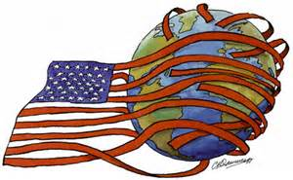
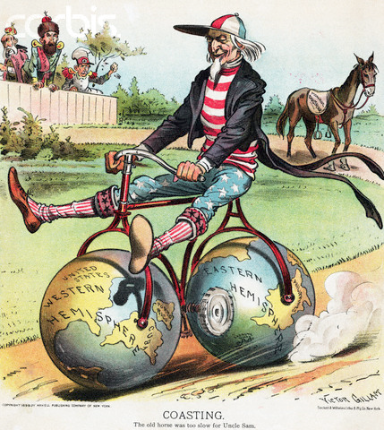
Anti-Imperialists
Protested new American acquisitions
“Hostile to liberty”
Violated “consent of the governed”
Formed Anti-Imperialist League after the Span-Am War

Slide 6
Philippine – American War
Political Cartoons

Slide 7
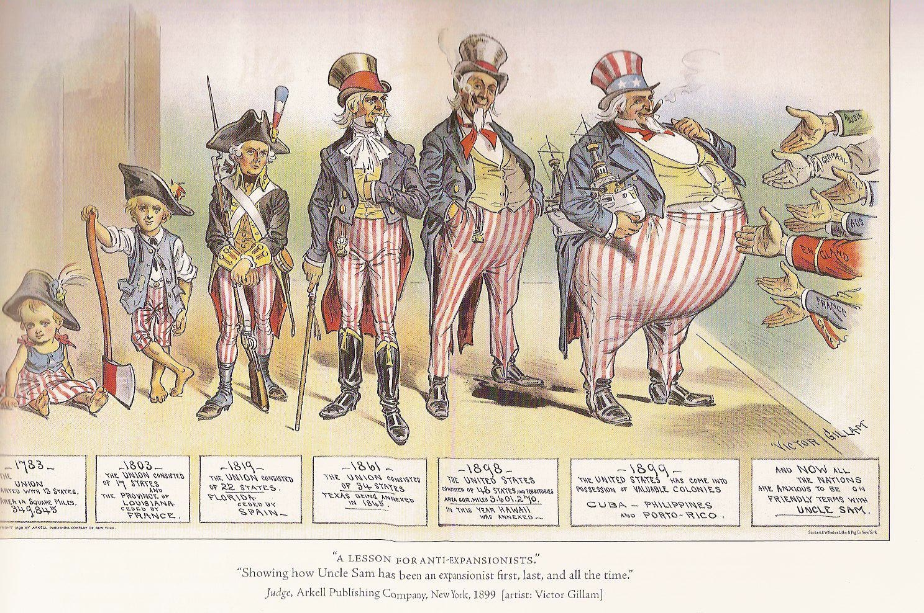
Set A: Cartoon 1 Judge, 1899

Slide 8
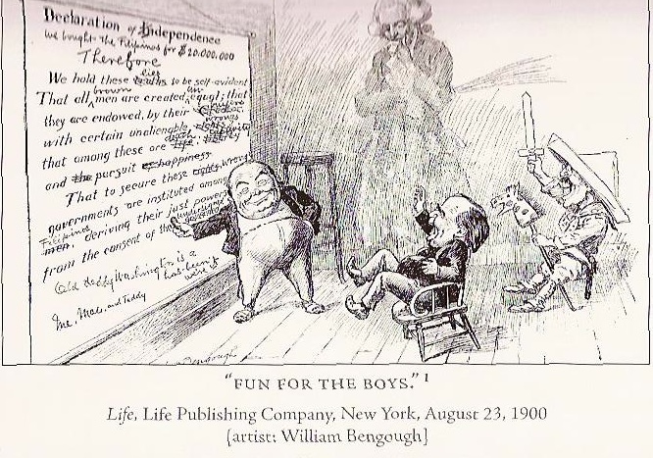
Set A: Cartoon 2 Life, 1900

Slide 9
Set B: Cartoon 1 Judge, 1899

Slide 10
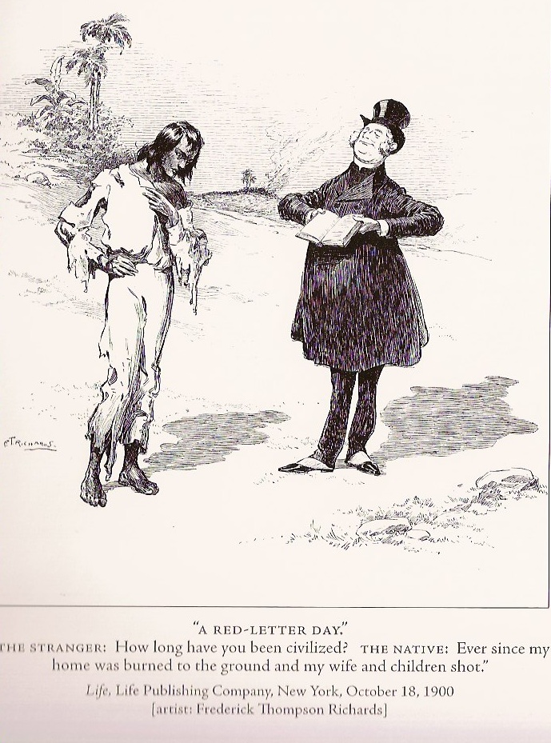
Set B: Cartoon 2 Life, 1900

Slide 11
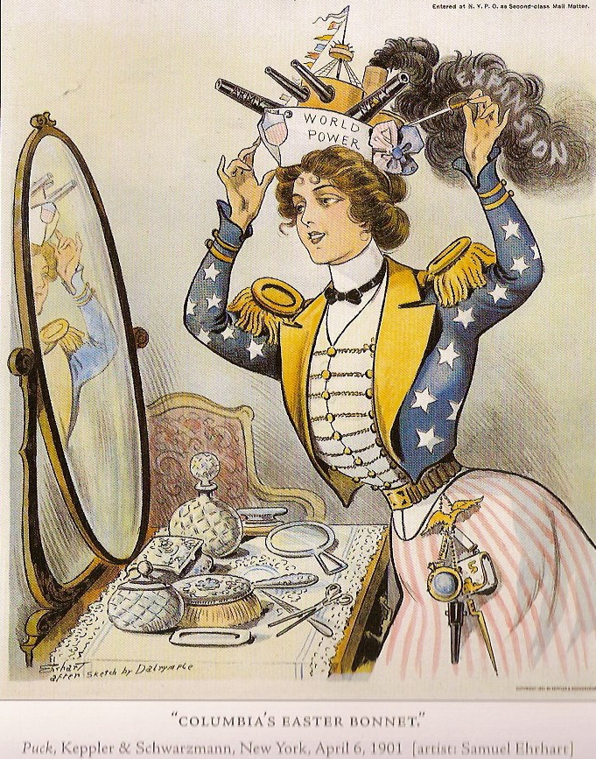
Set C: Cartoon 1 Puck, 1901

Slide 12
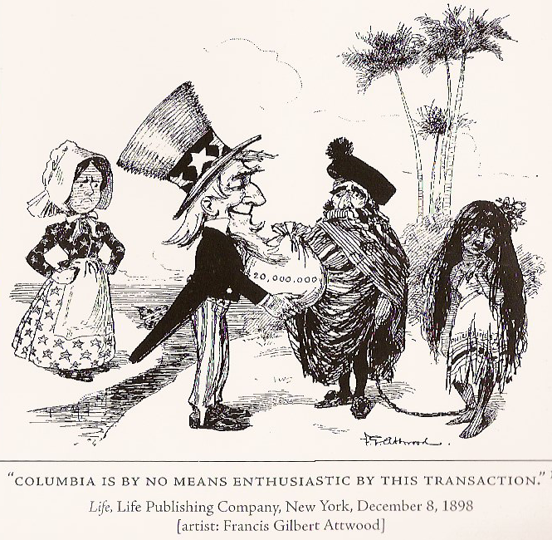
Set C: Cartoon 2 Life, 1898

Slide 13
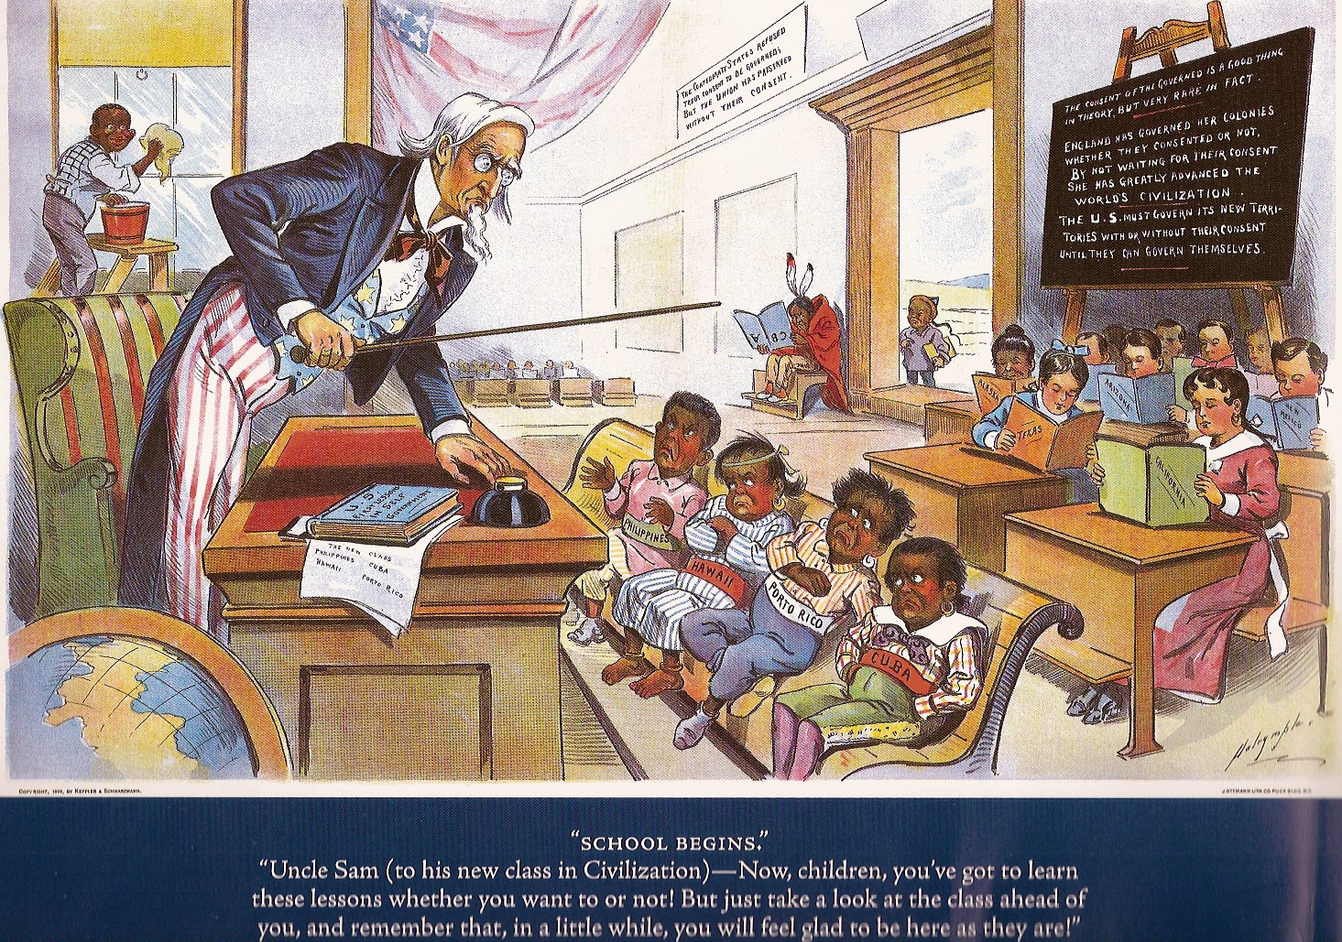
Set D: Cartoon 1 Puck, 1899

Slide 14
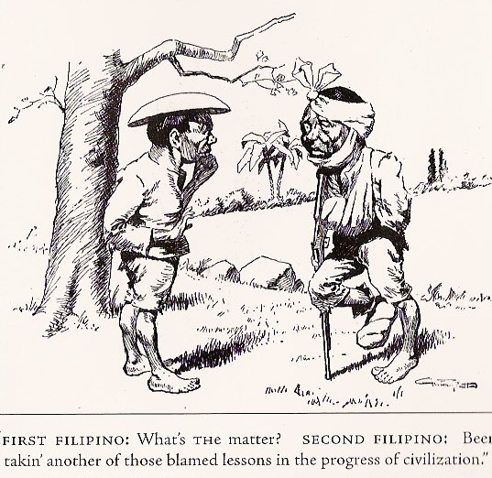
Set D: Cartoon 2 Life, 1899

Slide 15
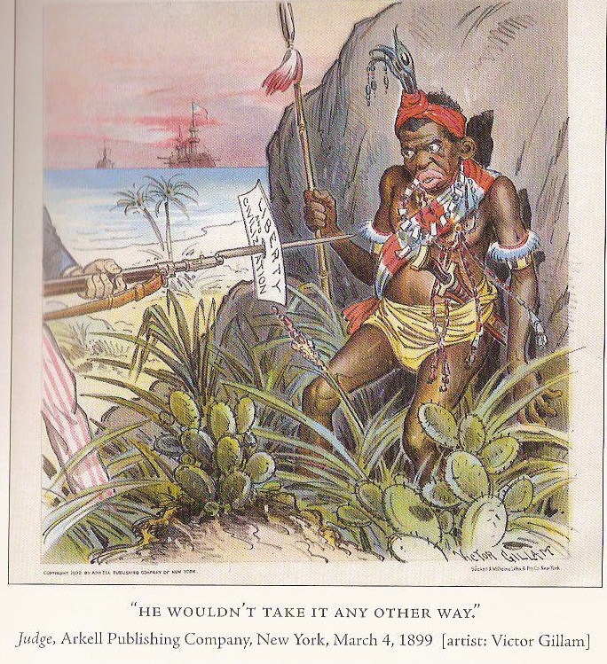
Set E: Cartoon 1 Judge, 1899

Slide 16
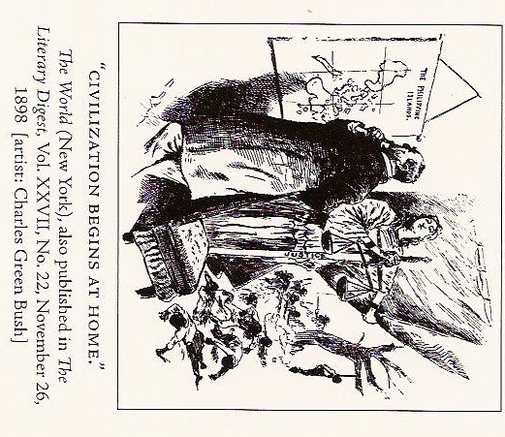
Set E: Cartoon 2 The World, 1898

Slide 17
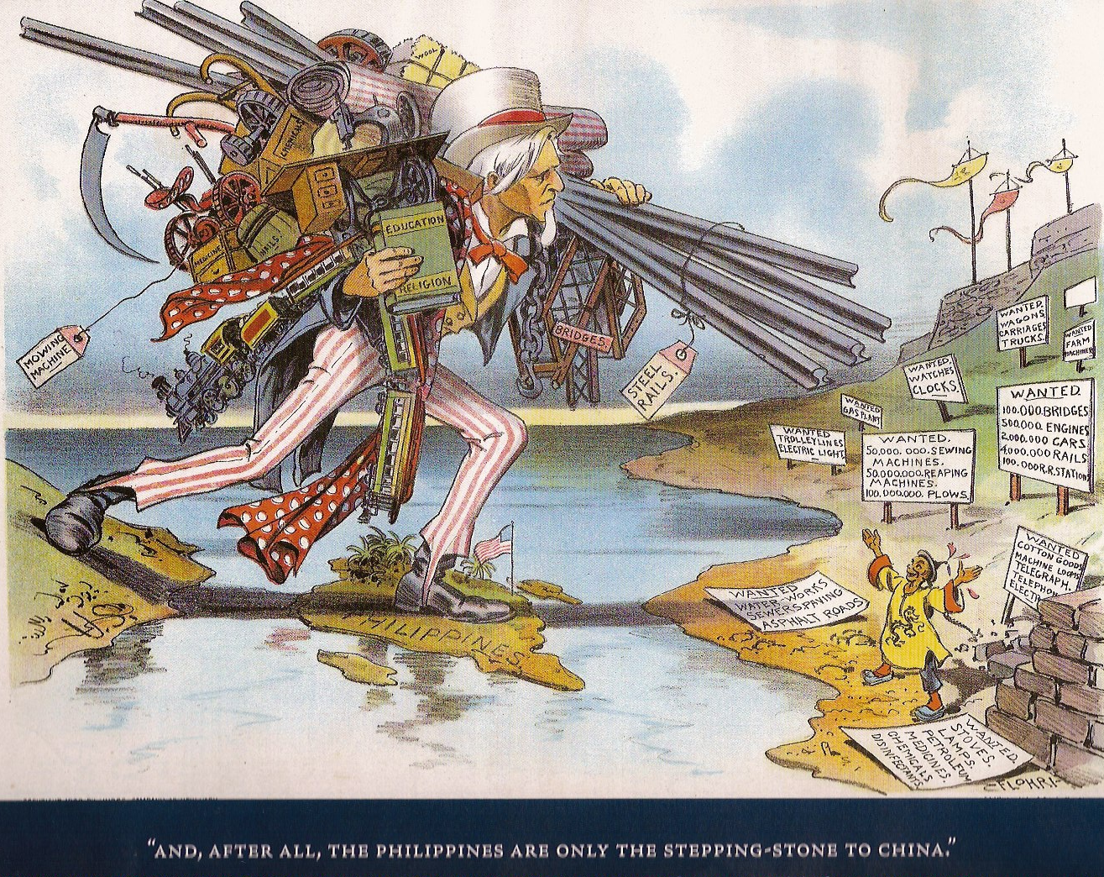
Set F: Cartoon 1 Judge, 1900

Slide 18
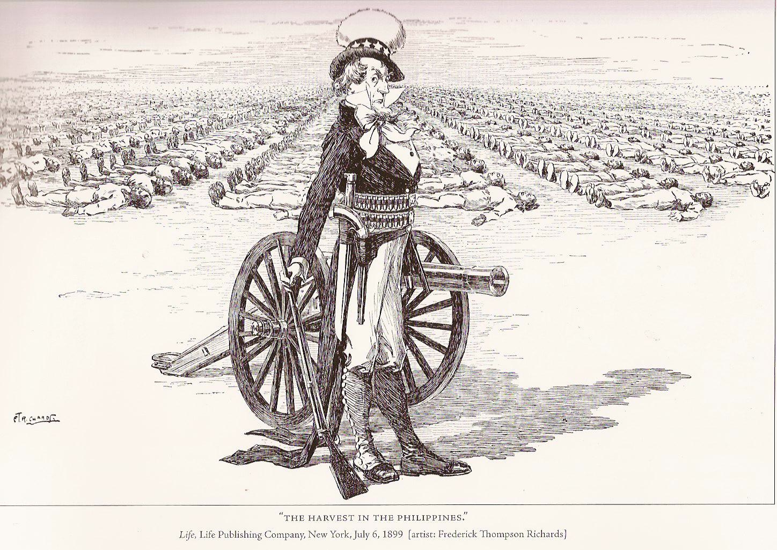
Set F: Cartoon 2 Life, 1899

Slide 19
CLOSURE: Imperialist vs. Anti-Imperialist
The difference between an Imperialist and an Anti-Imperialist is …
During this time, I think I would have been an ___________ because …

