Slide 1
Wednesday August 20, 2014 Mr. Goblirsch – Economics
OBJECTIVE – Students Will Be Able To – SWBAT:
- Identify the Factors of Production and explain why economists analyze the Production Possibilities Curve.
AGENDA:
WARM-UP: Opportunity Cost Journal
INSTRUCTION: Factors of Production & Production Possibilities
GUIDED PRACTICE: Interpreting Production Possibilities Curves
CLOSURE: Connecting Exit Ticket
***HW: Class Syllabus Signature DUE TODAY 8/20
**Workbook P. 18 DUE FRIDAY
Opportunity Cost Journal WARM-UP: (Follow the directions below)
***5 minutes***
Yesterday we talked about trade-offs and opportunity costs. Think about a service the government provides to its citizens. Identify some of the opportunity costs of providing that service.
(EXAMPLES of Government Services – Police/Fire, Public Education, Social Security, Military, Public Roads, Postal Service, etc.)

Slide 2
Section 1-4
Did You Know?
We witness scarcity with each year’s “hot” new toy. Inspired by hunter President Teddy Roosevelt, Americans coveted the teddy bear in 1906. Cabbage Patch dolls were big during the 1980s, as were Tickle Me Elmos in 1996. By 1999 Game Boy’s Pokémon was the rage with a 10-cent trading card. The most-prized first-edition pocket monsters were in such short supply that they commanded from $8 to $182.
Can you think of a “hot” item from recent years?

Slide 3
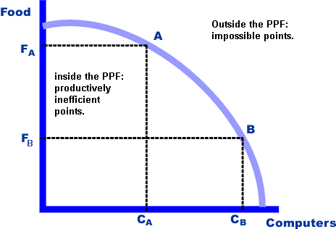
CHAPTER 1 Section 3: The Factors of Production & the Production Possibility Curve

Slide 4
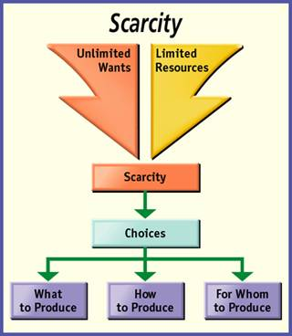
Section 1-9
Three Basic Questions
1) What must we produce? Society must choose based on its need. 
How should we produce it? Society must choose based on its resources. 
For whom should we produce? Society must choose based on its population and other available markets.

Slide 5
STRUCTURED ACADEMIC DISCUSSION
The 3 basic economic questions are …
Societies must answer these 3 basic economic questions because …

Slide 6
Section 1-14
The Factors of Production

Slide 7
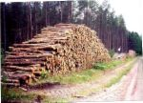
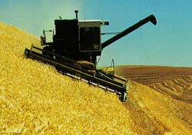
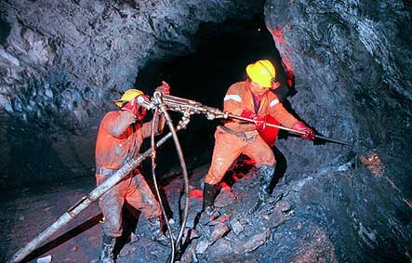
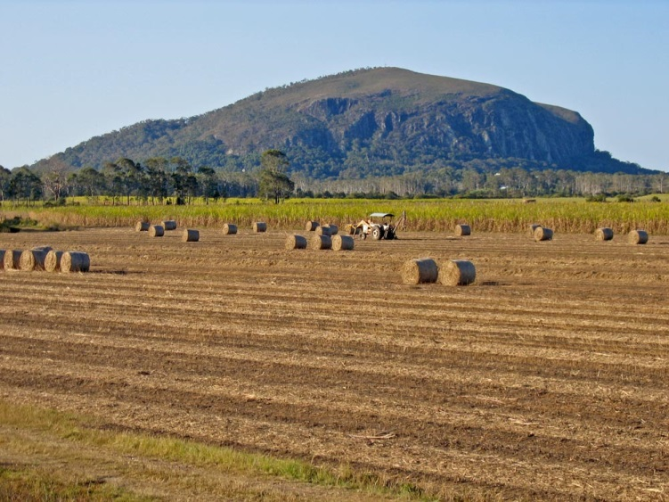
Land: All natural resources used to produce G & S

Slide 8
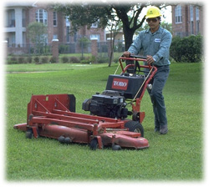
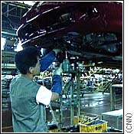
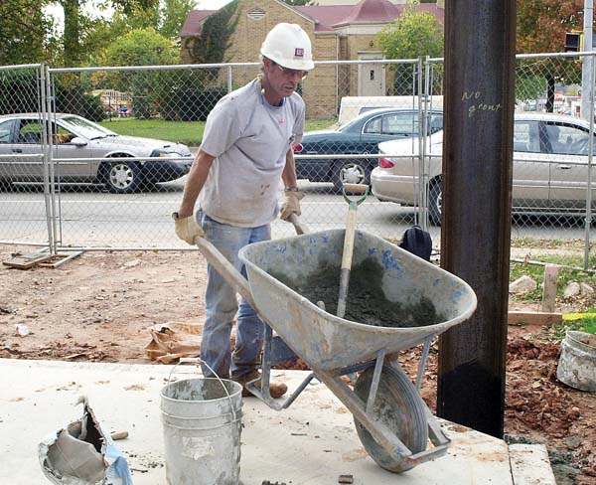
Labor: The human effort that a person devotes to a task that a person is paid.

Slide 9
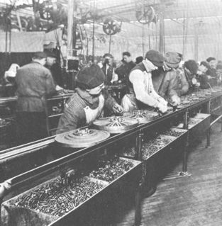
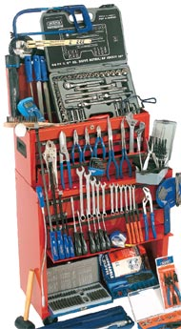
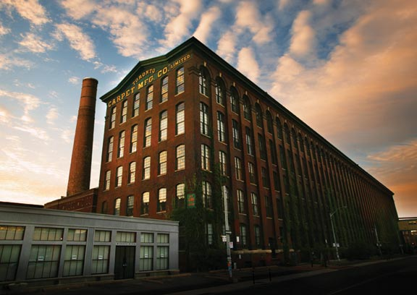
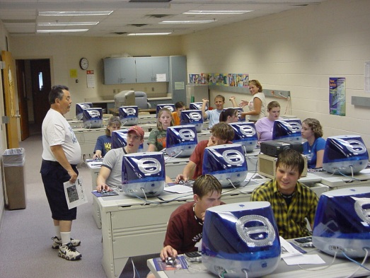
Capital: Human-made resources used to produce other G & S
Physical Capital: the tools/ equipment used to make other things
Human Capital: The knowledge and skills of workers

Slide 10
STRUCTURED ACADEMIC DISCUSSION
A) The 4 factors of production are …
B) The difference between Physical capital and Human capital is …
A) People invest time and money into their own human capital because …
B) Businesses invest time and money into their workers’ human capital because …

Slide 11
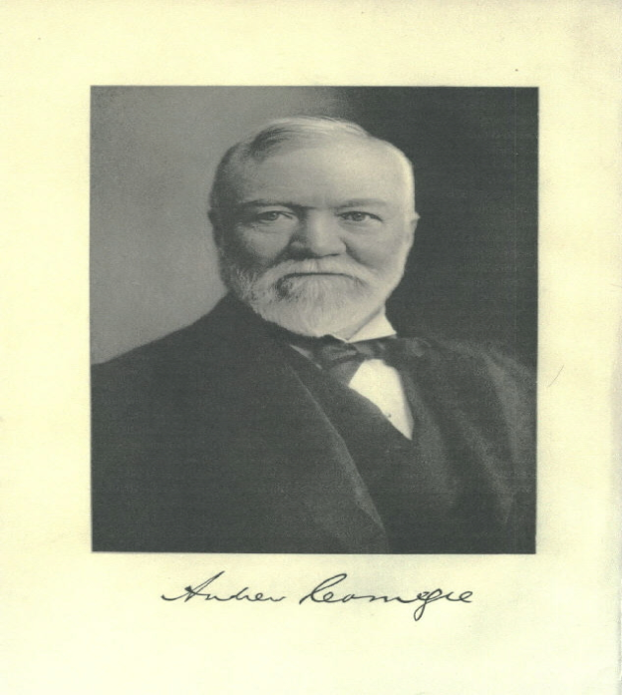
The Entrepreneur: Put together the land capital and labor to create a business

Slide 12
STRUCTURED ACADEMIC DISCUSSION
Entrepreneurs are important to a society because …

Slide 13
Why we use the Production Possibility Curve
Efficiency: the curve will show us how well we are using our resources (Factors of Production).
Growth: The curve allows us to see if we are at maximum efficiency
Costs: allows us to see the opportunity cost of allocating our resources in the economy

Slide 14
The Production Possibilities Curve

Slide 15
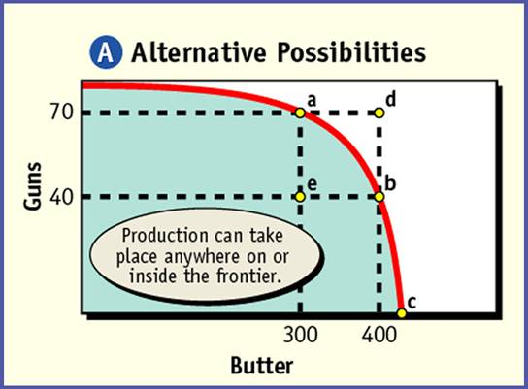
Section 3-10
Production Possibilities
Efficiency – How well are we using
our resources?
“Guns” = Military
Goods
Figure 1.6 The Production
Possibilities Frontier
“Butter” =
Consumer Goods

Slide 16
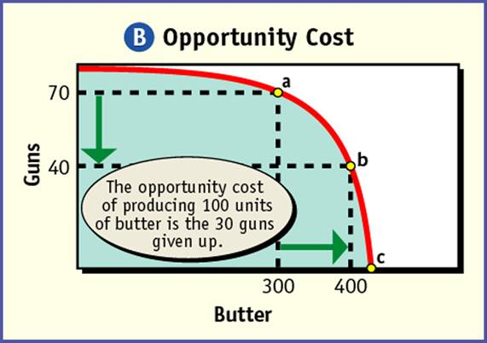
Section 3-10
Production Possibilities
Opportunity Cost – What’s given up?
Figure 1.6 The Production Possibilities Frontier
“Guns” = Military
Goods
“Butter” =
Consumer Goods

Slide 17
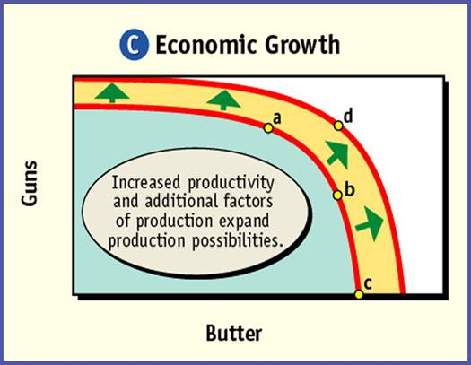
Section 3-17
Production Possibilities
Growth – always the goal
Figure 1.6 The Production Possibilities Frontier
“Guns” = Military
Goods
“Butter” =
Consumer Goods

Slide 18
CONNECTING EXIT TICKET
Connecting Yesterday to Today:
Explain the relationship between trade-offs and opportunity cost with the Production Possibilities Curve.

