Slide 1
Monday November 24, 2014
Mr. Goblirsch – Economics
OBJECTIVE – Students Will Be Able To – SWBAT:
- Explain the structure and function of The Federal Reserve System.
AGENDA:
WARM-UP: Fed Vocab
CONCEPT: The Fed
VIDEO: The Great Depression (12 min)
ASSIGNMENT: Workbook Pg. 68 – The Fed Functions
Fed Vocab WARM-UP: (Follow the directions below)
***5 minutes***
Define the terms below using the glossary of your textbook.
Fractional reserve banking
Monetary policy

Slide 2
The Fed
Chapter 16

Slide 3
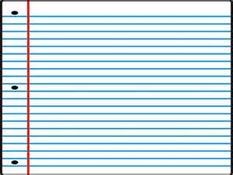
Federal Reserve System (the Fed), created Dec 23, 1913. Central Bank of the USA
  Responsibilities:
    Bank of U.S.
    Bank Regulations
    Services to national banks
    Conducts monetary policy (regulates money supply)
    ***Influences money supply with monetary policy: Fed has nothing to do with taxes***

Slide 4
The Journey of a Check
After you write a check, the recipient presents it at his or her bank.
The Path of a Check
Check writer
Recipient
The check is then sent to a Federal Reserve Bank.
The reserve bank collects the necessary funds from your bank and transfers them to the recipient’s bank.
Check writer’s bank
Your processed check is returned to you by your bank.
Federal Reserve Bank

Slide 5
STRUCTURED
ACADEMIC DISCUSSION
The Fed uses monetary policy to …
The journey of a check is …

Slide 6
Structure
  7-member Board of Governors, established 1935
    Appointed by the president
    Approved by the Senate
    Serve 14-year terms

Slide 7
Federal Reserve District Banks:
  12 Federal Reserve District Banks
  25 additional branch banks
  The Fed accepts deposits & makes loans to banks much like people interact with a bank
Federal Open Market Committee (FOMC)
  Make decisions about the money supply, cost & availability of credit
    12 voting members meet 8 times a year in Wash. D.C. to make decisions on credit

Slide 8
The Pyramid Structure of the Federal Reserve
About 40 percent of all United States banks belong to the Federal Reserve. These members hold about 75 percent of all bank deposits in the United States.
Structure of the Federal Reserve System
Board of Governors
Federal Open Market Committee
12 District Reserve Banks
4,000 member banks and 25,000 other depository institutions

Slide 9
STRUCTURED
ACADEMIC DISCUSSION
The Fed consists of …
The FOMC …

Slide 10
Monetary Policy
  Fractional Reserve System
  Legal Reserves
    % of each deposit set aside at the Fed = reserve requirement (10%)
    what is left = excess reserves can be loaned.
    Deposits can “create” money through the multiplier effect: Some loaned, spent, re-deposited

Slide 11
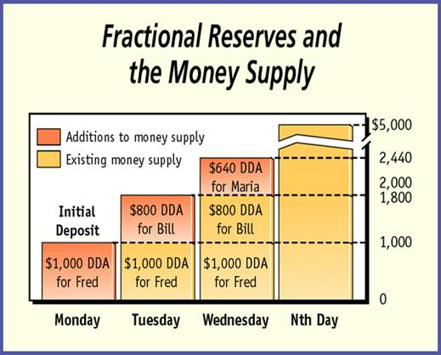
Section 2-22
Fractional Reserves Multiplier Effect
Total Reserves / Reserve Requirement = Money Supply
Example Below shows a 20% reserve requirement

