Slide 1
Monday December 1, 2014
Mr. Goblirsch – Economics
OBJECTIVE – Students Will Be Able To – SWBAT:
- Explain the 3 tools of the Fed in conducting monetary policy.
AGENDA:
WARM-UP: Monetary Policy Vocab
CONCEPT: The Fed Part II – Monetary Policy
VIDEO: Money Supply – Macro Review (3 min)
READING: The Fed Fights Inflation
Monetary Policy Vocab WARM-UP: (Follow the directions below)
***5 minutes***
Define the terms below using the glossary of your textbook.
Required reserve ratio (RRR) 3) Prime rate
Money multiplier formula 4) Open Market operations

Slide 2
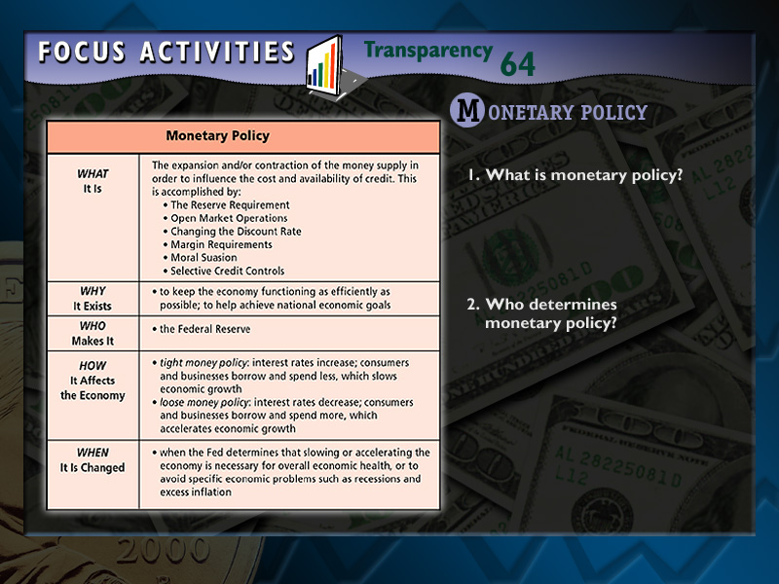
Focus Activity 2.1

Slide 3
The Fed
PARt II –
Monetary Policy
Chapter 16

Slide 4
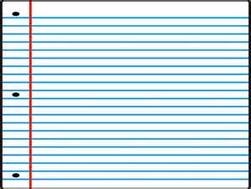
Easy Money Policy: Money supply grows = interest rates fall. Hope to stimulate the economy b/c w/ low interest rates people will buy more on credit
  REASONS:
    GDP is falling
    unemployment up
    economic recession is on
    = easy money policy
Tight Money Policy: Money supply declines = interest rate up
  REASONS:
    Rising inflation
    low unemployment
    economic expansion

Slide 5
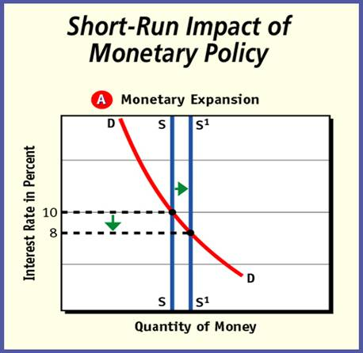
Section 3-6
Short-Run Impact (cont.)
Figure 15.7a

Slide 6
Section 3-7
Short-Run Impact (cont.)

Slide 7
IMPACTS
Short-Run:
  Availability of credit; Interest rate
Long-Run:
  INFLATION: changes in supply of money affect the general level of prices = QUANTITY THEORY OF MONEY

Slide 8


Section 3-Assessment 1
Structured Academic Discussion
How do changes in the money supply affect interest rates?
When the Fed expands the money supply, banks have plenty of money to lend and have to lower interest rates in order to lend all of the money in circulation. When the Fed contracts the money supply, banks have to ration the money they have, which is done by raising interest rates.

Slide 9
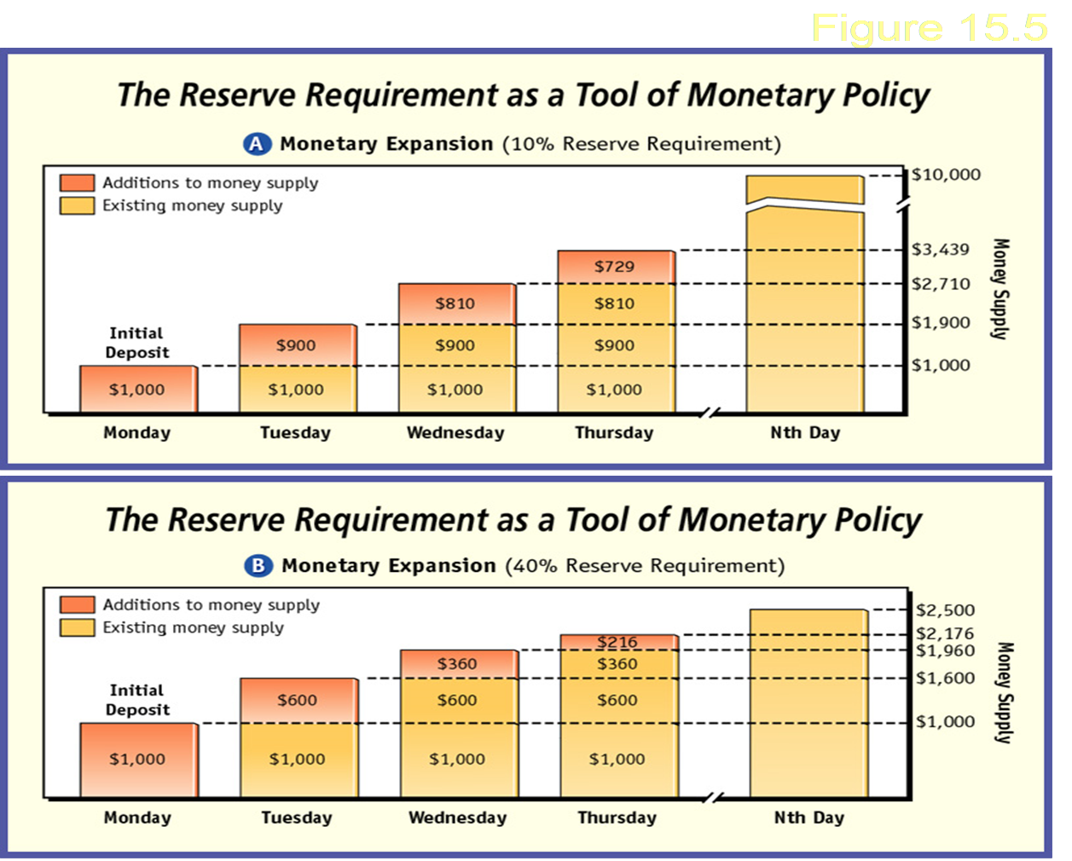
3 Tools of Monetary Policy
  Reserve Requirement:
  Lower reserve requirement = more money to loan out; Higher reserve requirement = less money to loan out

Slide 10
  Open Market Operations:
  Buy & selling of government securities (bonds) in financial markets.
    EXP:
    Fed wants to increase the money supply - BUY bonds = Increased money supply
    Fed wants to contract the money supply - SELL bonds = Decrease money supply
  Discount Rate: Interest rates charged to banks for borrowing money from the Federal Reserve
  EXP) Raise the discount rate = lower money supply
  Lower the discount rate = increase money supply

Slide 11
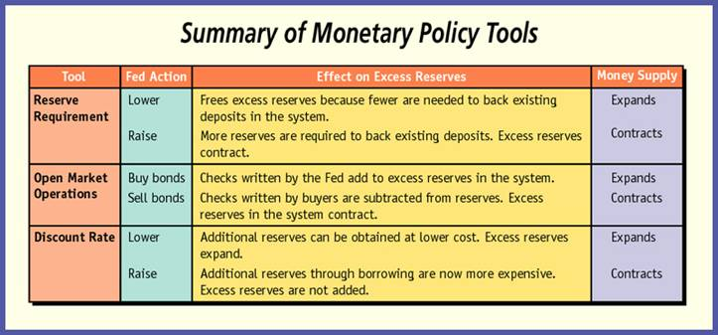
Section 2-35
Tools of Monetary Policy (cont.)
Figure 15.6

Slide 12
Section 3-Assessment 1
Structured Academic Discussion
If the economy was in a recession, what might the president want the Federal Reserve to do?
Increase the money supply in order to lower interest rates so that businesses would borrow money to expand.

Slide 13





Fiscal and Monetary Policy Tools
The federal government and the Federal Reserve both have tools to influence the nation’s economy.
Fiscal and Monetary Policy Tools
Fiscal policy tools
Monetary policy tools
1. open market operations: bond purchases
2. decreasing the discount rate
3. decreasing reserve requirements
Expansionary tools
1. increasing government spending
2. cutting taxes
1. open market operations: bond sales
2. increasing the discount rate
3. increasing reserve requirements
Contractionary tools
1. decreasing government spending
2. raising taxes

