Slide 1
Tuesday December 9, 2014 Mr. Goblirsch – Economics
OBJECTIVE – Students Will Be Able To – SWBAT:
- Simulate filing a Federal tax return and identify areas of federal, state, & local government spending.
AGENDA:
WARM-UP: Spending Vocab
Finish GUIDED PRACTICE: Filing a Tax Return
WORKBOOK ASSIGNMENT:
Federal, State, & Local Spending
***Earn up to 10 Points Extra Credit on the Economics Final for Econ Final Study Guide***
Spending Vocab WARM-UP: (Follow the directions below)
***5 minutes***
Define the terms below using the glossary of your textbook.
Mandatory spending
Discretionary spending
Entitlement

Slide 2
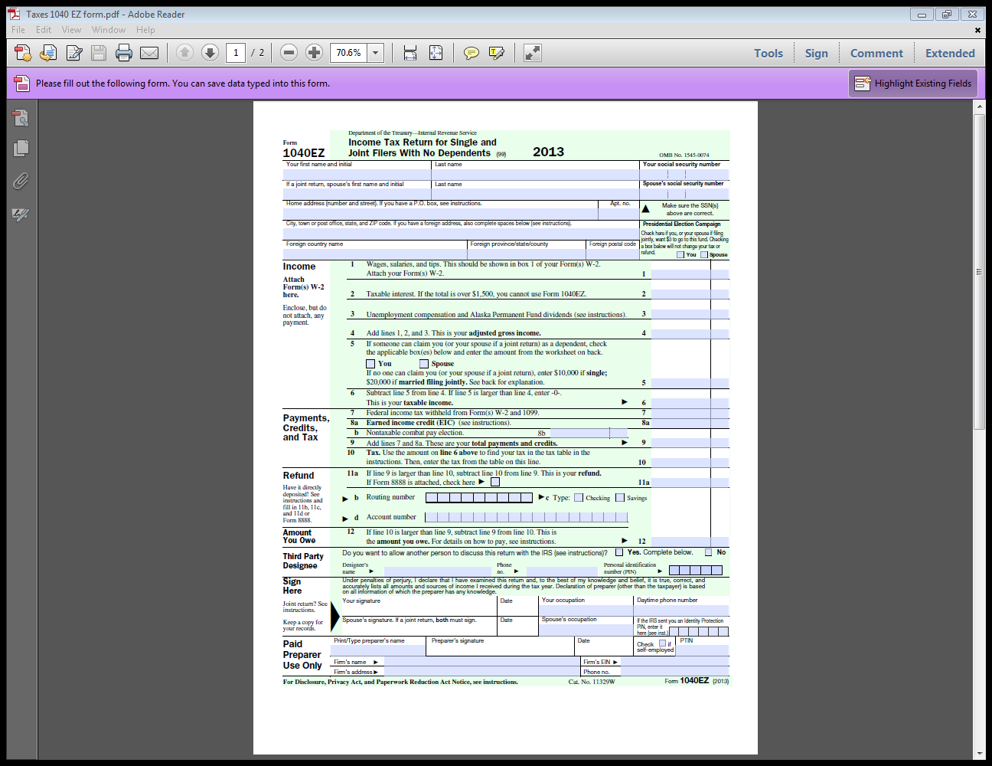

Slide 3
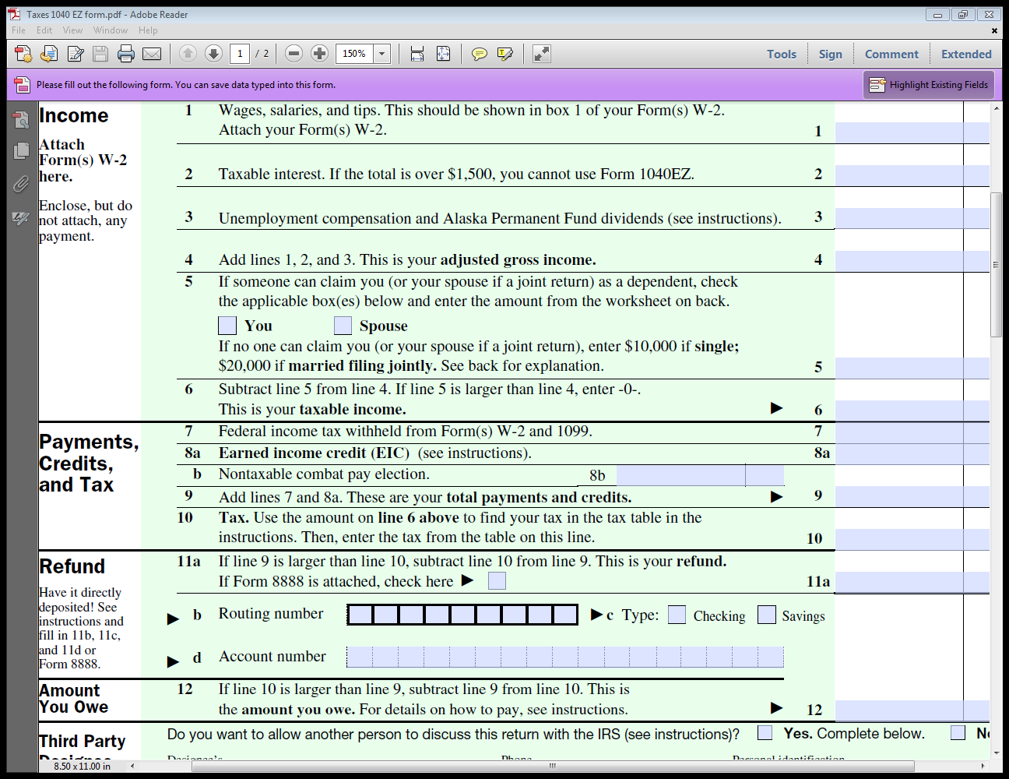

Slide 4
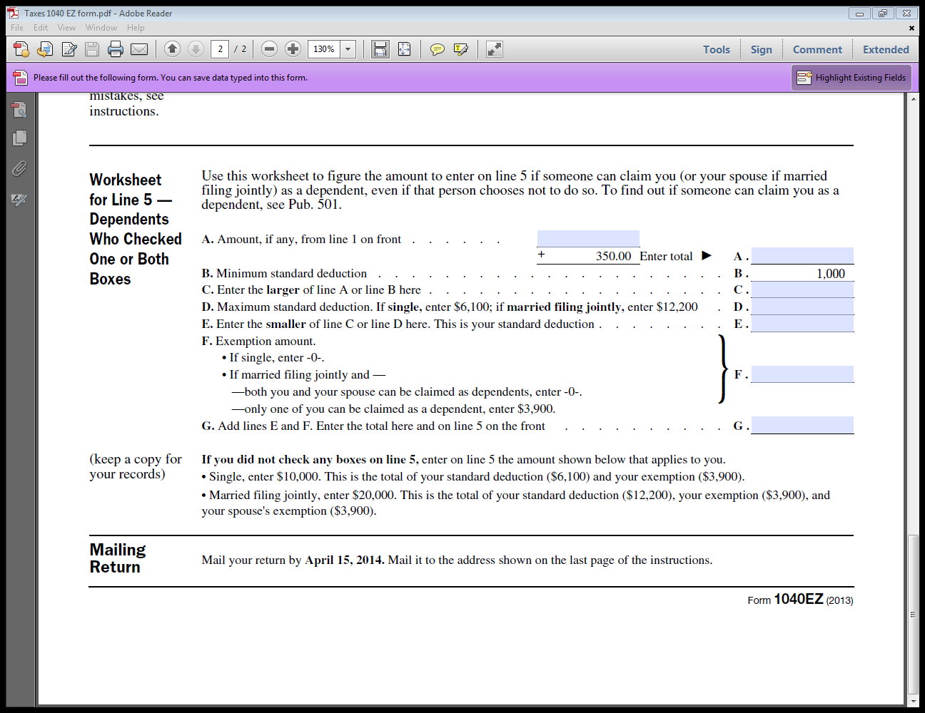

Slide 5
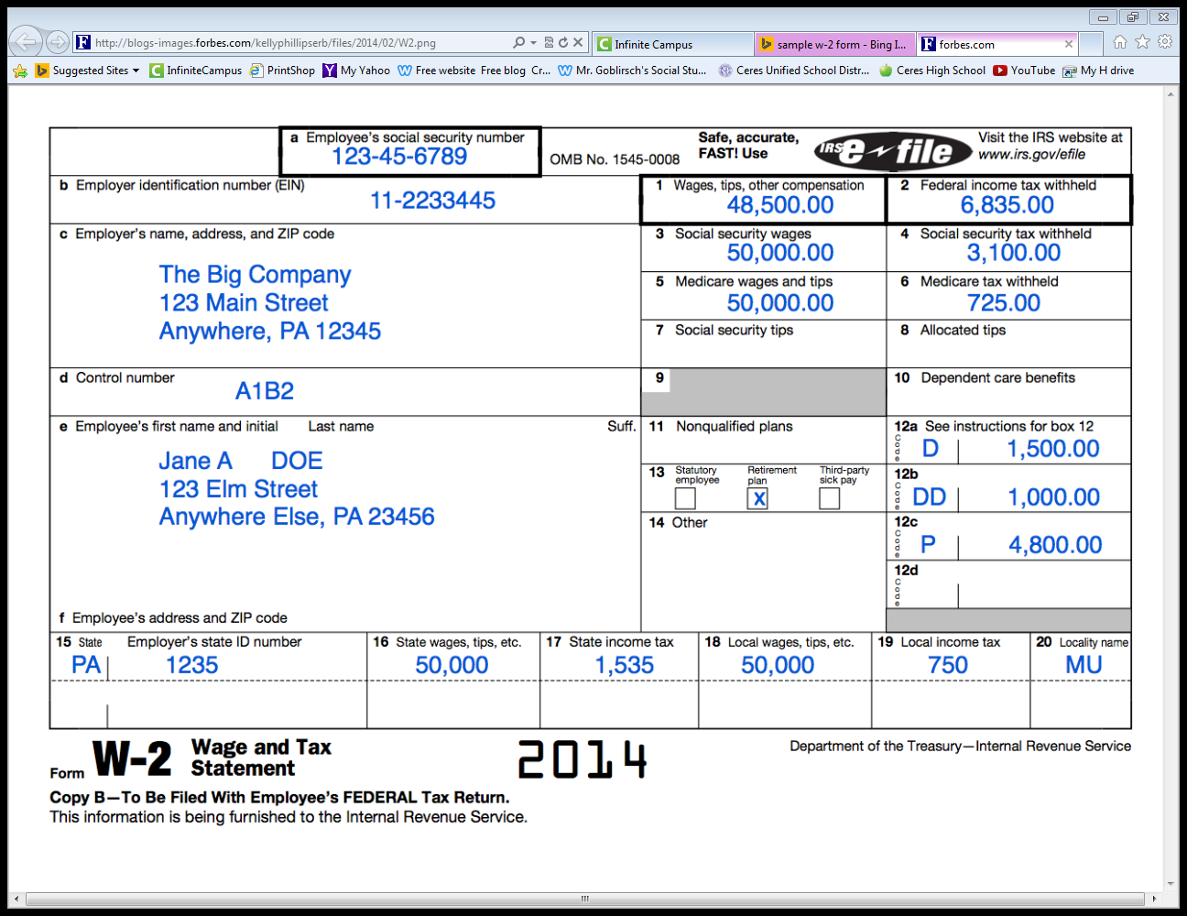

Slide 6
U.S. FEDERAL INCOME TAX RATES
Tax Rate | Single Taxable Income | Married Filing Jointly | Married Filing Separately Taxable Income | Head of Household Taxable Income
10% | $0 – $8,925 | $0 – $17,850 | $0 – $8,925 | $0 – $12,750
15% | $8,926 – $36,250 | $17,851 – $72,500 | $8,926 – $36,250 | $12,751 – $48,600
25% | $36,251 – $87,850 | $72,501 – $146,400 | $36,251 – $73,200 | $48,601 – $125,450
28% | $87,851 – $183,250 | $146,401 – $223,050 | $73,201 – $111,525 | $125,451 – $203,150
33% | $183,251 – $398,350 | $223,051 – $398,350 | $111,526 – $199,175 | $203,151 – $398,350
35% | $398,351 – $400,000 | $398,351 – $450,000 | $199,176 – $225,000 | $398,351 – $425,000
39.6% | $400,001+ | $450,001+ | $225,001+ | $425,001+
WATCH: Calculating Federal Taxes Video (YouTube – Khan Academy)

Slide 7
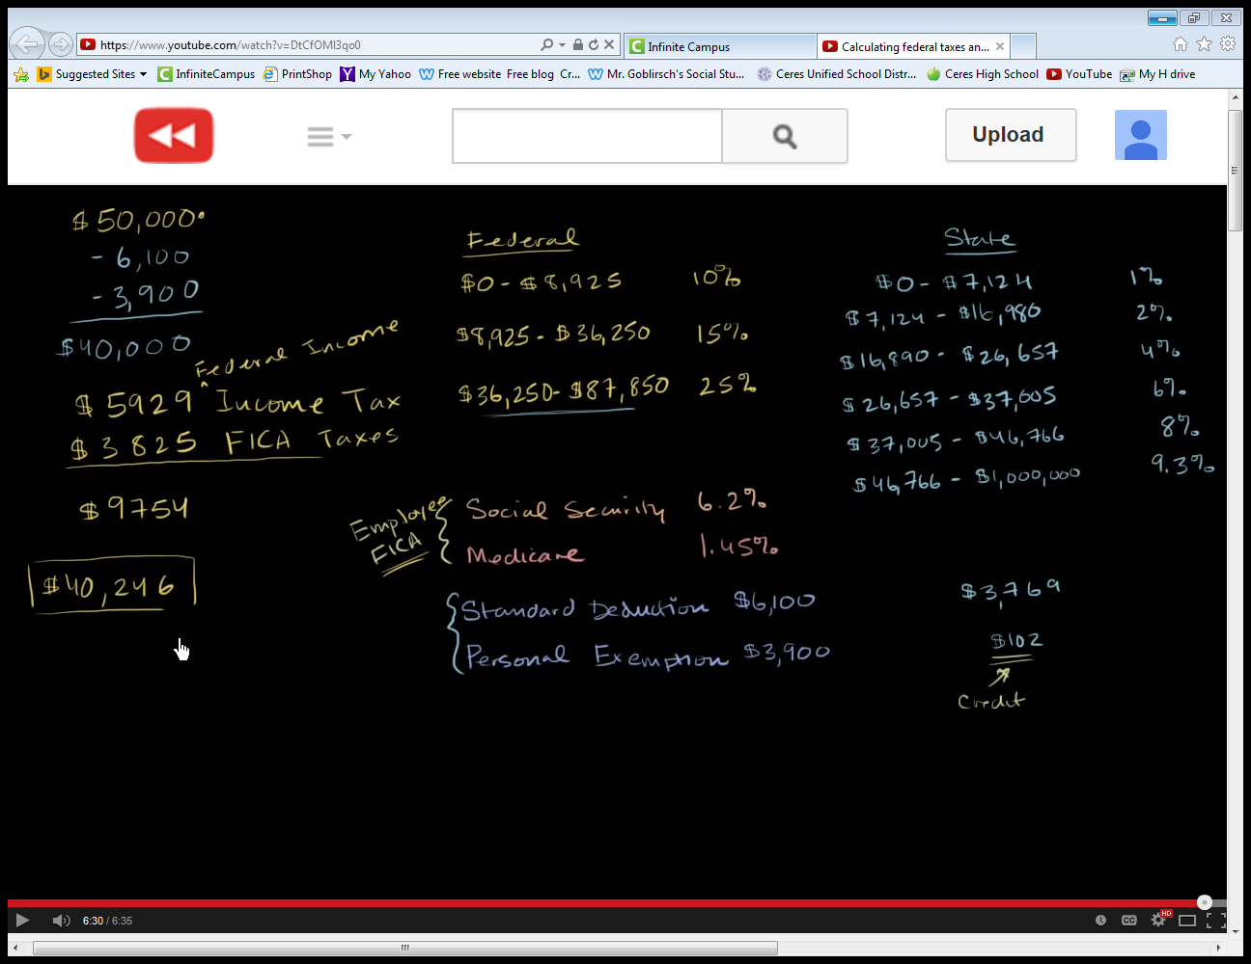

Slide 8
ASSIGNMENT: Government Spending
Federal Spending:
Complete Workbook Pg. 62 (part A only). Fill out the Federal Spending Web by providing examples in each category.
State & Local Spending:
Complete Workbook Pg. 63 (Left Column of part A only). Fill in the outline with examples of goods or services on which state & local taxes are spent on for each category.

Slide 9
SPENDING DISCUSSION
What areas does the government spend tax money?
What areas do you feel the government should spend less tax money?
What areas do you feel the government should spend more tax money?

