Slide 1
Wednesday January 14, 2015 Mr. Goblirsch – American Government
OBJECTIVE – Students Will Be Able To – SWBAT:
- Analyze the influence of landmark English documents on our rights as Americans.
AGENDA:
WARM-UP: Political Origins Vocab
CONCEPT: Influences on America
READING: Magna Carta (P. 33)
SKILL: Matching Our Rights
ASSIGNMENT: Workbook Pgs. 17 & 19 – DUE TOMORROW
***HW: 2 Political Surveys – DUE FRIDAY (actually 8:00 pm Sunday)***
Political Origins Vocab WARM-UP: (Follow the directions below)
***5 minutes***
Define the terms below using the glossary of your textbook.
Limited government 3. Unicameral
Representative government 4. Bicameral

Slide 2
Ch 2 Sec 1 TITLE: Influences on the American System
English Political Heritage
Limited Government. The Magna Carta (Great Charter), King John, 1215
First time power of king is limited, not absolute
Protects: Life, liberty, property. King to follow the law
Establishes Parliament (British legislature)
Petition of Right
King Charles I, 1625 dissolves Parliament
1628, Parliament forces king to sign Petition of Right
Can’t levy taxes without Parliament approval
No imprisonment w/o just cause, can’t enter home w/o approval…
English Bill of Rights
Glorious Revolution, 1688. Parliament puts William & Mary on throne
Monarchs sign Bill of Rights
Monarchs, no absolute authority
Parliament separate from monarch (established Parliament’s authority)
Right to petition, speedy/fair trial, jury trial
No cruel/unusual punishment, excessive bail/fines
Representative Government
England: Parliament, bicameral. House of Lords, House of Commons

Slide 3
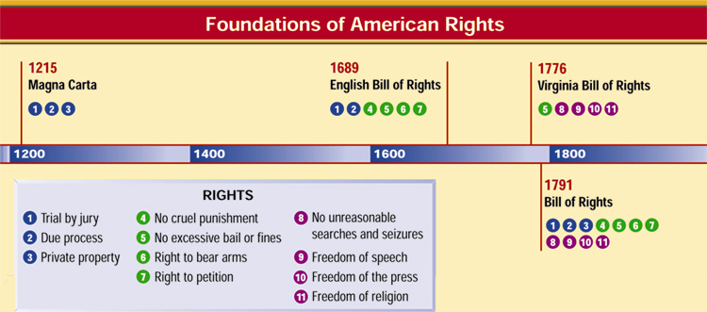
Important English Documents
The way our government works today can be traced to important documents in history:
2
3
4
5
Chapter 2, Section 1

Slide 4
Ch 2 Sec 1 TITLE: Influences on the American System
II. Government in the Colonies
Written Constitutions: Mayflower Compact (1620)
Virginia House of Burgesses (1619), first legislature in America
Puritans elect own church leaders → community leaders
Royal colonies
Governor & council appointed by King (upper house)
Property owners elect lower house (bicameral)

Slide 5
SKILL: Matching Our Rights
DIRECTIONS:
Analyze the timeline
With your partner, read through the U.S. Bill of Rights on P. 771-772.
*****(The First 10 Amendments to the Constitution are the Bill of Rights. For this lesson we will only be using Amendments 1-8.)
On the timeline worksheet, write the Amendment number that matches up to the right in each foundational document.
EXAMPLE:
6 – Right to bear arms
ANSWER: 2nd Amendment
“the right of the people to keep and bear Arms, shall not be infringed”

Slide 6
WORKBOOK ASSIGNMENT:
Complete Workbook Pg. 17 Part A only
Complete Workbook Pg. 19 Part A only
DUE THURSDAY

