Slide 1
Friday August 22, 2014 Mr. Goblirsch – Economics
OBJECTIVE – Students Will Be Able To – SWBAT:
- Identify fundamental concepts of economics and select stocks to follow during our class stock market simulation.
AGENDA:
WARM-UP: Tax Day
QUIZ: Chapter 1
INSTRUCTION: The Stock Market
ACTIVITY: Begin Selecting Stocks
***HW: Workbook P. 18 DUE TODAY***
Tax Day WARM-UP: (Follow the directions below)
***5 minutes***
Take out your Weekly Time Sheet.
Complete the tax form for this week’s pay check. (Check with your partner to make sure it’s accurate)
Make your weekly deposit in your Account. (I will be coming around to stamp your account forms)

Slide 2
Chapter 1 Quiz
SHORT ANSWER
DIRECTIONS: Answer the following question in a complete paragraph.
Using examples of land, labor, and capital, explain why economists believe that all goods and services are scarce.

Slide 3
What is Stock?
Stock represents partial ownership in the corporation.
A piece of stock is called a share.
Stocks are also called equities.
Corporations can raise money by issuing/selling stock.

Slide 4
The Stock Market
Why to Buy Stock?
Benefits of buying stock
Dividends — portions of companies profits paid to shareholders ($ .58 Div. / share)
capital gains — selling a stock at a higher price than you bought it for (capital losses can occur as well)
Bought at $35.00 / share
Sold at $40.00 / share
Gain of $5.00 / share

Slide 5
Risks of Buying Stock
capital losses
If the Sale price drops below the purchase price
Buy at $25.00 and Sell at $20.00 = loss $5.00
stockholders get dividends only if money is available
If the company profits they share some
Company earns $5 million in profits. $.53 per share

Slide 6
Measuring Stock Performance
Bull and Bear markets
bull market—stock prices rise steadily over time
bear market—stock prices decline over time
Dow Jones Industrial Average (the Dow)
the closing prices of 30 selected stocks
Standard and Poor’s 500
the closing prices of 500 selected stocks

Slide 7
General Electric CO. (GE) 1907 – Conglomorate

Slide 8
Exxon Mobil 1928 – Oil & gas

Slide 9
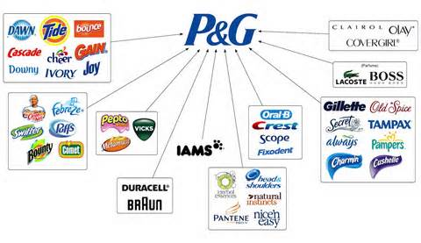
Proctor and Gamble 1932 – Consumer goods

Slide 10
DuPont 1935 – Chemical industry

Slide 11
United Technologies Corp 1939 - Conglomorate

Slide 12
3M Company 1976 - Conglomorate

Slide 13
International Business Machines (IBM) 1979 – Computers & Technology

Slide 14
Merck and Co. Inc. 1979 - Pharmaceuticals

Slide 15
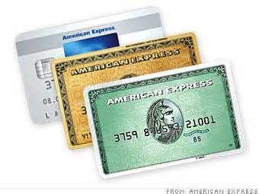
American Express Co. 1982 – Consumer Finance

Slide 16
McDonalds Corp 1985 – Fast food

Slide 17
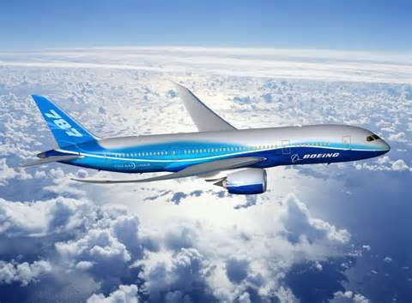
Boeing Co. 1987 – Aerospace and defense

Slide 18
Coca Cola 1987 Beverages

Slide 19
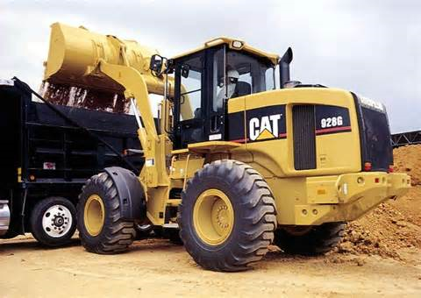
Caterpillar INC 1991 – Construction & Mining Equipment

Slide 20
JP Morgan and Chase 1991 - Banking

Slide 21
Walt Disney Co. 1991 Broadcasting & Entertainment

Slide 22
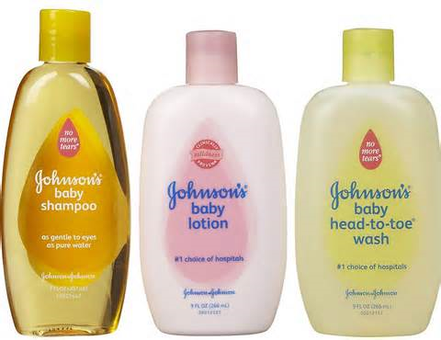
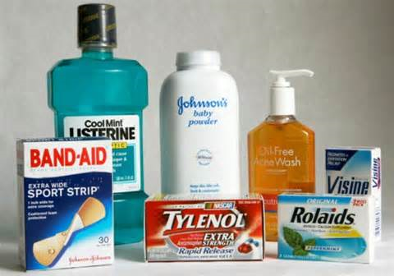
Johnson and Johnson 1997 - Pharmeceuticals

Slide 23
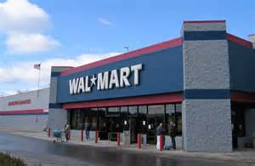
Wal-Mart 1997 - Retail

Slide 24
At&T 1999 - Telecommunications

Slide 25
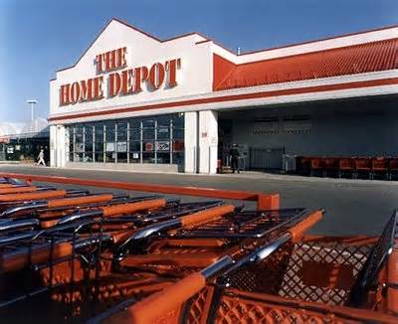
Home Depot Inc 1999 – Home Improvement retailer

Slide 26
Intel Corp. 1999 - Semiconductors

Slide 27
Microsoft Corp 1999 - software

Slide 28
Pfizer Inc. 2004 - Pharmaceuticals

Slide 29
Verizon Communications 2004 - Telecommunications

Slide 30
Chevron Corp. 2008 – Oil & Gas

Slide 31
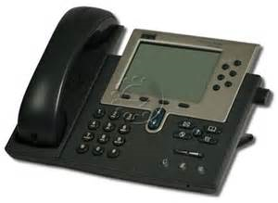
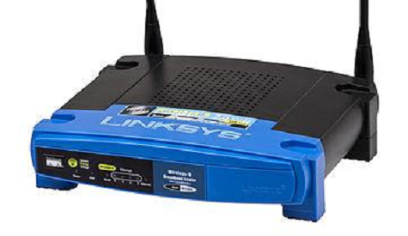
Cisco Systems Inc. 2009 Computer Networking

Slide 32
Traveler’s Co. Inc 2009 - INSURANCE

Slide 33
United Health group 2012 – Managed Health care

Slide 34
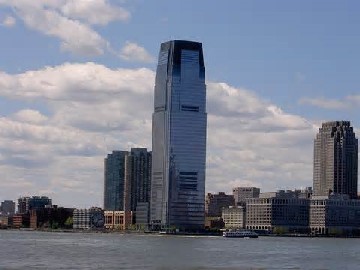
Goldman sachs 2013 – Banking, Financial services

Slide 35
NIKE 2013 - Apparel

Slide 36
Visa 2013 – Consumer banking

