Slide 1
Thursday January 15, 2015 Mr. Goblirsch – American Government
OBJECTIVE – Students Will Be Able To – SWBAT:
- Analyze the purpose, reasons for, and significance of the Declaration of Independence.
AGENDA:
WARM-UP: Declaration Quote
CONCEPT: Ideas of Independence
DOCUMENT: Analyzing the Declaration of Independence
WRITING: Declaration News Article
ASSIGNMENT: Workbook Pgs. 17 & 19 – DUE TODAY – Turn in basket
***HW: 2 Political Surveys – DUE FRIDAY (actually 8:00 pm Sunday)***
Declaration Quote WARM-UP: (Follow the directions below)
***5 minutes***
“We must all hang together, or assuredly we shall all hang separately.”
Explain the meaning behind this quote from Benjamin Franklin at the signing of the Declaration of Independence.

Slide 2
Ch 2 Sec 2 TITLE: Coming of Independence
Social Contract Theory & Natural Rights
John Locke:
NATURAL RIGHTS = Life, liberty, and property
Govt’s job = protect rights
people willingly “contract” with the govt = less freedom for protection
If govt “breaks” contract = people have the right to form a new government

Slide 3
Ch 2 Sec 2 TITLE: Coming of Independence
The Colonies on Their Own
Britain Tightens Control:
French-Indian War, 1754-1763 = Taxes
The Stamp Act, 1765 → Intolerable Acts
Colonists angry, begin to organize
First Continental Congress, Sept 1774 – embargo on British goods
Second Continental Congress, 1775, first acting gov’t - organized army/navy
Independence
Declaration of Independence, Thomas Jefferson
July 4, 1776. “We hold these truths to be self-evident…”
Argued that governments should protect “inalienable rights… life, liberty, & pursuit of happiness.”

Slide 4
SKILL: Analyzing the Declaration of Independence
STEP 1 – We will read the first part of the D.o.I. together and correctly fill out this chart.
STEP 2 – With your Committee, read through the rest of the D.o.I. and finish filling out the chart. (P. 40)
RIGHTS | GRIEVENCES | INTENTIONS
Examples – - Life - Liberty - Pursuit of happiness | Example – - Abolishing ***Only need 8 for this column*** | Example – - Declare

Slide 5
ASSIGNMENT: Declaration News Article
DIRECTIONS: Each committee will suppose they are news paper editors on the day of the signing of the Declaration of Independence. Your committee’s task is to complete the front page of the newspaper with 4 articles relating to the event.

Slide 6
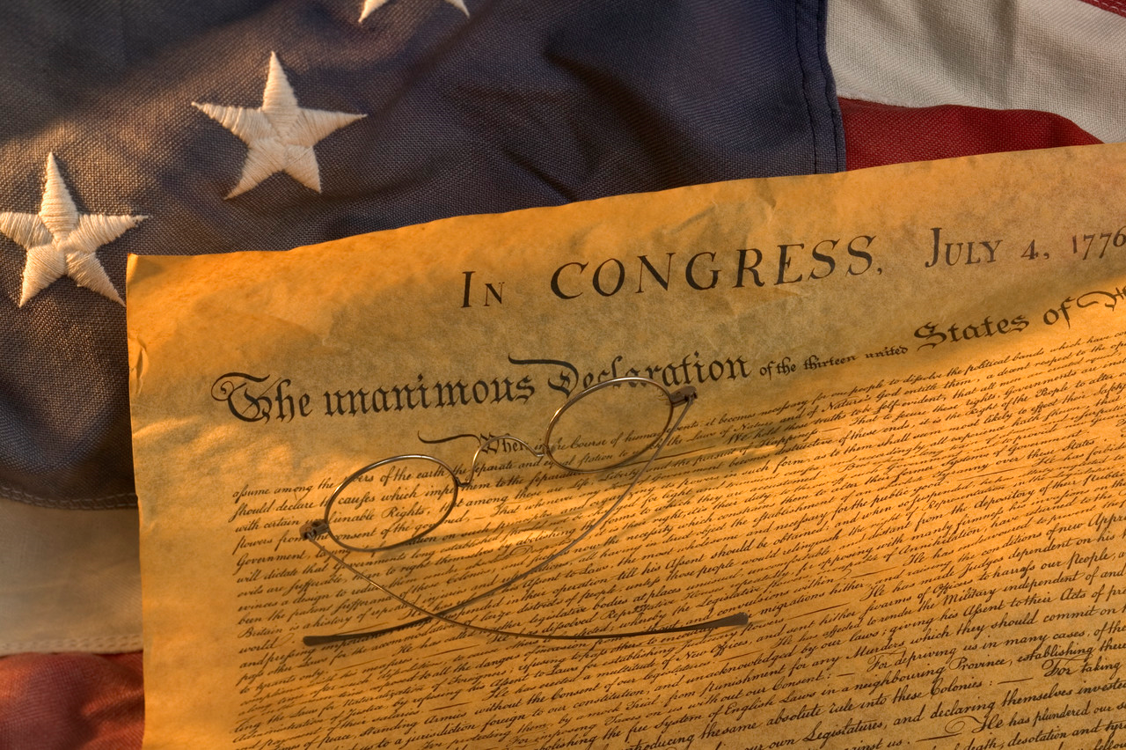
Newspaper Title HEADLINE!!!
Article Title
Summary of Rights
(Make sure to give credit to Thomas Jefferson and John Locke)
Article Title
Importance /
Significance
of Declaration
Article Title
Summary of Grievances
Article Title
2 Interviews:
1 with a patriot (supporter) and
1 with a loyalist (against/skepticlal)

Slide 7
Newspaper Title HEADLINE!!!
Article Title
Summary of Rights … (Make sure to give credit to Thomas Jefferson and John Locke)
Article Title
Importance/Significance of Declaration …
Article Title
Summary of Grievances …
Article Title
2 Interviews: 1 with a patriot (supporter) and 1 with a loyalist (against/skeptical) …

