Slide 1
Friday January 16, 2015 Mr. Goblirsch – American Government
OBJECTIVE – Students Will Be Able To – SWBAT:
- Analyze the purpose, reasons for, and significance of the Declaration of Independence.
AGENDA:
WARM-UP: Tax Day
COMMITTEE WORK: Declaration News Article
***HW: 2 Political Surveys – DUE FRIDAY (actually 8:00 pm Sunday)***
Tax Day WARM-UP: (Follow the directions below)
***5 minutes***
Calculate your weekly taxes and make your Weekly Deposit.
Ask your Section Leader if you received any daily bonus pay
If so, add it to your pay for that day on your Weekly Time Sheet
Add up your daily pay from the week to get your Gross Total
Calculate your taxes using the TAX BRACKETS below:
Gross Total Less than $45.00 =========→ 28% tax rate (X 0.28)
Gross Total $45 through $55.00 =======→ 33% tax rate (X 0.33)
Gross Total More than $55.00 =========→ 38% tax rate (X 0.38)
Subtract your taxes from your gross to get your net pay
Your net pay for the week = you Weekly Deposit

Slide 2
Section Leader Bonus Pay Summary
DIRECTIONS: Each section leader has $5 a day in Bonus Pay to distribute to workers within their section. This includes any Bonus Pay the section leaders pay themselves, and any Bonus Pay they pay any employees they hired.
On the chart below, write down the amount of Bonus Pay each member received each day. EXAMPLE – If Mr. Goblirsch received a $2 bonus on Monday, then I would write Mr. Goblirsch - $2 under the Monday column.
MONDAY | TUESDAY | WEDNESDAY | THURSDAY | FRIDAY

Slide 3
SKILL: Analyzing the Declaration of Independence
STEP 1 – We will read the first part of the D.o.I. together and correctly fill out this chart.
STEP 2 – With your Committee, read through the rest of the D.o.I. and finish filling out the chart. (P. 40)
RIGHTS | GRIEVENCES | INTENTIONS
Examples – - Life - Liberty - Pursuit of happiness | Example – - Abolishing ***Only need 8 for this column*** | Example – - Declare

Slide 4
ASSIGNMENT: Declaration News Article
DIRECTIONS: Each committee will suppose they are news paper editors on the day of the signing of the Declaration of Independence. Your committee’s task is to complete the front page of the newspaper with 4 articles relating to the event.

Slide 5
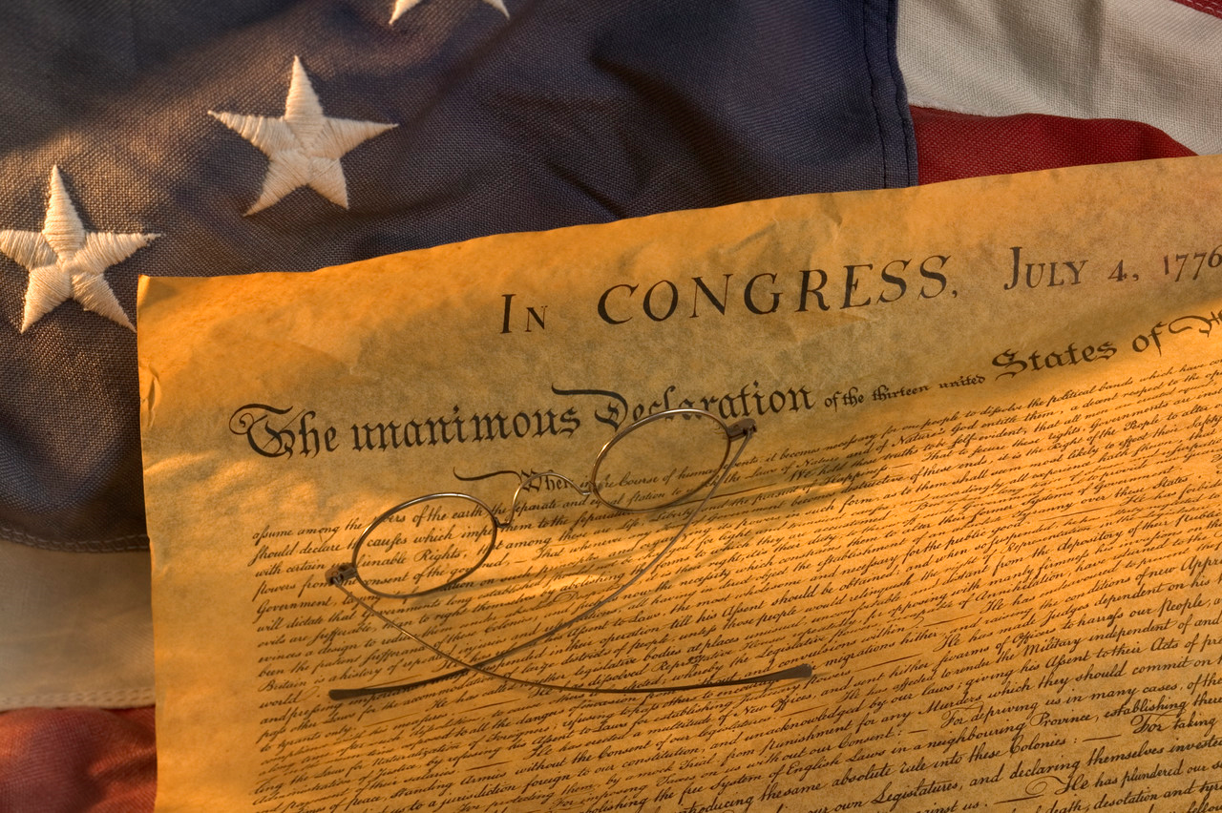
Newspaper Title HEADLINE!!!
Article Title
Summary of Rights
(Make sure to give credit to Thomas Jefferson and John Locke)
Article Title
Importance /
Significance
of Declaration
Article Title
Summary of Grievances
Article Title
2 Interviews:
1 with a patriot (supporter) and
1 with a loyalist (against/skepticlal)

Slide 6
Newspaper Title HEADLINE!!!
Article Title
Summary of Rights … (Make sure to give credit to Thomas Jefferson and John Locke)
Article Title
Importance/Significance of Declaration …
Article Title
Summary of Grievances …
Article Title
2 Interviews: 1 with a patriot (supporter) and 1 with a loyalist (against/skeptical) …

